Slide 1
GCE Computer Science
AS / A LEVEL
First Teaching September 2015
Jen Gillies
Principal Moderator
November 2018

Slide 2
Jen Gillies – a bit about me
Teaching Computing for over 20 years
WJEC Principal Moderator GCE
EDUQAS Principal Moderator GCE Component 3
WJEC Principal Moderator GCSE CS3
EDUQAS Principal Moderator GCSE Computer Science Unit 3
Deliver CPD training
Involved in the development of new specifications

Slide 3
CPD Event
This CPD event will cover the following areas:
Principal moderator’s report
The sections of the project:
Discussion
Investigation
Design
Prototype
Post-prototype refinement of design
Software development
Testing
Evaluation

Slide 4
Coursework
The A2 project provides an opportunity for learners to develop system development and programming skills. This is a substantial piece of work, undertaken over an extended period of time.
Learners will need to apply the areas specified in the Programmed Solution to a Problem section of the specification, which are:
Discussion
Investigation
Design
Prototype
Post-prototype refinement of design
Software development
Testing
Evaluation

Slide 5
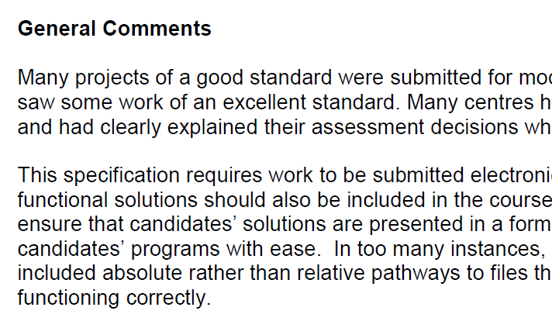
Principal Moderator’s Reports
Examiners Report 2018
Imparts important information about candidates’ performance
Gives messages/lesson to be learnt
Essential reading for all teachers and supervisors.

Slide 6
Principal Moderator’s Reports
Initial issues raised in the reports
The role of the teacher as an informed mentor is central to the success of the work
Centres had not realised the pivotal importance of the Discussion section
The purpose of the Prototype and Post Prototype Refinement sections of the work appear to have been misunderstood.
Value of informed third party feedback.

Slide 7
Principal Moderator’s Reports
Take some time to read the Examiners’ report that is relevant to the qualification you are teaching (WJEC Unit 5 or Eduqas Component 3). Both are available for you to download from the screen.
Which areas of the project are you most confident about?
Which areas do you find most concerning?
Discussion
Investigation
Design
Prototype
Post prototype refinement
Software development
Developmental testing
Testing
Evaluation

Slide 8
Scope of the problem
“Candidates should consider whether their choice of problem situation provides them with sufficient:
Opportunities to carry out an investigation in appropriate depth to provide evidence to allow them to complete the analysis, problem definition and objectives sections of the work to an appropriate level of complexity for an A2 qualification.
Complexity to provide the opportunities needed to access the full range of marks.
Data handling process to allow thorough testing processes to take place. “

Slide 9
Scope of the problem
Some examples of possibly appropriate problems

Slide 10
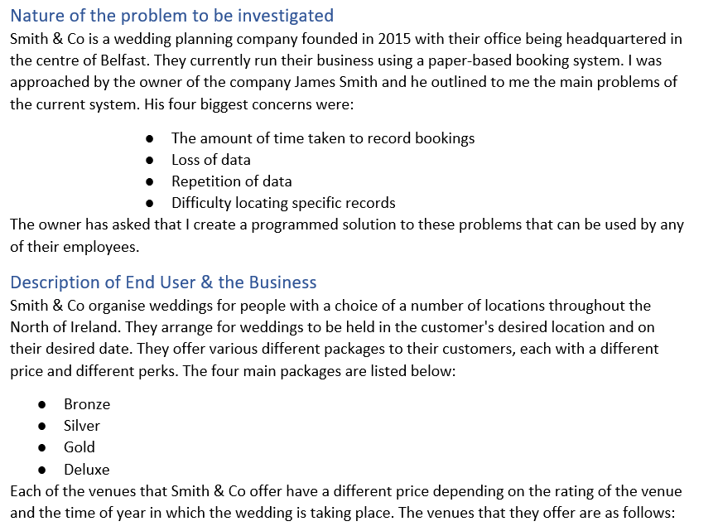
Scope of the problem

Slide 11
Scope of the problem
An example of a less appropriate problem

Slide 12
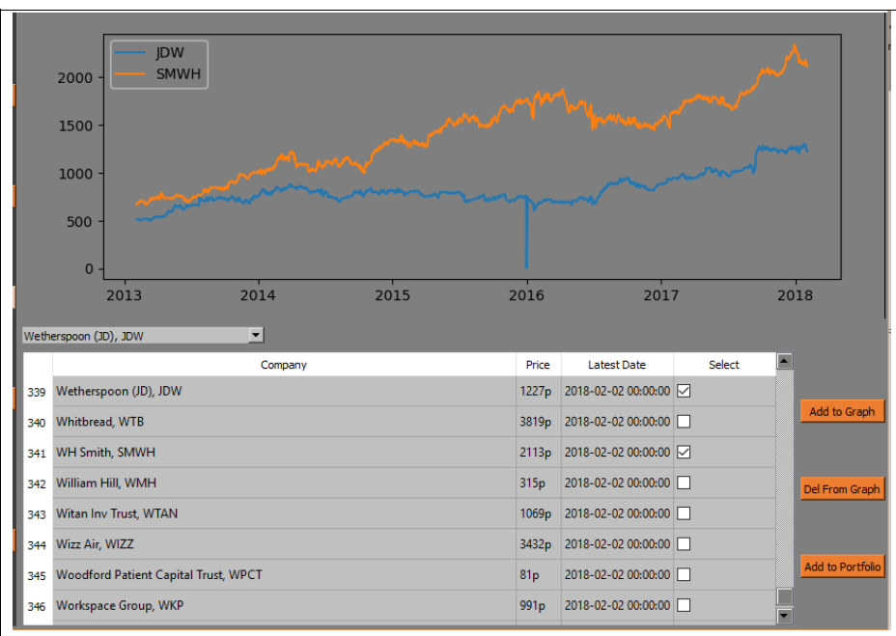
Scope of the problem
An example of a less appropriate problem

Slide 13
Discussion
Foundation stone of the project – stand or fall
Essential that candidates should think through their ideas and carry out initial reconnaissance
Candidates should gather their ideas together and produce a presentation/report or any other method of delivery with which they are happy.
It is important that the audience includes those with the expertise to provide informed feedback to ‘nudge’ candidates down the path towards a project with sufficient scope for success.

Slide 14
Discussion
Discussion section – actions for supervisors
Consider providing both vocal and written feedback to all students.
If possible ensure that feedback challenges students’ ideas and stretches them
If a student’s proposal is too simplistic suggest ways in which the problem could be broadened
If necessary be prepared to support students in the identification of a more appropriate problem situation

Slide 15
Discussion Assessment Grid

Slide 16
Discussion issues
This is the end of the consideration of the discussion session. Hopefully the information given has prompted you to consider the following issues:
How valuable true discussion of project ideas can be
How a teacher/supervisor can facilitate the process to ensure that discussions are fruitful
How would a candidates demonstrate responses to feedback effectively?

Slide 17
Investigation
A Level Specification - Component 3
Needs to identify input, processing, output
^{Full consideration of data}
Important to carry out a full investigation
Essential that due regard is given to desk based research:
particularly when the candidate does not have a ‘real life’ problem situation
Must be thorough to support evaluation against commercial solutions
Framing of measurable objectives will support the remainder of the work.

Slide 18
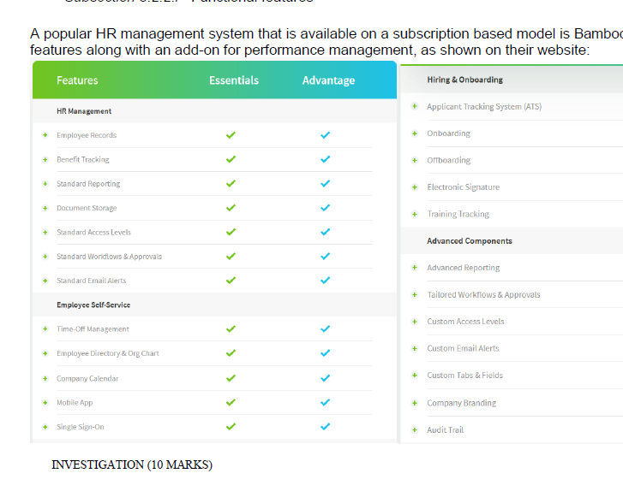
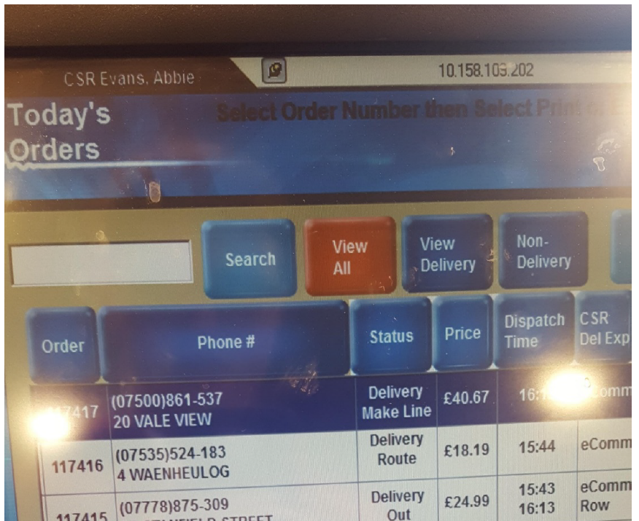
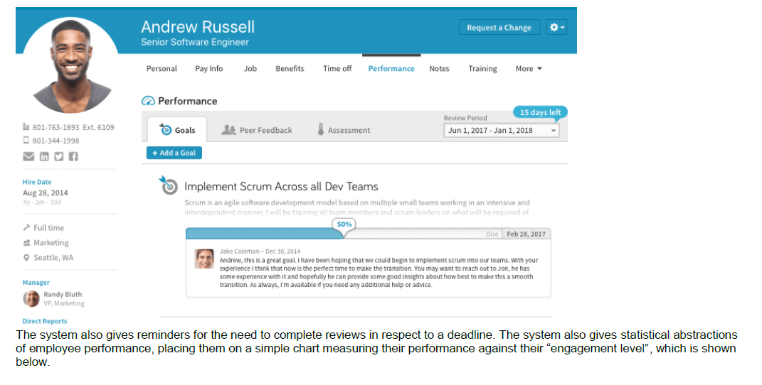
Desk based research

Slide 19
Objectives
Objectives set in the investigation section should inform the coursework
For each objective candidates should:
Design input and output facilities and data structures
Produce algorithms for processing
Develop a prototype if relevant and redesign if necessary
^{Fully develop the solution}
Testing should cover each objective
Evaluation of the solution for each objective

Slide 20
Investigation Assessment Grid

Slide 21
Investigation issues
Consider: how candidates can be encouraged to set measurable objectives
Consider: how the remainder of the project could be structured to ensure that objectives are central
Consider: the importance of objectives for the testing and evaluation sections of the work
What would you look for in a Mark Band 3 response?

Slide 22
Design section
The basis for the design section must be the objectives set at the end of the Investigation section of the work.
Candidates should:
Describe and justify the breaking down of the problem into sub problems
Explain the links between the sub programs and the project objectives

Slide 23
Design specification
To achieve each of the stated objectives:
Input and output
Specify, design and document screen layouts, reports and other forms of input and output required to create the user interface.
Data structures and methods of access
Design and document all data structures that will be required to produce the output for the solution to the problem together with the method of accessing the data in hat data structure.
Ensure that all data entered into the system is valid.
Processing stages
Design programming routines to be used to handle and process data within the proposed solution to achieve each objective.
Document these designs using a structured convention such as pseudo-code.

Slide 24
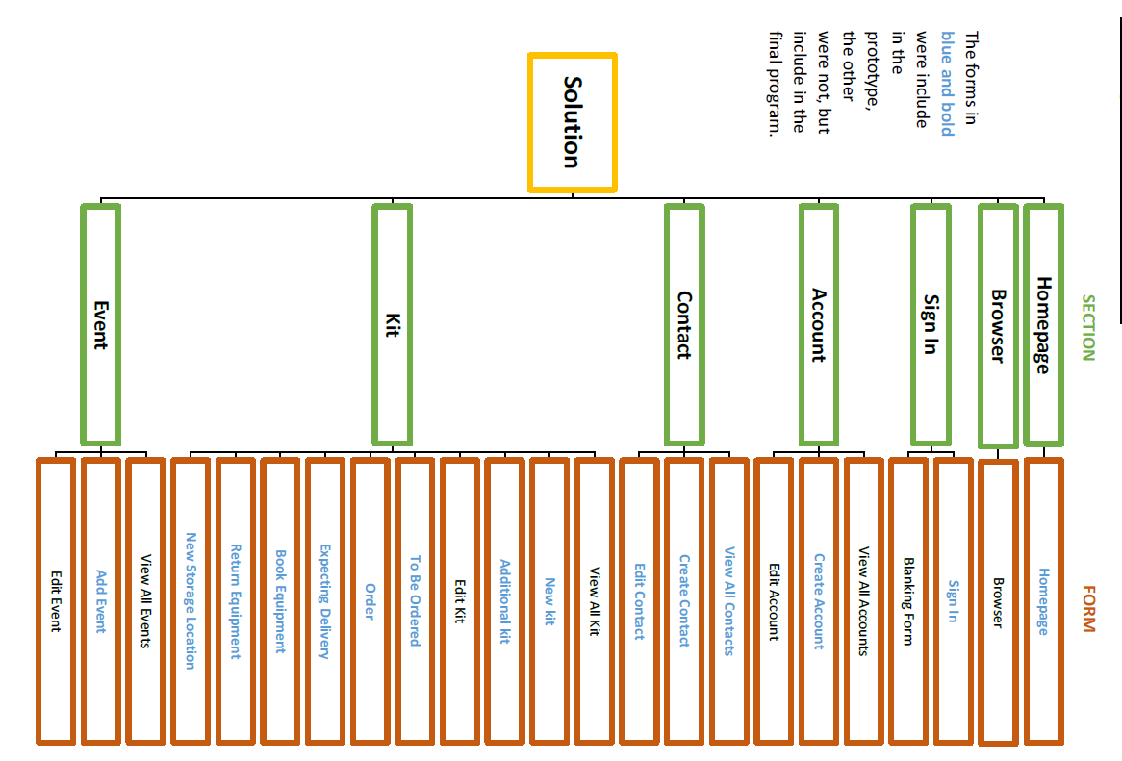
Overview
Describe and justify the breaking down of the problem into sub problems and
explain the links between the sub programs and the project objectives

Slide 25
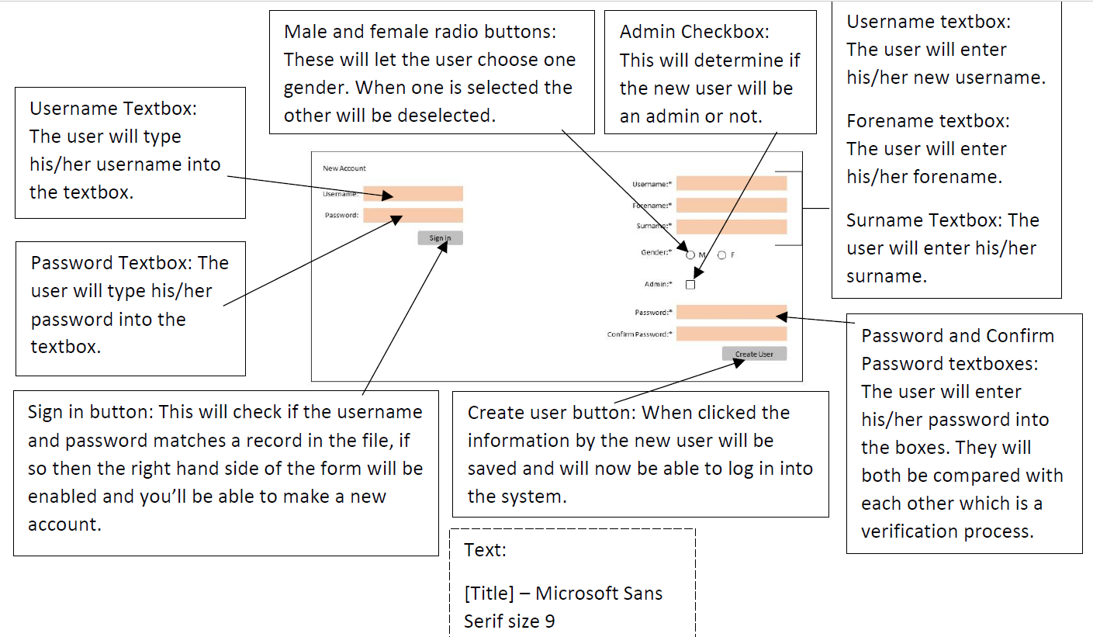
Input and output
Designed in detail the input and output to be produced by the system

Slide 26
Data requirements and structure
fully identified and described the data to be input to and output from the system
given full consideration to the reasons for the data that is to be included in the outputs
fully described all the required files and/or data structures and has fully considered and fully described methods of access
fully described the validation routines to be carried out on the data entered into the system

Slide 27
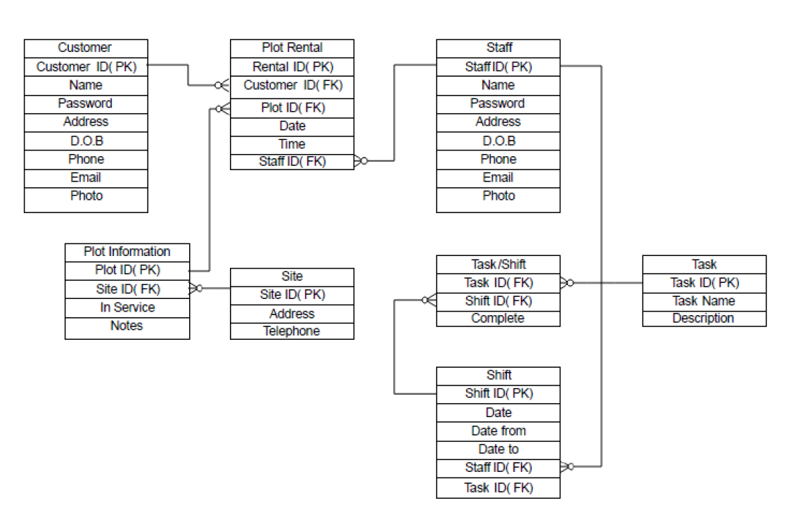
Data structures

Slide 28
Data structures
Fully describe the validation routines to be carried out on the data entered into the system

Slide 29
Processing
identify all processes needed to provide a comprehensive solution to the problem
fully describe the processing routines using an appropriate recognised convention in sufficient detail for implementation by a competent third party.
Demonstrate interconnection between the programs and the files they access has been clearly shown.

Slide 30
Processing
Consider:
If a student is designing objective by objective, what would be the most effective way to lay out this section of the work?
Objective
Overview of system
Data structures
Interface
Processing stages

Slide 31
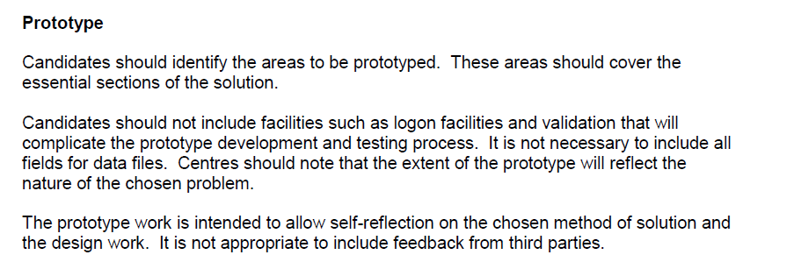
Principal Moderator’s Report

Slide 32
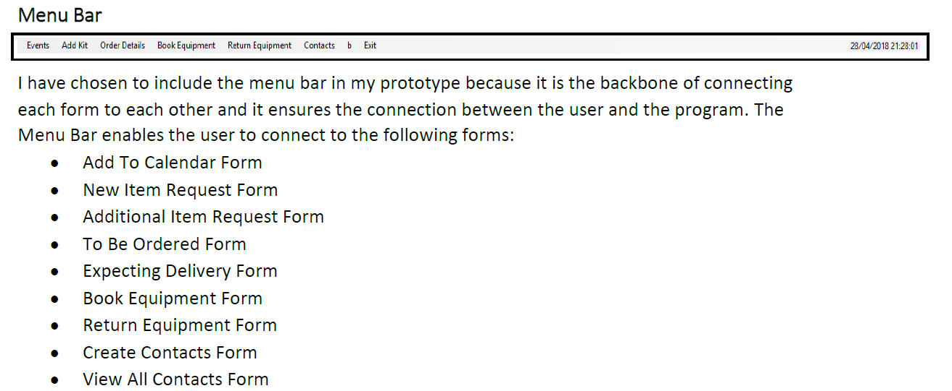
Prototype
Justify the choice of areas to be included in the prototype system and explain the reasons for omitting the remaining areas

Slide 33
Prototype Conclusions
Evaluate the functioning of the prototype and justify the good features of the prototype solution
Describe the shortcomings and make specific suggestions for improvement.
The prototype section of the work is for self reflection and should not include feedback from others
It is more important that candidates take the opportunity to reflect on their method of solution and the appropriateness of their design
This is a point that can be used for the revision of a project that lacks sufficient scope

Slide 34
Prototype issues
Consider: How can a candidate draw on the prototype experiences to fully develop their system?
Consider: How can a candidate be encouraged to reflect effectively on their prototype construction and outcomes rather than produce a narrative of what was done?

Slide 35
Post Prototype Refinement
obtained feedback on the prototype system from a competent third party
fully described the feedback received and explained the implications of the feedback for the re-design of the system
The post prototype refinement should take place against feedback from competent third party/parties
The extent of re-design will depend on the quality/extent of the prototype solution
Very few candidates included appropriate feedback or considered the implications of appropriate feedback
In considering all work submitted for this section of the work I have only been able to find one example that can be considered in this session.

Slide 36
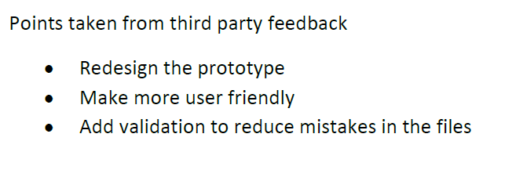
Post Prototype Refinement
fully refined with detailed design, in response to feedback or justified instances where suggestions have been discounted.
The refinement may not only consider the revision or extension of a candidate’s deign but also a reality check regarding the extent of the proposed fully developed system

Slide 37
Post Prototype Refinement issues
Consider: this is a vital point in the project. It is essential that candidates not only reflect on the success or otherwise of the prototype system but take detailed attention of third party feedback.
can they be encouraged to take full account of the issues raised to ensure the success of their finished systems?

Slide 38
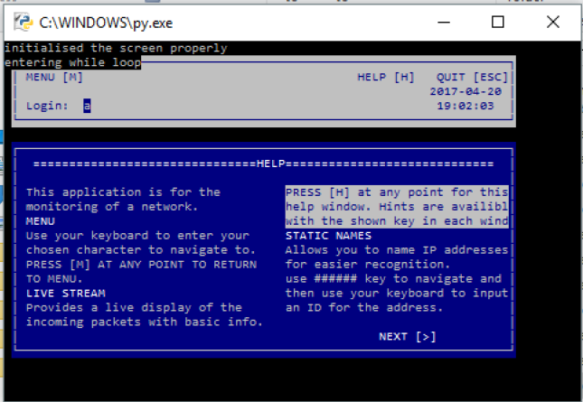
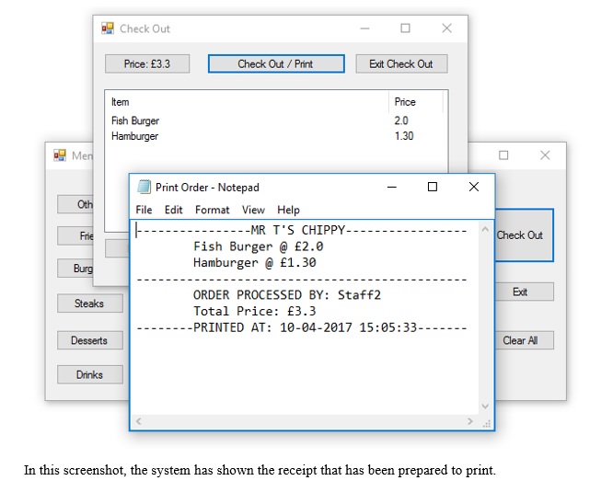
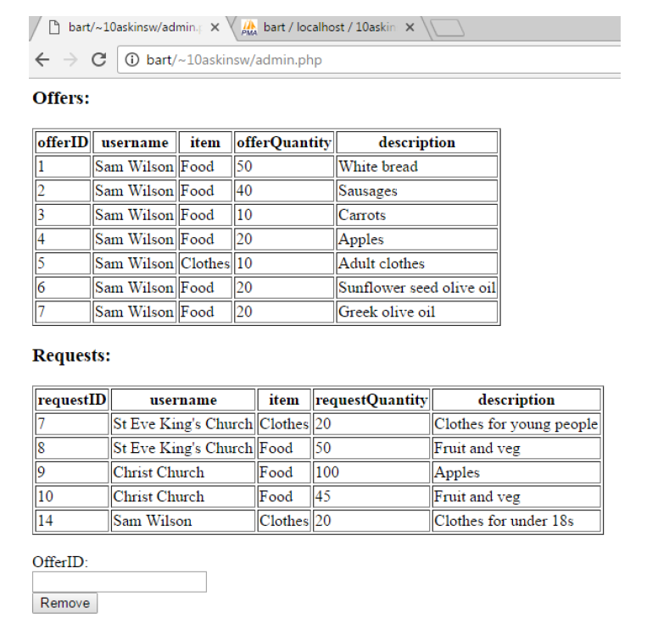
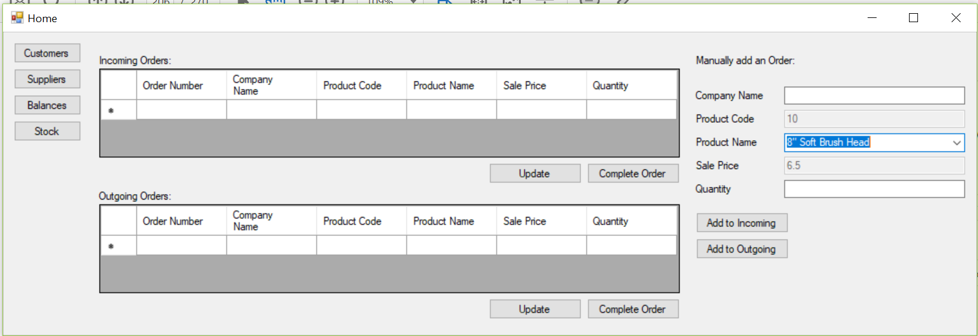
Software development

Slide 39
Software development
== INSTALLATION INSTRUCTIONS ==
Transfer everything from "All files" to a directory called /10askinsw/ inside your web server's public_html folder
Restore the database with the name "10askinsw"
== Passwords ==
SQL Database:
Username: 10askinsw
Password: cat
Admin account:
Username: admin
Password: pass123

Slide 40
Software development issues
Consider: A moderator needs to be able to run your candidates’ systems.
It is essential that details of all logon data is provided.
How best can they be prepared for submission?

Slide 41
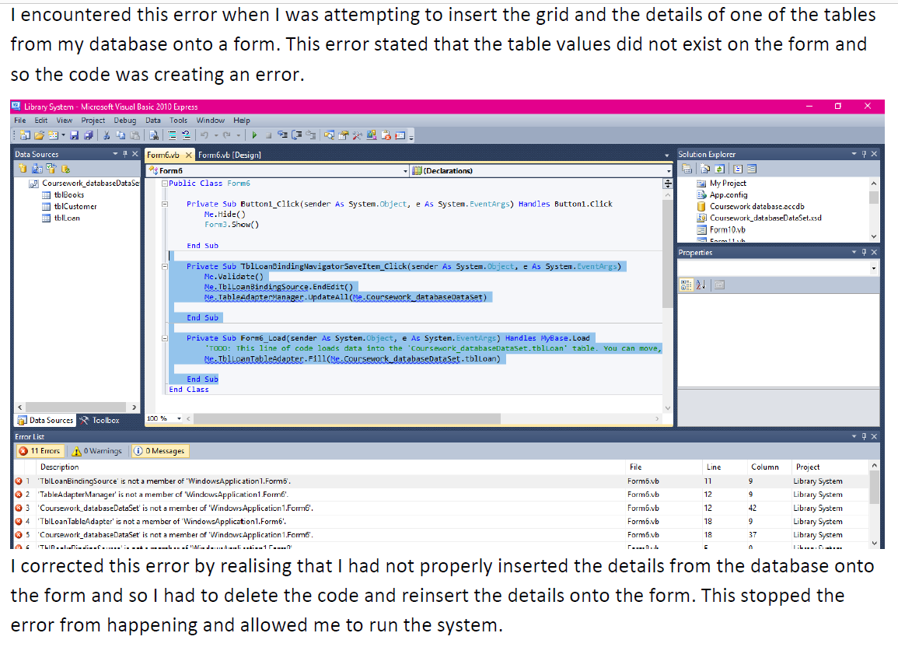
Developmental testing
The candidate has:
Provided evidence of comprehensive testing at each stage of the development of the solution to the chosen problem
Provided evidence of all problems encountered and fully justified and evidenced the actions taken to overcome these problems.

Slide 42
Testing
Testing should be organised by objectives. For each objective the candidate should:
Devise a testing strategy
Design test data
Produce evidence of testing outcomes
Provide an informed commentary of the testing process
The candidate has:
• produced a comprehensive plan for testing all areas of the system
• made use of a wide range of appropriate testing methods
• made use of test data including typical, extreme and invalid data where appropriate
• presented all results with detailed and informed commentaries and included specific suggestions to refine the system.

Slide 43
Testing issues
Consider: Candidates need to undertake intelligent testing with informed commentaries. They should be encouraged to carry out tests that prove or disprove that objectives have been achieved.
How can you ensure that testing is worthwhile and informative?

Slide 44
Evaluation
The candidate has:
• produced a detailed evaluation of the effectiveness of the programming language and justified the tools and techniques used
• compared and contrasted the completed system with similar commercially available systems
• identified good features and shortcomings of the completed solution and described significant potential improvements that could be made to improve its effectiveness
• evaluated their own strengths and weaknesses in the design and development of the system
• described specific changes of approach that would be adopted in future to avoid problems experienced during the project

Slide 45
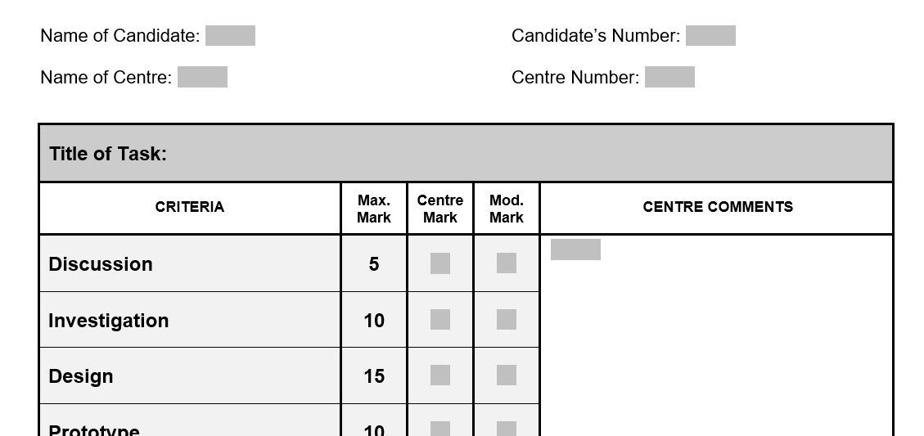
Assessment

Slide 46
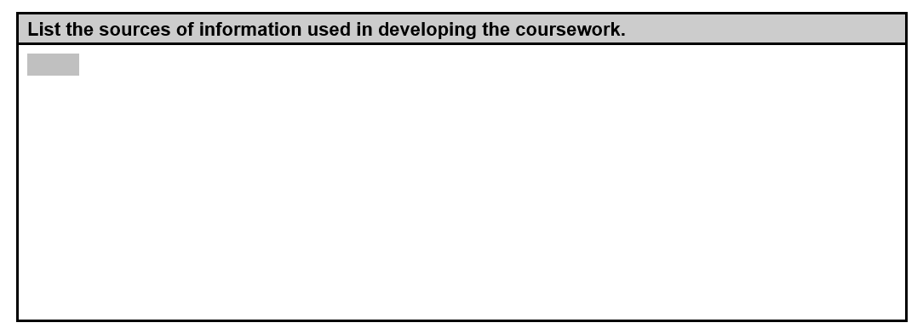
Assessment

Slide 47
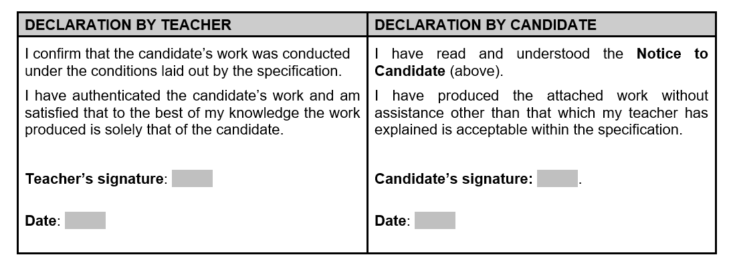
Assessment

Slide 48
Submission
Following assessment of candidates’ work
Enter all candidates’ final marks into IAMIS system
The system will select a sample of work to be submitted if you have more than 10 candidates. Otherwise you must submit work of all candidates.
Work will be submitted online to BTL system (as Unit 2)
The opportunity to submit work will be time limited to comply with coursework deadlines.

Slide 49
RESOURCES FOR TEACHERS
Supporting teaching and learning
http://www.wjec.co.uk/supporting/qualification-reform-wales/gce-as-and-a-levels-from-2015/index.html
Free subject specific resources available for all to download from our website
http://resources.wjec.co.uk/
Free digital resources to support the teaching and learning
http://oer.wjec.co.uk/
Our free Online Exam Review allows teachers to analyse item level data, critically assess sample question papers and receive examiner feedback
http://www.wjec.co.uk/shop/
A vast range of educational resources, specifications, past papers and mark schemes to support the teaching and learning of subjects offered by WJEC
https://www.wjecservices.co.uk/
A range of resources material only available to teachers

Slide 50
Any Questions?
Contact our specialist Subject Officers and administrative support team for your subject with any queries.
Andy Parker – Subject Officer
andy.parker@wjec.co.uk
029 2026 5137
Kwai Wong– Subject Support Officer
kwai.wong@wjec.co.uk
029 2026 5332

