Slide 1
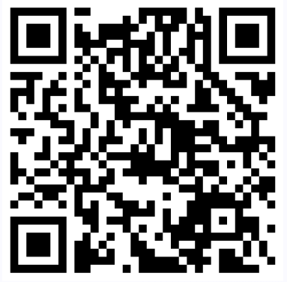
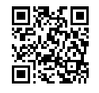
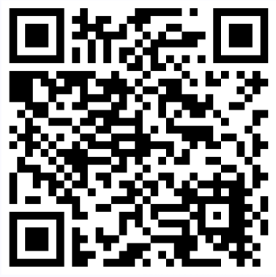
Level 1/2 Performing Arts
Unit 1 Overview
1
Research
2
Schedule
3
Reflect
4
Perform
5
Evaluate
1A: Outline the findings of the research you have undertaken for your chosen piece(s)
1B: Discuss how this research will influence your performance and what impact you are hoping to achieve.
Outline a rehearsal schedule that will enable you to be fully prepared for the performance required in the brief.
Be specific about different types of rehearsal.
Produce a reflective journal that records the practical rehearsal process required to ensure you are fully prepared for the performance required in the brief.
Perform / present your chosen piece(s) to an audience.
v
Evaluate the success of your performance including what you have learned from undertaking this work and how it will inform your future performances.
15 Marks
11 Marks
4 Marks
10 Marks
20 Marks
15 Marks
Pages 7-8 Unit Guide
Pages 9-10 Unit Guide
Pages 9-10 Unit Guide
Pages 11-17 Unit Guide
Page 18 Unit Guide
30%
Internally Assessed
36 GLH
10 Hours
Controlled
Assessment
Unit 1 Guide
Access to Brief
Mark Scheme
Acting
Music
Musical Theatre
Music Technology

Slide 2
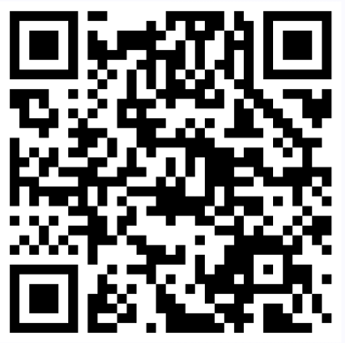
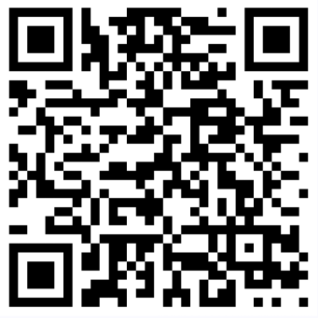
Level 1/2 Performing Arts
Unit 2 Overview
Disciplines
1
Outline
2
Develop
3
Present
4
Evaluate
Choreography
Composition
Composition with Technology
Devised Drama
Costume Design
Set Design
Lighting Design
Sound Deign
Make Up and Hair
Outline the components that you considered when writing your creative brief. Make clear links to the brief.
Produce a development log that records the exploration and development of your ideas in response to a creative brief.
Present your chosen piece(s) to an audience.
v
Evaluate the success of your creative process and final creation. Discuss the areas of your work that need improving / developing and respond to feedback.
15 Marks
10 Marks
10 Marks
20 Marks
20 Marks
Pages 7-8 Unit Guide
Pages 9-18 Unit Guide
Pages 20-25 Unit Guide
Pages 26-27
Unit Guide
30%
Internally Assessed
36 GLH
10 Hours
Controlled
Assessment
Unit 2 Guide
Access to Brief
Mark Scheme
Make clear links to the brief.

Slide 3
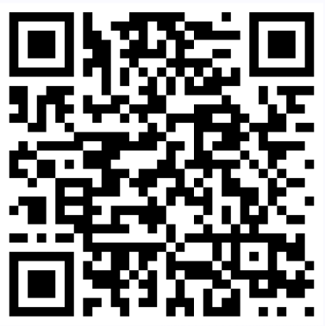
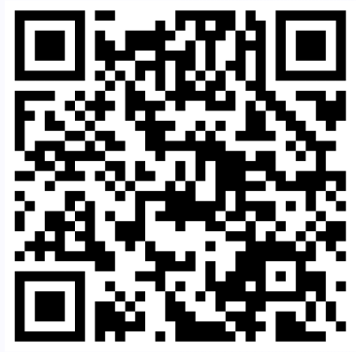
Level 1/2 Performing Arts
Unit 3 Overview
1
Influences
2
Plan
3
Resources
4
Marketing
5
Examples
Outline the factors that have influenced the creation of your proposed performance work.
Produce your plans and ideas for your proposed event. Including a full proposal.
Outline the timeline, personnel and resources required for the implementation of your creative proposal.
Outline how you could use marketing and public relations to promote your event.
v
Produce practical examples from your proposed event. This should give a taster of your overall idea.
10 Marks
10 Marks
5 Marks
5 Marks
20 Marks
Pages 7-8 Unit Guide
Page 10
Unit Guide
6
Pitch
7
Evaluate
Produce and pitch your creative proposal, including your practical examples, to an audience and gain feedback.
Pages 7-8 Unit Guide
Pages 7-8 Unit Guide
Page 9
Unit Guide
Evaluate the success of your creative proposal. Discuss what you have learnt and how it will inform your future planning of events.
Unit 3 Guide
Access to Brief
Mark Scheme
10 Marks
20 Marks
Page 10
Unit Guide
Page 11
Unit Guide

Slide 4
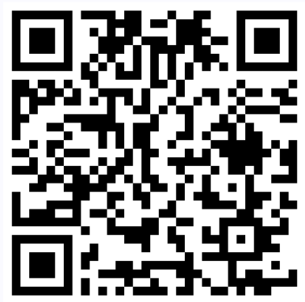
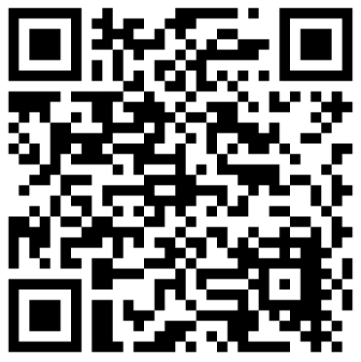
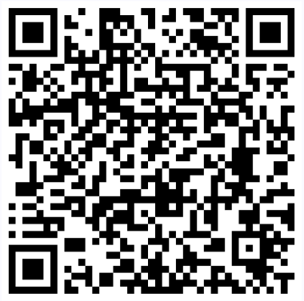
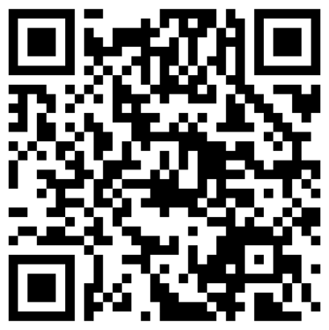
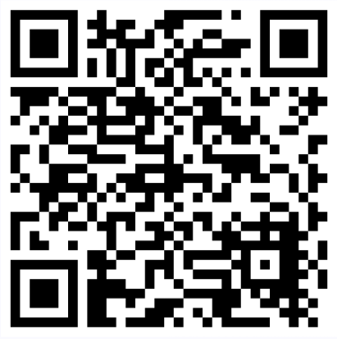
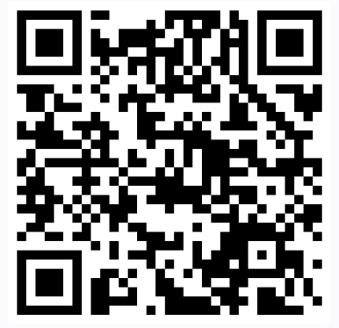
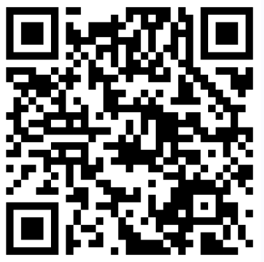
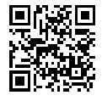
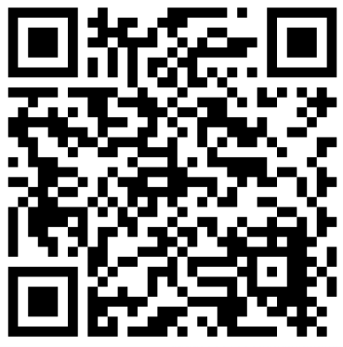
Level 1/2 Performing Arts
Key Information and Useful Guides
UMS
Key Dates
Specification
Assessment
CPD
Briefs Released
Unit 2 – 1st September
Unit 3 – 1st January
January Series (Units 1 and 2)
Entry Deadline – 21st October
Submission – 10th December
June Series (All Units)
Entry Deadline – 21st February
Submission – 5th May
 | Unit 1 | Unit 2 | Unit 3 | Overall
L1P | 18 | 18 | 24 | 60
L1M | 27 | 27 | 36 | 90
L1D | 36 | 36 | 48 | 120
L1D* | 45 | 45 | 60 | 150
L2P | 54 | 54 | 72 | 180
L2M | 63 | 63 | 84 | 210
L2D | 72 | 72 | 96 | 240
L2D* | 81 | 81 | 108 | 270
Max | 90 | 90 | 120 | 300
Delivery Guide
Surpass
Newsletters
FAQs
Access to Brief
Exemplar
Contact Us
Examiners’ Reports

