Slide 1



Eduqas A Level Film Studies
Pre-recorded Professional Learning: autumn 2020
Screenwriting Top Tips
Component 3
NEA

Slide 2

Top Tips
This presentation will hopefully provide you with helpful tips on the teaching of screenwriting for the Component 3 coursework.
If you have not taught screenwriting before, I would suggest that you also look at my ‘Intro to Screenwriting’ PPT presentation, available on the WJEC Secure Services website. The Eduqas Film Studies Digital Resources page (https://resources.eduqas.co.uk/Pages/ResourceByArgs?subId=50) also has many helpful materials on the topic.
After years and years of teaching screenwriting, we found that the recipe to a successful Component 3 screenwriting project is to dedicate as much time to the study of screenwriting as a unique visual writing format, followed by detailed planning of student short film scripts. Once students have feasible ideas with solid structures and well-developed character profiles, there’s much they can do outside the classroom.

Slide 3
Top Tips
Reading professional screenplays is one of the most important activities to pursue at the beginning of the students’ screenwriting journey. It seems like an obvious thing to say but it is clear this is not always done as thoroughly as it should have been.
One of the main issues NEA moderators witness when looking at student work is a clear lack of understanding of what a screenplay is supposed to look like or supposed to do. From all dialogue with little to no action (a screenplay is not a stage play!) to overly-detailed description of the mise-en-scene and characters’ emotional states (a screenplay if not a novel!), the action-based, succinct flow a good screenplay requires tends to get lost in the process.
This is why throughout our students’ journey into screenwriting, we need to make sure they are always given examples from the best of the best. At every opportunity.

Slide 4
Top Tips
Screenplay Databases:
The free script databases widely available online are a screenwriting teacher’s best friends. All those Bafta and Oscar winning screenplays (as well as the ones that didn’t win but likely should have) can be reached at the click of a button.
Some of the best databases are:
IMSDB (https://www.imsdb.com/): the biggest, but scripts are not PDF.
Simply Scripts (https://www.simplyscripts.com/): also huge, some scripts PDF, some not.
Studio Binder (https://www.studiobinder.com/blog/best-free-movie-scripts-online/): This is a good website for everything film: screenwriting, storyboarding (their templates are great) and lots of filming tips as well as helpful analysis of various elements of film language. They also have their own free screenwriting software.
Bulletproofscreenwriting (https://bulletproofscreenwriting.tv/screenplay-downloads/): collections by screenwriter, genre and more.
Other popular ones: Daily Script, Scriptslug, Drew’s Scriptorama and more.

Slide 5
Top Tips
We recommend starting the creative process by reading some stand-out opening scenes from films students like. All reading should be accompanied by annotation (they can do this directly on PDF via Adobe Acrobat or similar)
Some Tarantino or Nolan, for example, always get their creative juices flowing…
Here are some good extracts:
BlacKkKlansman (Charlie Wachtel & David Rabinowitz)
Pulp Fiction (Quentin Tarantino & Roger Avary)
Juno (Diablo Cody)
A Quiet Place (Scott Beck & Bryan Woods)
The Lord of the Rings: The Fellowship of the Rings (Fran Walsh & Philippa Boyens & Peter Jackson)

Slide 6
Top Tips
Comparing screenplays to their prose counterparts is another helpful exercise to help drive the point that these 2 are very different writing formats to students.
Twilight (Melissa Rosenberg)
The Bourne Identity (Tony Gilroy and William Blake Herron)
The Silver Linings Playbook (David O. Russell)
The Hunger Games (Gary Ross, Suzanne Collins, Billy Ray)
The Road (Joe Penhall)
Jurassic Park (David Koepp)
Drive (Hossein Amini)

Slide 7
Friendly reminder…
Lastly on this ‘Top Tip’, it is worth mentioning that reading professional screenplays is not merely helpful to students’ own writing, it is an integral part of the specification.
The NEA Evaluative Analysis requires all students who opted for the screenwriting + storyboarding combo to refer to professional scripts that have inspired or influenced them as part of the compulsory marking criteria.
From the Band 5 descriptor:
An excellent and perceptive evaluative analysis of how screenplay, visual/audio and narrative elements are used to create meaning for spectators in relation to other professionally-produced screenplays, including screenplays for short films.

Slide 8
Top Tips
Learning to write action:
The first and most important thing to establish with students from the start is what can and cannot be included in the action.
What it does:
1) Describes what is going on (the action) happening in the scene, as it happens;
2) Describes the location of a scene (without excessive detail), if it’s the first time we are in this location or if there are significant changes to the location (it’s bombed, flooded, redecorated, etc);
3) Describes characters when we first meet them (without excessive detail) or again if there has been a significant change in their appearance;

Slide 9
Top Tips
Some action exercises:
Something quick and personal:
Near-death experience or first brush with danger.
Something a bit more elaborate:
A couple on their first trip together – relationship is on honeymoon period. They go wild camping and in the middle of the night discover that they are not as alone as they’d hoped for.
2 school friends try to out-dare each other, going from silly to increasingly riskier tasks until one of these goes horribly wrong.
A child wakes up alone in the middle of a deserted street. There are no signs of any other humans around but also no sign of violence or conflict. She walks and walks until she finds another child, equally lost. Where are all the other people?!
At night, our protagonist hears scratching on his roof but when he checks out of the window for the culprit, he finds nothing causing it. That is until the time he decides to climb the roof and wait. What he finds out, changes his life forever.
Fluffster, the pet chinchilla, plays cute and cuddly during the day but his nightly activities would make Mr Hyde green with envy.

Slide 10
Top Tips
Learning to introduce characters:
Introducing a character is of course part of the action but students often write either too little or too much, so it’s really worth spending the time doing some character development with them.
They should think about this in 2 stages:
Writing a character profile: including backstory, personality and physical traits, the character’s wants or dreams and what stands in their way;
Writing the character’s introduction in script form: much more concise than the profile.

Slide 11
Top Tips
Learning to introduce characters:
Once more, looking at professional work really helps students understand the whole ‘less is more’ mantra we teachers ought to repeat exhaustively from the beginning.
Here are some good examples – can they name the film?
RON STALLWORTH, black, 21, handsome, intelligent, sporting a good-sized Afro, rebellious but strait-laced by most 1970s’ standards.
OR
Sitting there, her hands still on the keyboard, is TRINITY; a woman in black leather.
OR
R (21, undead). Blank face, sunken eyes. Blueish lips. If we didn’t know any better we’d think he was a junkie, a runaway from the set of My Own Private Idaho. Then we might notice a few thin gashes cutting across his cheeks. And then we might hear a soft groan humming from his frozen lips. And then we might start to wonder…

Slide 12
Top Tips
We are tracking in on a fortyish man in BERMUDA SHORTS and sunglasses at the dairy case. He is the DUDE. His rumpled look and relaxed manner suggest a man in whom casualness runs deep.
OR
DR. HANNIBAL LECTER is lounging on his bunk, in white pajamas, reading an Italian Vogue. He turns, considers her… A face so long out of the sun, it seems almost leached – except for the glittering eyes, and the wet red mouth. He rises smoothly, crossing to stand before her; the gracious host. His voice is cultured, soft.
OR
Bozo PULLS off his MASK. The Bank Manager GASPS. In the reflections of the glass DEBRIS behind the Bank Manager we see GLIMPSES of a SCARRED MOUTH and CLOWN MAKEUP. THE JOKER.

Slide 13
Top Tips
Learning to write good dialogue:
The problem with real life dialogue, where to begin?
Real-life dialogue is often uninteresting and rarely engaging, unless you are part of the conversation. We frequently talk in circles and often take the most convoluted route to make a point. Teachers are great at this type of padding and repetitions are something we tend to specialise in…
Screen dialogue, however, needs to be engaging, informative and sharp, whilst also sounding realistic and authentic (to a character's life experience, job, backstory, etc). In other words, it is really hard to nail and this is one of the reasons we at Eduqas very much favour the action-based, rather than dialogue-based script…

Slide 14
Top Tips
Dialogue rules to ‘indoctrinate’ students with:
Keep dialogue to a minimum. The rule of thumb is “show, don’t tell”.
Avoid repetition. Screen characters are a lot more direct and precise than most actual human beings.
Dialogue needs to help move the narrative forward or reveal important things about the characters (not necessarily plot, but their personality, their wants, their fears).
Dialogue lines need to ‘sound different’ for each character (they need to have individual voices).
“Dialogue is not conversation”, says one of the greatest screenwriting gurus of our time, Robert McKee

Slide 15
Top Tips
Looking at the masters of dialogue at work:
Scene 57 from When Harry Met Sally (Nora Ephron, p68 on PDF).
The break-up scene (opening) in The Social Network (Aaron Sorkin, great for character intros too).
There are many films in the specification that have excellent dialogue and here we have an opportunity to link sections and make sure students don’t forget all they've been taught once they start their coursework.
Pulp Fiction (see previous slide)
Do The Right Thing (Spike Lee)
Casablanca (Julius and Philip Epstein and Howard Koch)
Captain Fantastic (Matt Ross)
Shaun of the Dead (Simon Pegg and Edgar Wright)
La La Land (Damien Chazelle)
Vertigo (Alec Coppel and Samuel Taylor)

Slide 16
Top Tips
Writing dialogue exercises:
There are a number of prompts that can be used to force students to think about how different people with various backgrounds talk with individual voices that are relevant to who they are. We use a classic prompt that has varied somewhat each year but the gist of it is this:
There is a group of strangers from all walks of life stuck together in an uncomfortable situation that forces them to communicate with each other.
Here’s an example:
5 people are inside the lift of a skyscraper, going up. The building holds offices, residences and a viewing platform with restaurant at the top with amazing views of the city.
Each of the 5 characters has a very different background (gender, class, race/ethnicity, age, nationality and so on). They also have different reasons for being inside the lift.
Halfway up to the 30th floor, the lift jerks and halts.
The lights blink. It's stalled!
What happens next?

Slide 17
Top Tips
The short film format: similar but different to the feature…
1. Keeping it simple: a common student screenwriter mistake is to try to cram an entire feature film into the 10 minutes or so that our 1800-word limit allows them. In order to convince them that simple is better, they need to watch lots and lots of successful short shorts (under 10 minutes).
The film Two and Two is excellent to demonstrate that even the simplest of plots can still be hard-hitting and profound: https://www.youtube.com/watch?v=kHOOV83j7bo&feature=emb_logo
2. Choosing a unique or unusual concept also goes a long way. A quirky idea might become tiresome and too gimmicky in a longer plot but the short film format is perfect for going ‘wacky’. The short film One-Minute Time Machine epitomises the ‘unique concept’ short and tends to be a student favourite:
One-Minute Time Machine: https://www.youtube.com/watch?v=vBkBS4O3yvY&feature=emb_logo

Slide 18
Top Tips
3. The last minute plot twist is another brilliant narrative device that works incredibly well with the short film format.
Here is a classic short with a clever twist:
The Black Hole: https://www.youtube.com/watch?v=P5_Msrdg3Hk
While studying the Specification shorts and looking for ‘influences’, the shorter length films, such as The Gunfighter, High Maintenance, About a Girl, etc, are particularly useful when thinking about how to structure their own projects.
We also give students a set of questions to answer as they view our chosen shorts:
What is the genre(s) of the film? What genre conventions evidence your choice?
What is memorable about the character(s) of the film?
Does it have a twist? If yes, does it work? Did you see it coming? Will it stay with you? Why?
What is the premise/concept of the short? Can you define it in one sentence?
Rate the film 0 to 10 for how much you enjoyed it.
Rate the film 0 to 10 for how well-made it is and for its audience potential (it might not be your cup of tea but can you see others enjoying it?).

Slide 19
Top Tips
A list of short shorts (under 10 minutes) for students to watch:
Post-it Love: https://www.youtube.com/watch?v=TsKghhQ41FM
I’ll Wait for the Next One: https://www.youtube.com/watch?v=cN0Ayw-1fgU
City Lights: https://www.youtube.com/watch?v=Ub0DQvo2ZWw&feature=emb_logo
Jet: https://www.youtube.com/watch?v=VGwiOXnfnCw
Playhouse: https://www.youtube.com/watch?time_continue=502&v=4j7UtqbN4U0&feature=emb_logo
Standby: https://vimeo.com/207630463
7:35am: https://vimeo.com/36470597
Vincent (Tim Burton): https://www.youtube.com/watch?v=fxQcBKUPm8o
Two Birds: https://www.youtube.com/watch?v=I9iKBXoCErw&feature=emb_logo
20 HZ: https://vimeo.com/126788735
The Life of Death: https://www.youtube.com/watch?v=jcK0ykUm1zo
Saw (the short that originated the popular, albeit disgusting, movie franchise): https://www.youtube.com/watch?v=3vWAGzlq110
Sniffer: https://vimeo.com/2639044
Room 8: https://vimeo.com/64878402

Slide 20
Top Tips
Finding their idea:
This can be the most painful part of the process for some students but the good news is that after a thorough journey through professional scripts and short films, fewer voices will claim ‘I have no idea!’
Still, some students have vague premises or images they want to convey, others want to make a film about generic topics such as ‘mental health issues’ or ‘knife crime’ (in 10 minutes!), while a minority will, indeed, have no idea…
So, here are some of the tried and tested methods we use to get the ‘way too vague’ and ‘cannot think of a single thing’ types to come up with better structured, feasible plots:
News stories: https://news.sky.com/strangenews, https://www.mirror.co.uk/news/real-life-stories/ , https://mysteriousuniverse.org/
Write what they know
Find the genre, its conventions and use a plot generator (https://www.writerswrite.com/fiction/plot-generators/
Do some research!

Slide 21
Top Tips
Writing the synopsis:
So they now have their initial ideas and some even have some decently developed structures. What’s next, then?
The synopsis.
We ask our students to give us a 3-act-structure synopsis between 200 and 400 words. We might mention Syd Field or Robert McKee but we don’t follow any screenwriting guru. There is no need. All they need to know is that most films have the following structure:
The beginning (or set-up), where they introduce their characters, their wants and finally, the conflict.
The middle (or confrontation), where our protagonists try to resolve the issues caused by the conflict.
The end (or the resolution), where the conflict is dealt with (or not…).

Slide 22
Top Tips
Good examples from Sight & Sound:
THE MATRIX
Synopsis by Sight & Sound
Menial office worker Thomas Anderson operates by night as computer hacker Neo. Warnings from unknown girl Trinity fail to prevent his detention by law-enforcement agent Smith, who demands Neo help capture notorious subversive Morpheus. Refusing to co-operate, Neo is released. Trinity takes him to meet Morpheus, leader of the struggle against the Matrix, an artificial intelligence that controls the world. Morpheus explains that the planet's long-derelict citizens are trapped in the illusion of 1999 (really the distant past) until converted into food and energy to power the Matrix itself.
Joining Morpheus' team, Neo endures an agonising awakening process. Although his body is on a life-support system, a mental projection of his digital self roams the Matrix's simulation of the everyday. He can also be programmed with phenomenal skills. Morpheus is convinced they have found in Neo the fabled leader, The One, who can rescue the planet. Betrayed by fellow crew-member Cypher, Morpheus is captured by Smith, desperate to prise from him the location of Zion, the last stronghold of humanity. Rushing to the rescue, Neo and Trinity battle enormous odds to save him.
As Matrix forces close in, Smith traps Neo and shoots him down. But when Trinity declares her love to Neo's body his digital self is miraculously resurrected. He blows Smith apart and returns to his body just in time to thwart the Matrix invaders. Embracing Trinity and accepting his role as The One, he prepares to revitalise a dormant world.
243 words

Slide 23
Top Tips
Good examples from Sight & Sound:
Bridget jones’ diary
Synopsis by Sight & Sound
London, a recent Christmas. Thirty-something Bridget Jones works for a publisher, spends her free time drinking with her mates and despairs at her non-existent love life. While visiting her parents, she is introduced to handsome lawyer Mark Darcy, but takes against him when she overhears him disparage her. At work, Bridget begins an affair with her boss, Daniel Cleaver, who claims that Mark Darcy once stole his fiancée.
Bridget runs into Mark at a number of social occasions, and perseveres in disliking him, a fact she reveals in her diary. When Bridget discovers a naked woman in Daniel's flat, she dumps him and gets a job reporting for a current-affairs show called Sit Up Britain. Bridget presents an item about a political refugee's trial and Mark, the refugee's lawyer, grants her an exclusive interview. She grows more attracted to Mark, especially when he helps her prepare for a dinner party. The evening is spoiled by the arrival of Daniel who's come to attempt a reconciliation with Bridget. The two men fight clumsily in the street. It turns out that it was Daniel who stole Mark's wife years before. By Christmas, Bridget is on the verge of revealing her feelings for Mark when it is announced he is getting engaged to Natasha, a lawyer.
Just before Bridget is about to go on holiday, Mark shows up to confess his love to her, but leaves when he accidentally reads the negative diary entries about him. Bridget runs after him in her skimpy underwear; they kiss in the snow, a couple at last.
260 words

Slide 24
Top Tips
The software:
The following slides are a beginner’s guide to the free screenwriting software we use in our centre: Celtx.
Some of my students actually prefer Writer Duet.
Some enjoy Studio Binder.
If you have other suggestions, then please share with us on the Film Studies Facebook page.

Slide 25

1. Go to Website and register
Sign in to Celtx from Google Chrome, Firefox or Safari, but not Edge or Explorer (it won’t work…).
https://www.celtx.com/index.html
Register your email and choose a password that you will remember!
You will then be sent an email with a code to verify your new account.

Slide 26
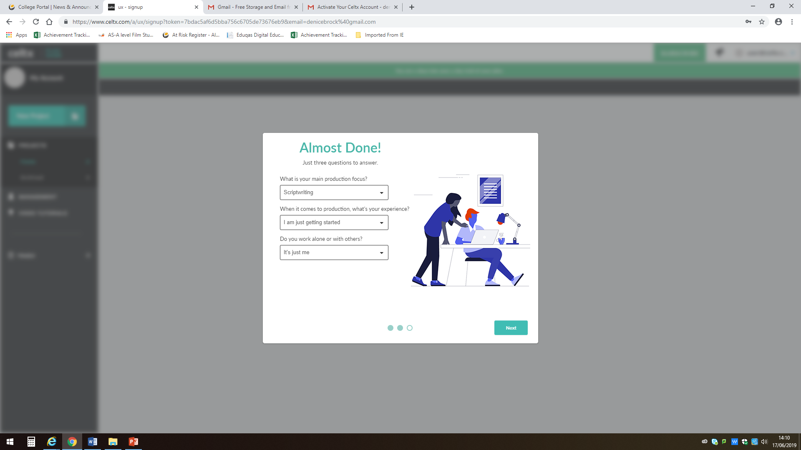
Make sure you specify that your ‘main production focus is ‘Scriptwriting’

Slide 27
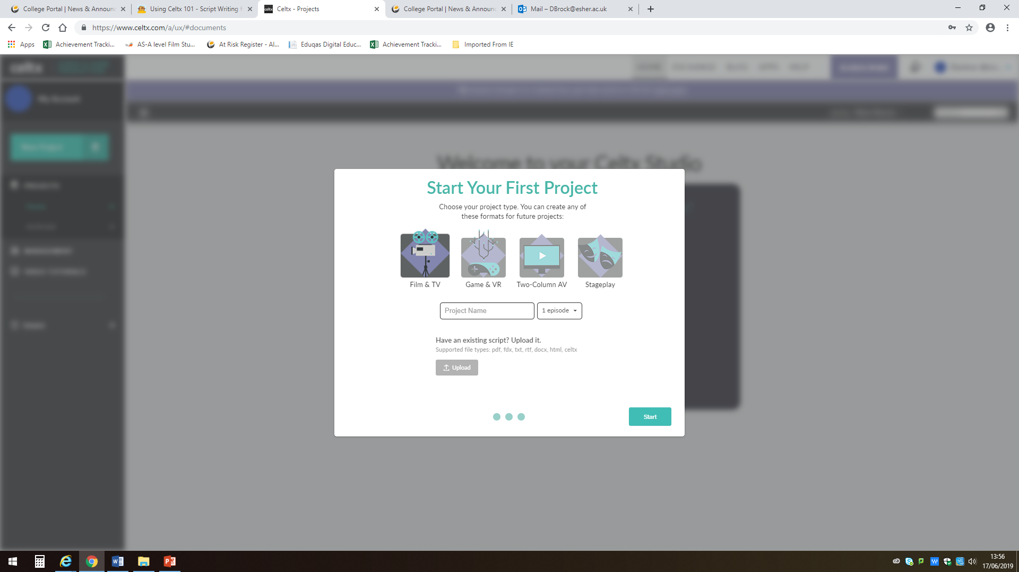
Name your project (you can rename later). Keep the ‘1 episode’ option

Slide 28
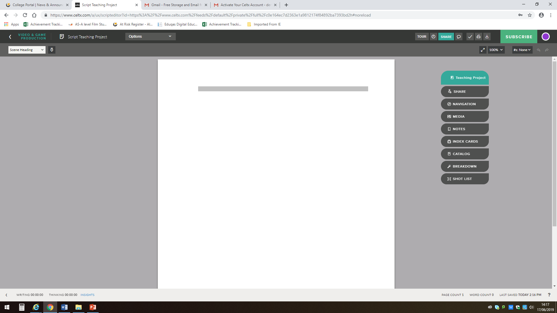
You are now ready to start.
The grey line indicates a scene heading and students ought to be reminded that every time they change location, they must change the scene heading…

Slide 29
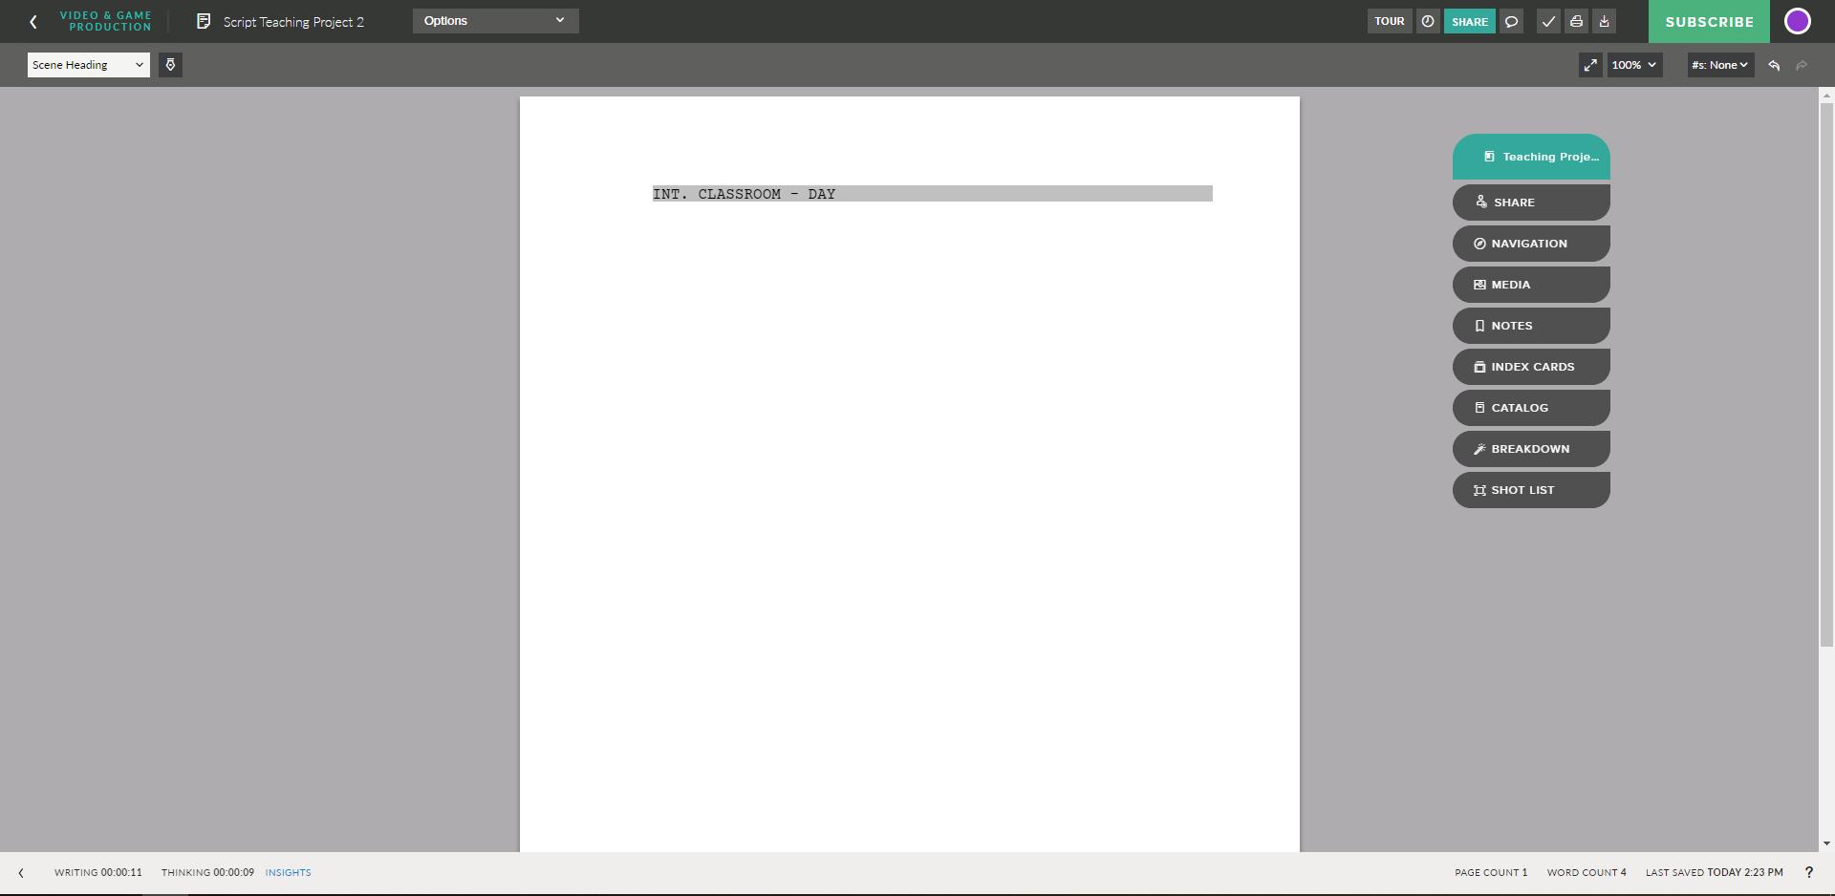
Every scene starts with a slugline or ‘Scene Heading’
The correct format requires students to tell whether the scene is EXT (external/exterior) or INT (internal/interior).
Then, full stop.
Then the location without any description: CLASSROOM (not ‘messy secondary school classroom’, for example).
Then, HYPHEN.
Then DAY or NIGHT (no need to specify what time of the day or the night…).
Scene headings are always all caps but they don’t need to worry about this. As long as they select ‘scene heading’ from the menu, Celtx and other software will do it for them.
Scene Headings are always in all caps, but you don't need to do it, Celtx will do it for you!

Slide 30
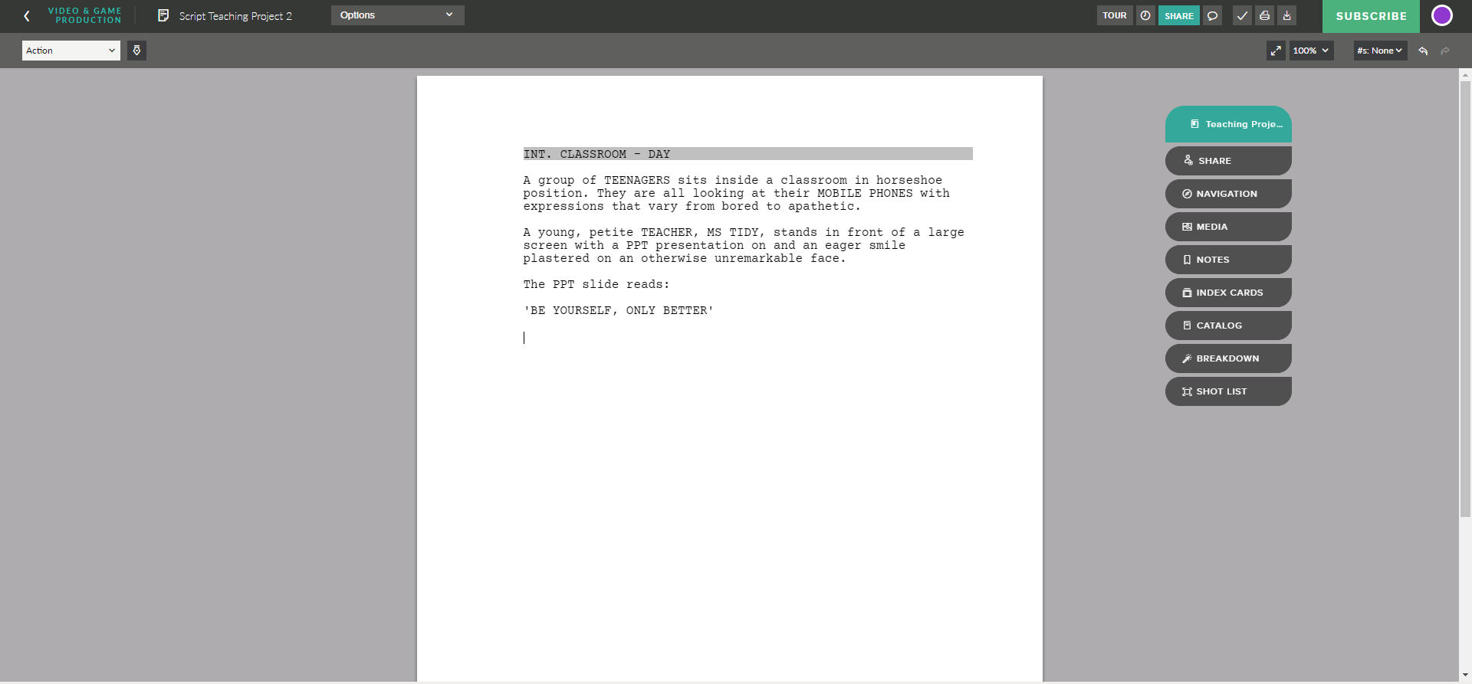
After a scene heading, they need to write ‘action’ (which includes action and description). In fact, the moment they press enter from their Scene Heading, Celtx will automatically assume they are writing action (because they should be).
When introducing a character or group of characters, students should always use ALL CAPS.
If they have important props, such as the mobile phones on the action extract above, it is a good idea to put them in CAPS.
The same can be said for any item of the mise-en-scene or a particular action they might wish to emphasise.
They should not start scenes with dialogue, unless there is a conversation from a previous scene going on.

Slide 31

When characters are about to speak, they must switch from ‘Action’ to ‘Character’.
The name will be centred and all caps. Again, Celtx will do this for them.

Slide 32
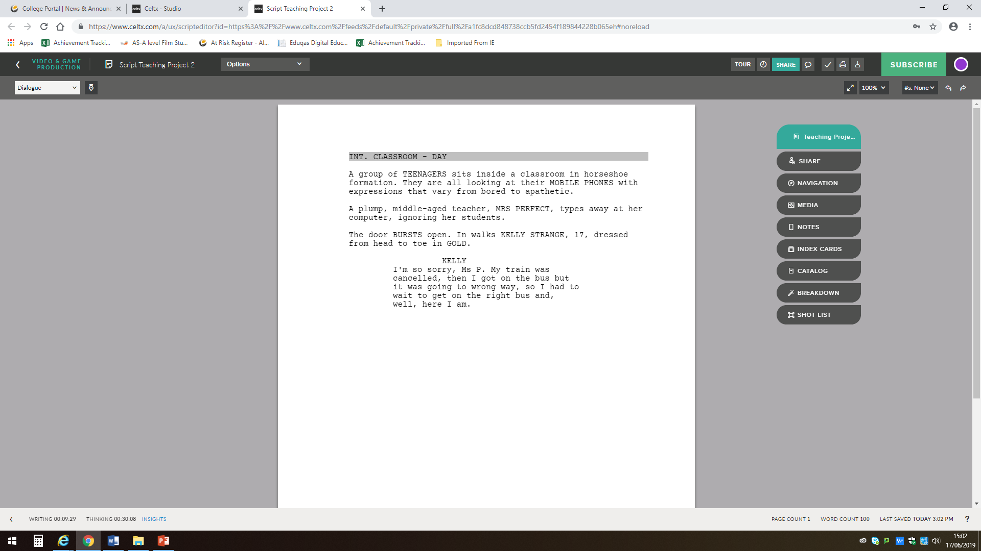
For the actual dialogue lines, switch from ‘Character’ to ‘Dialogue’.
Again, Celtx should do this for them.

Slide 33

Back to action.

Slide 34

Parentheticals are to be used minimally.
Most of time they are not needed and can become annoying, cluttering the action/dialogue.
They should go under the character’s name.
They can also be used in the middle of a dialogue line, if the character’s emotional state or intentions change.

Slide 35
Reminders for Students
Only write what you can see and hear, in the present tense, as it happens.
Avoid using the passive voice, when possible. She is sat at the table sounds terrible! Write in the active voice instead: she sits at the table.
Do not overuse the present continuous. Instead of Jane walking to Martha, write Jane walks to Martha.
Do use the occasional visual metaphor.
Do not over-write descriptions of locations or characters. Some info is important, too much is just horrible to read and not very script-like (you are not writing prose!).
Plan your scene before you write it (i.e. outline it in Word).
Wrote too much dialogue? Edit it! Ask yourself, all the time, do I need this line? Does it actually add something to the plot? Be ruthless.
Know your characters. Do a profile for each of your speaking characters, otherwise you’ll end up with characters that all sound the same, despite their age, gender, personality differences, etc.
Punctuate! Use Caps for characters’ names and at the beginning of sentences! No lower case ‘I’ for the subject pronoun, please. It’s a screenplay, not a text message!

Slide 36
Top Tips
Stages of feedback:
We have 4 stages of ‘official’ feedback during the screenwriting progress.
The synopsis;
The outline;
The first scene or first 300 words;
The first full draft.

Slide 37
Any Questions?
film@eduqas.co.uk

