Slide 1



GCSE BUSINESS
Introduction for New Centres

Slide 2

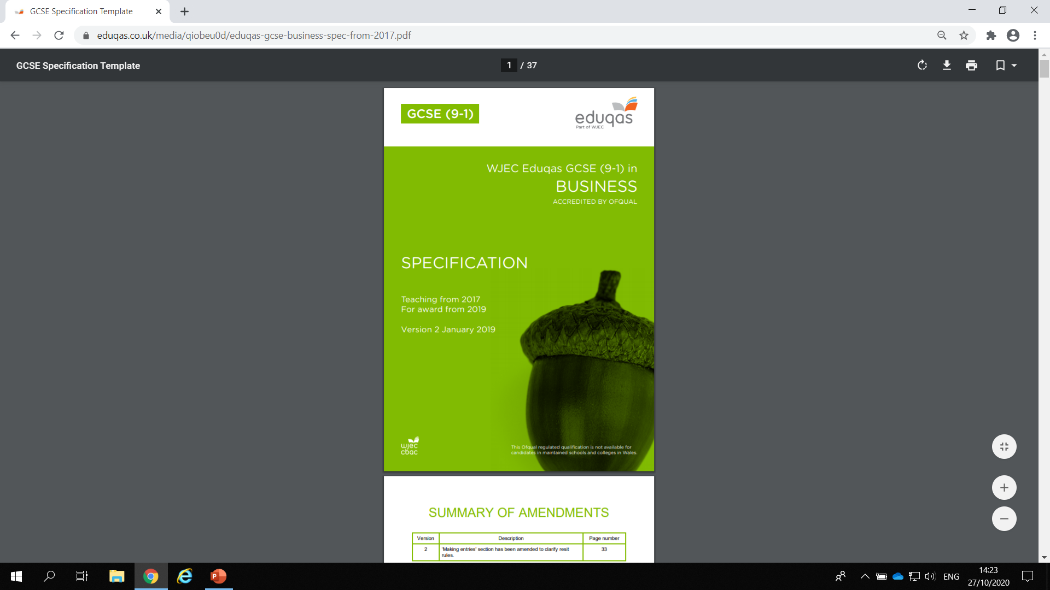
Specification

Slide 3
Summary of Assessment
Component 1: Business Dynamics Written examination: 2 hours 62.5% of qualification
A mix of short answer and structured questions based on stimulus material covering all of the specification content Total marks: 100
Component 2: Business Considerations Written examination: 1 hour 30 minutes 37.5% of qualification
Data response questions covering all of the specification content Total marks: 60

Slide 4
Component 1:
A mixture of:
Multiple-choice
Short-answer
Structured questions (ranging from 4-10 marks)
Component 2:
Two sets of data based on different business contexts
Mixture of qualitative and quantitative data with each case study between 300-400 words
Total time for the exam takes into account the reading time required
Candidates need to use the data to answer the questions and answers need to
be in context of the data

Slide 5
Assessment objectives
AO1
Demonstrate knowledge and understanding of business concepts and issues
AO2
Apply knowledge and understanding of business concepts and issues to a variety of contexts
AO3
Analyse and evaluate business information and issues to demonstrate understanding of business activity, make judgements and draw conclusions.

Slide 6
Assessment objectives
The table below shows how the assessment objectives are weighted across the two assessment components.
The weighting of assessment objectives for individual components is tailored to the specific assessment requirements and focus for each component.
 | AO1 | AO2 | AO3 | Total
Component 1 | 25% (40) | 22.5% (36) | 15% (24) | 62.5%
Component 2 | 10% (16) | 12.5% (20) | 15% (24) | 37.5%
Total | 35% (56) | 35% (56) | 30% (48) | 100%

Slide 7
Structure of the Specification
The structure of the specification has been designed to allow learners to develop an appreciation of business in a wide range of contexts. The subject content gives learners the opportunity to apply knowledge and understanding of a number of core business functions and issues in a straightforward and synoptic way.
The specification has two components:
Component 1 Business Dynamics
Component 2 Business Considerations
The focus in each component is the assessment and not the content.
The content has not been divided into components, but is presented as one coherent section, then organised into six topic areas of study.

Slide 8
Content
• Business activity
• Influences on business
• Business operations
• Finance
• Marketing
• Human resources
The content is presented consistently throughout in two columns.
Column 1 - sets out the content area to be studied
Column 2 (amplification column) – provides information and clarification on the content in the first column.

Slide 9
Content – Amplification Column
Provides specific direction where needed, making it clear what needs to be included, for example SMART objectives, contribution, ARR etc.
Provides further guidance with the use of ‘including’ and ‘such as’ to give further clarification on the breadth and depth that needs to be covered
Allows deliverers to extend breadth by including additional content they deem suitable
Provides a clear minimum requirement using ‘including’ and suggestions through ‘such as’

Slide 10
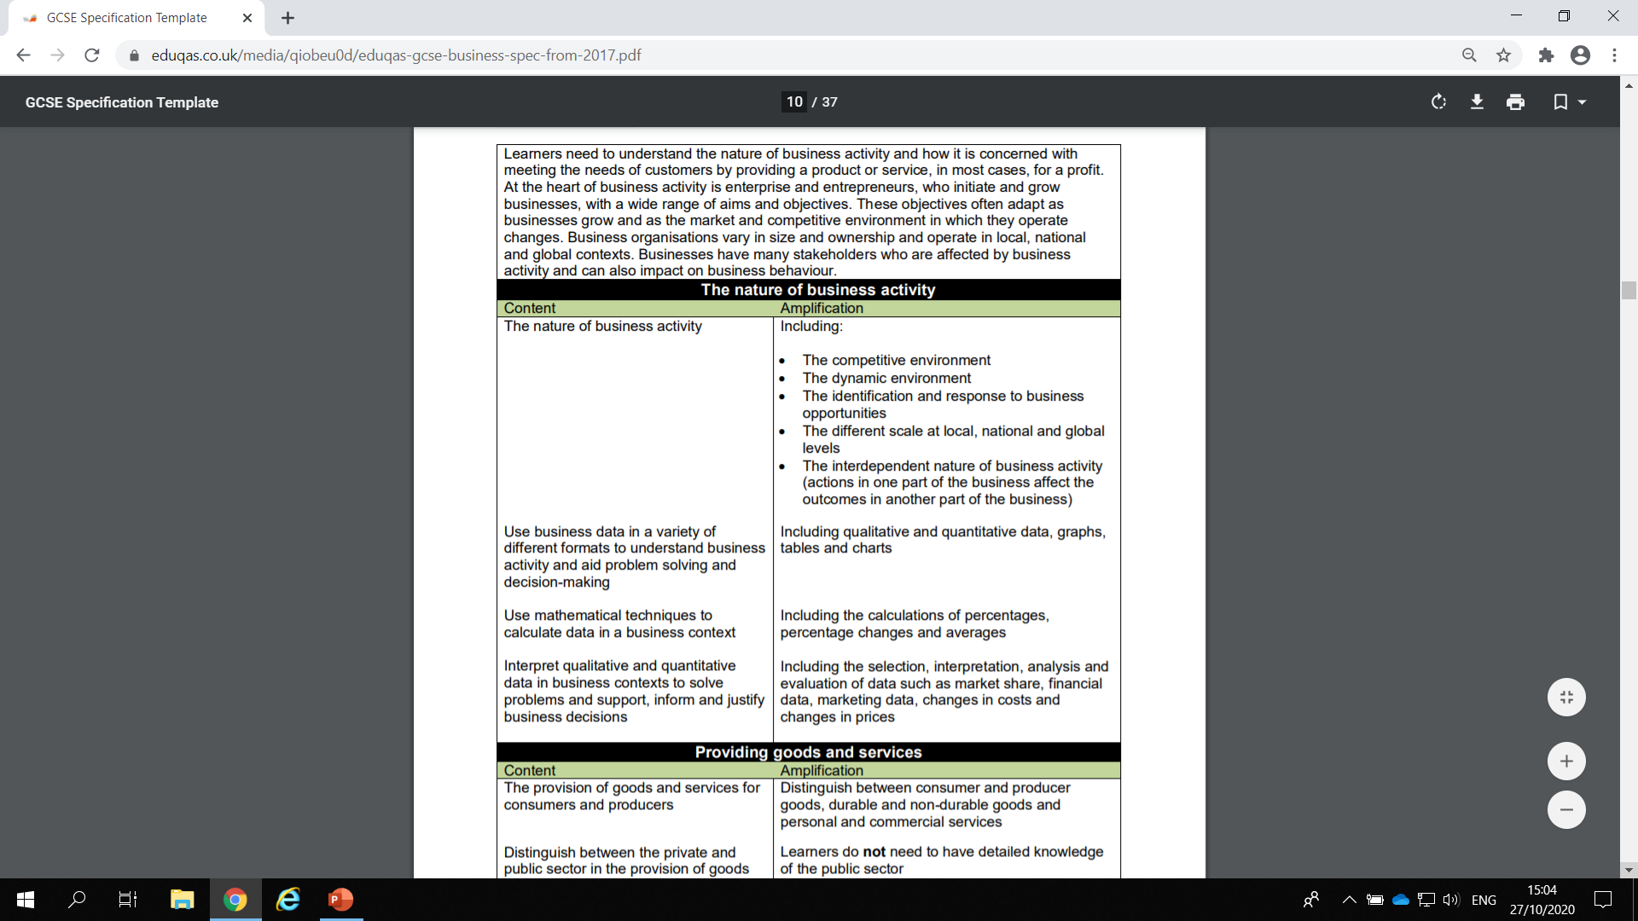
Note the references in the specification to quantitative skills

Slide 11
Both components asses quantitative skills:
Learners will be expected to use a range of mathematical skills and make justifiable decisions using both quantitative and qualitative methods applied in the context of GCSE Business.
These quantitative skills will be assessed in both examination papers, totalling at least 10% of the overall marks available for the qualification.

Slide 12
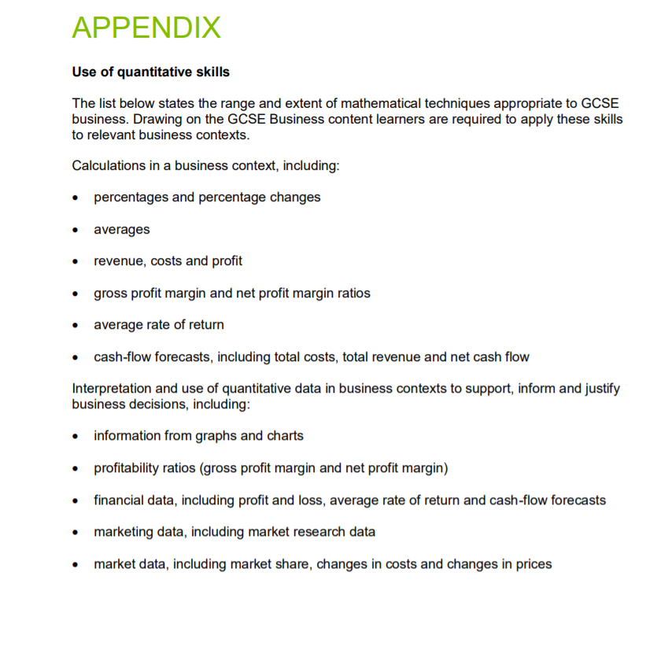

Slide 13
Support & Resources
Eduqas GCSE Business Homepage: https://www.eduqas.co.uk/qualifications/business-gcse/#tab_overview
Key Documents:
https://www.eduqas.co.uk/qualifications/business-gcse/?sub_nav_level=course-materials#tab_resources
Free Digital Resources: https://resources.eduqas.co.uk/Pages/ResourceByArgs.aspx?subId=4&lvlId=2
Past Papers:
https://www.eduqas.co.uk/qualifications/business-gcse/#tab_pastpapers
Training & CPD Materials:
https://www.eduqas.co.uk/qualifications/business-gcse/?sub_nav_level=courses#tab_training
OER (On-line Exam Review): https://oer.eduqas.co.uk/Pages/ProjectByArgs.aspx?subId=10&lvlId=2

Slide 14
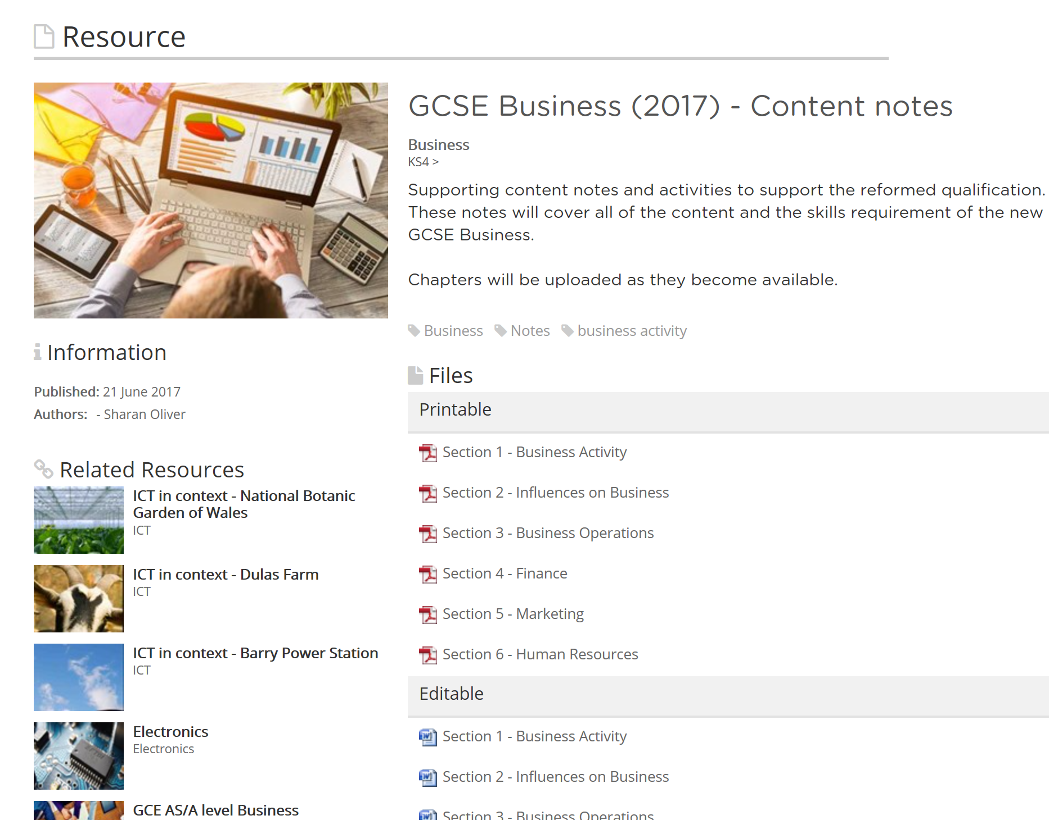
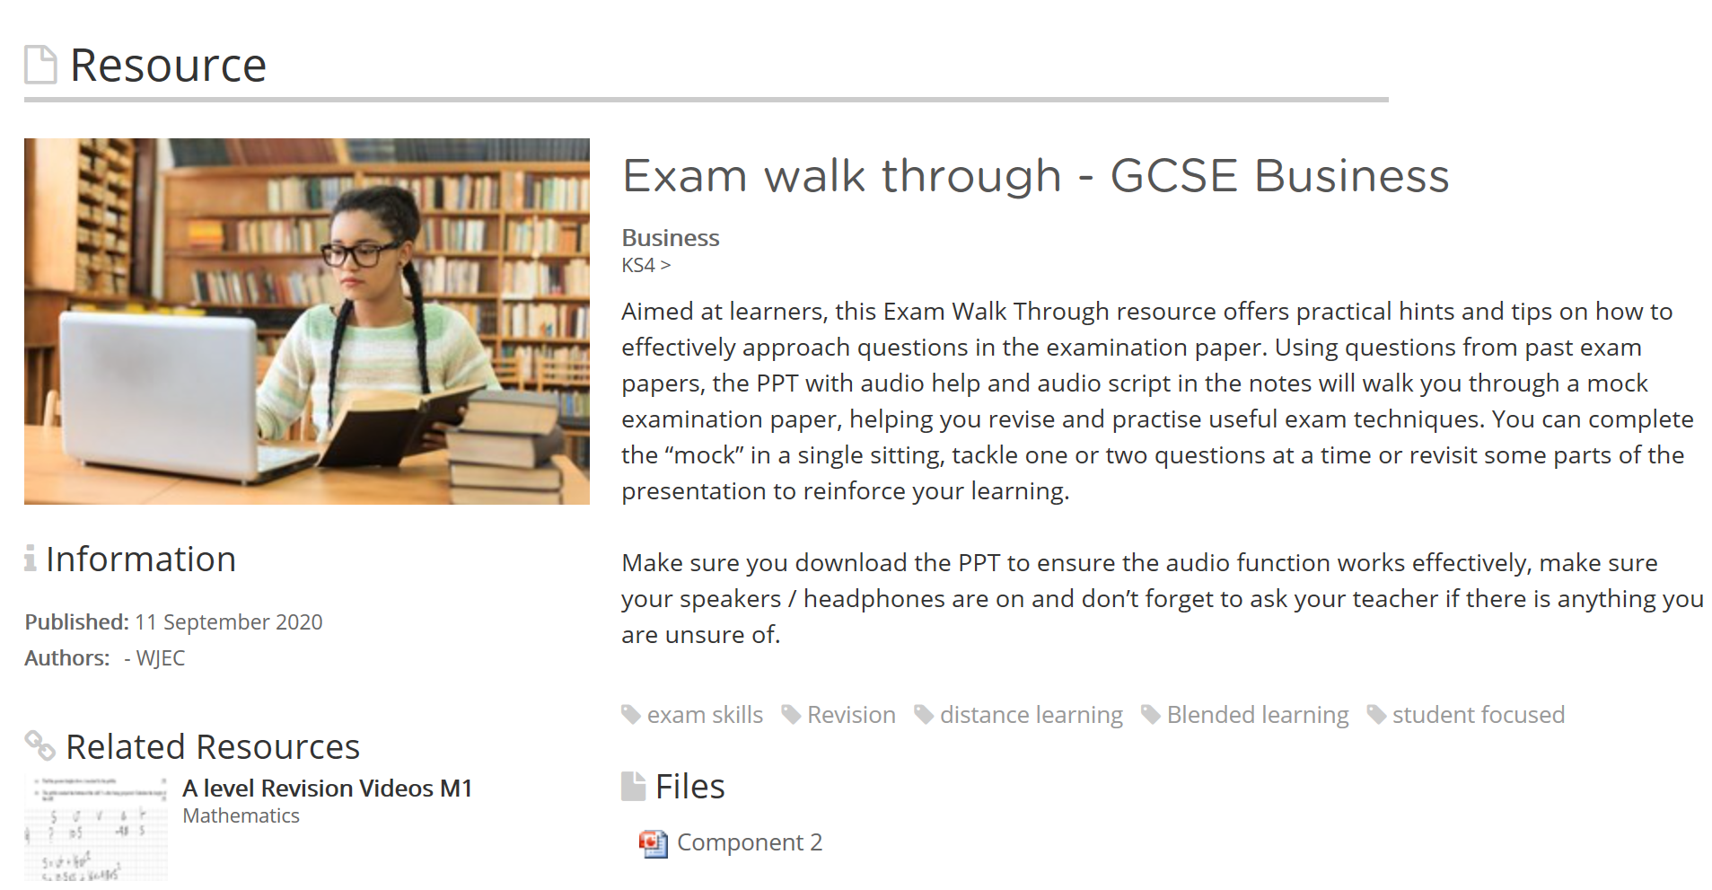
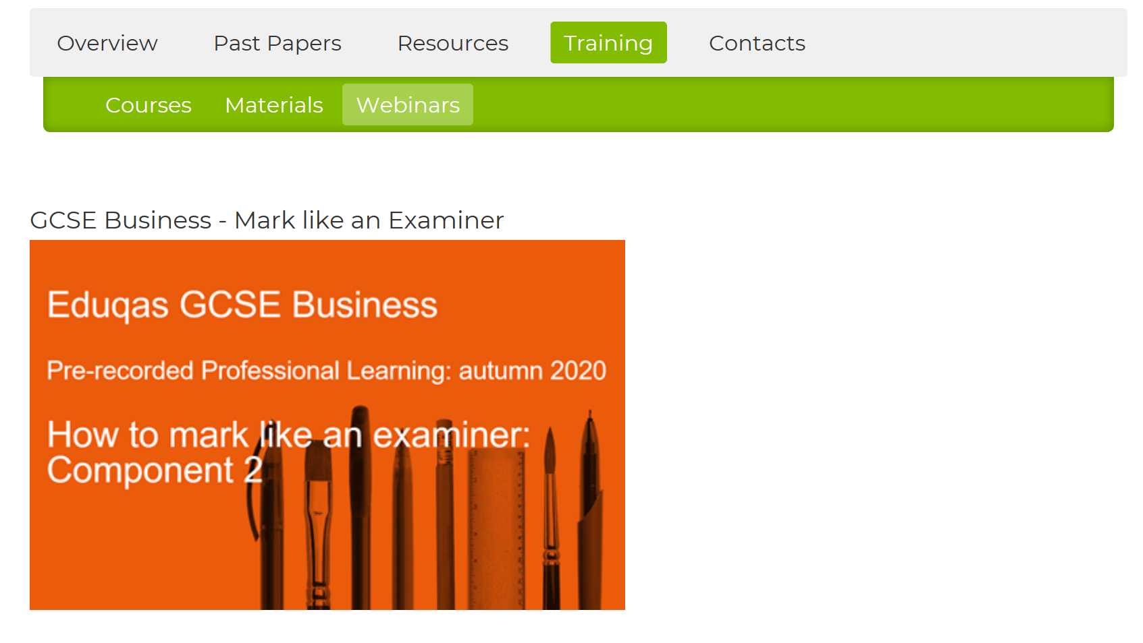
Support & Resources
https://resources.eduqas.co.uk/Pages/ResourceByArgs.aspx?subId=4&lvlId=2
https://www.eduqas.co.uk/qualifications/business-gcse/?sub_nav_level=prerecorded-webinars#tab_training

Slide 15
Further Support:
Contact our Subject Officer and administrative team:
business@eduqas.co.uk
029 2240 4257

