Slide 1

Introduction to Level 1/2 Award Retail Business
November 2020

Slide 2

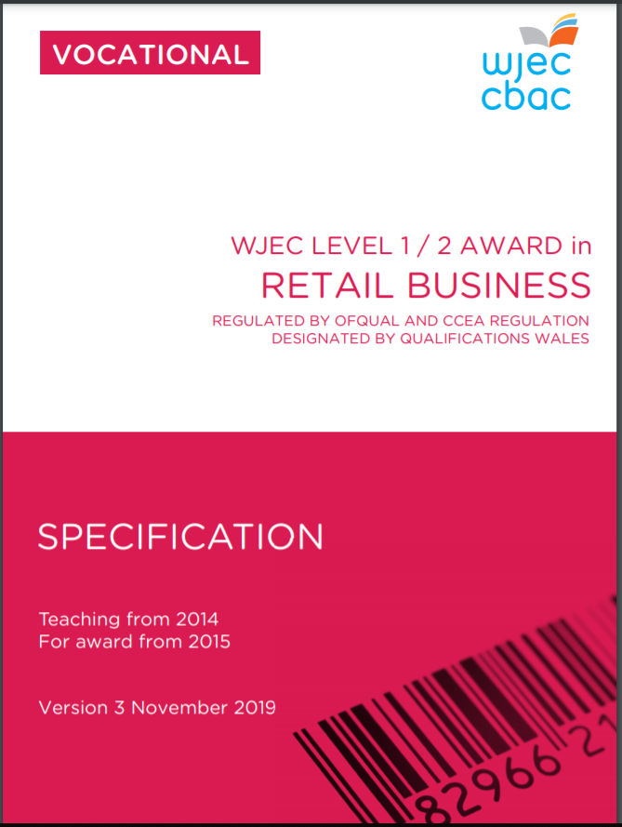
Specification

Slide 3
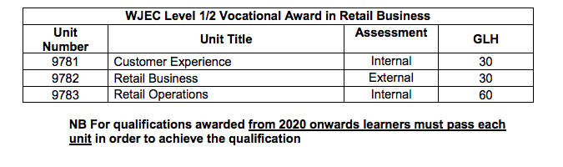
Qualification Structure
Retail Business Award Units
Grading - Each unit is assessed using Performance Bands:
Level 1 Pass
Level 2 Pass
Level 2 Merit
Level 2 Distinction

Slide 4
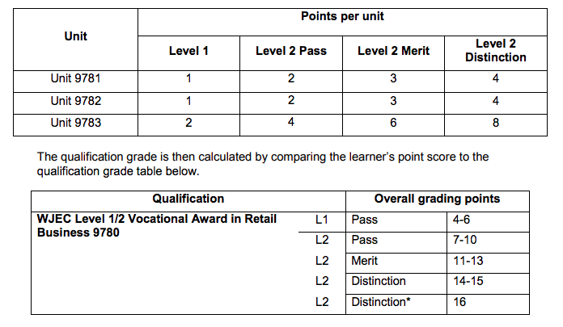
Grading

Slide 5
Internal Assessments
Units 1 & 3: The Controlled Assessment Tasks
Unit 1: 6 hours
Unit 3: 10 hours

Slide 6
Deadlines & Sampling
Final date for Unit 1 and Unit 3 Controlled Assessment samples to reach moderators – 5th May
For each unit (there will be different moderators for each unit) the sample will be:
Total number of candidates | Work to be submitted
1 -10 | All
11 - 99 | 10 to cover a representative sample of Level 1 Pass, Level 2 Pass, Level 2 Merit and Level 2 Distinction candidates
100-199 | 15 to cover a representative sample of Level 1 Pass, Level 2 Pass, Level 2 Merit and Level 2 Distinction candidates
200+ | 25 to cover a representative sample of Level 1 Pass, Level 2 Pass, Level 2 Merit and Level 2 Distinction candidates

Slide 7
Key Information
Units 1 and 3
Make sure you use the correct assignment briefs:
Use the ones on the secure website and NOT the ones on the open website
There is a Candidate assignment brief and an Assessor assignment brief for
each unit
Candidate assignment briefs must only be given to candidates when the task
begins – they are time related
Take care to complete the mark record sheet for all candidates – mistakes
are common
Do not adjust/change the tasks – this could disadvantage your students
This is controlled assessment and not coursework – no redrafts allowed

Slide 8
Grading Rules
Units 1 and 3
Be clear on the grading rules before marking the work:
Unit Grade | Requirements
Level 1 Pass | All AC’s must be achieved as set out in L1 Pass performance band.
Level 2 Pass | All AC’S must be achieved as set out in L2 Pass performance band.
Level 2 Merit | All AC’s that contain the Merit performance band must be achieved as set out in L2 Merit performance band.
Level 2 Distinction | All AC’s that contain the Distinction performance band must be achieved as set out in L2 Distinction performance band.

Slide 9
Unit 1
Unit 1: Customer Experience
Unit entry code: 9781
Guided learning hours: 30
Aim and purpose: The applied purpose of the unit is to review the quality of the customer experience in a retail organisation

Slide 10
Unit 1
Learning outcomes
LO1 – Know customer service standards of retail business
LO2 – Understand how retail business meet the expectations of customers
LO3 – Be able to investigate the quality of customer experience in retail businesses

Slide 11
Unit 1
Guidance for delivery
Try and ensure that the teaching and learning is vocationally relevant
Visit shopping centers and/or stores – enabling pupils to experience the customer service for themselves
Arrange guest speakers from local retailers, either at your centre or at their place of work
LO3 requires pupils to investigate the quality of customer service – time should be spent teaching how to formulate a successful mystery shopper exercise, including the collection and the analysis
Practice this investigative skill at as many retailers as possible

Slide 12
Unit 1
Model of delivery
Teaching and learning is the key element, and the whole specification for Unit 1 is advised be delivered before the commencement of the assignment
Use and refer to a range of retailers in order to investigate their customer service so that candidates may compare and contrast; developing their understanding

Slide 13
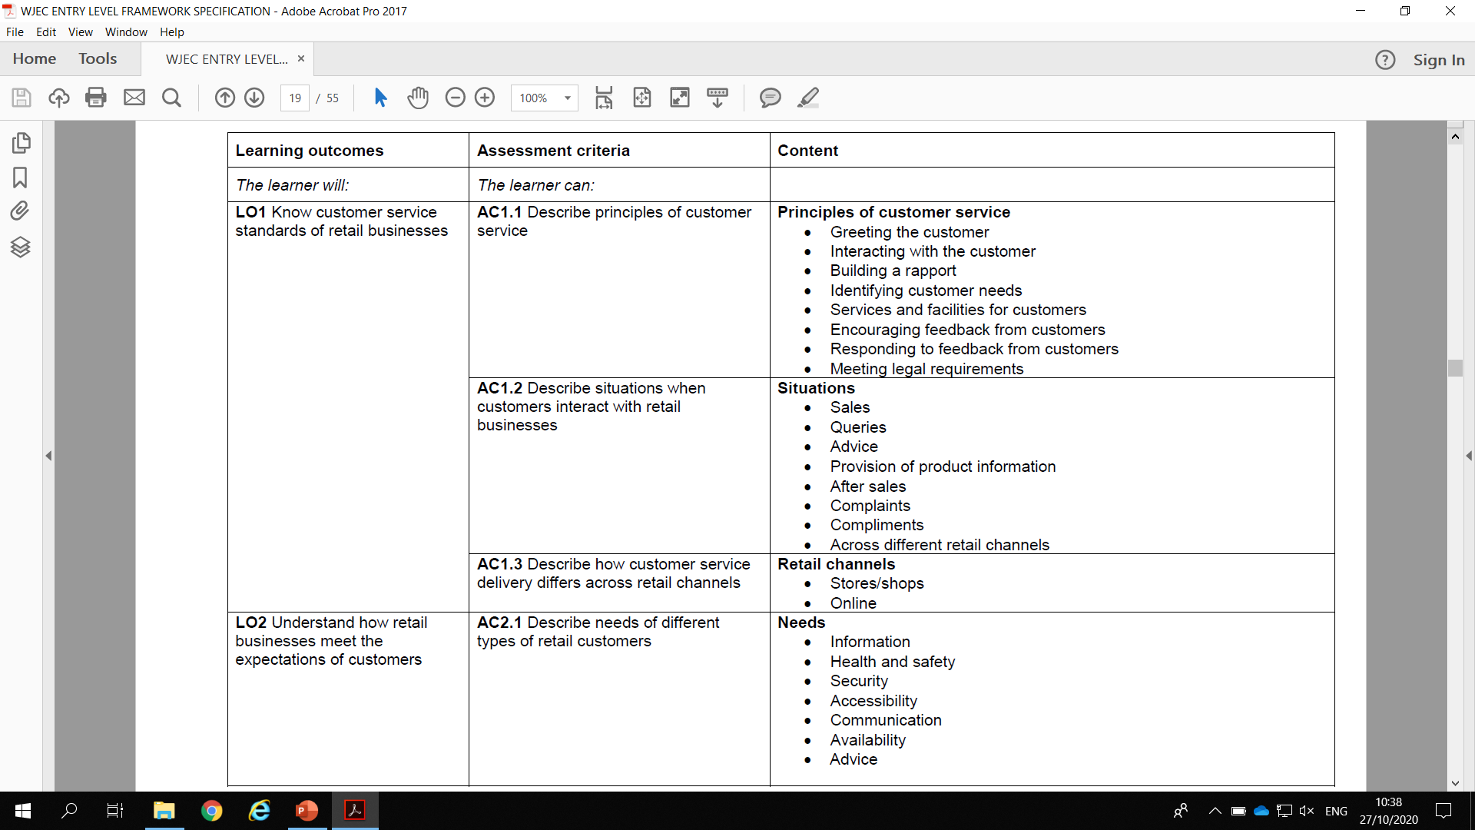
Unit 1

Slide 14
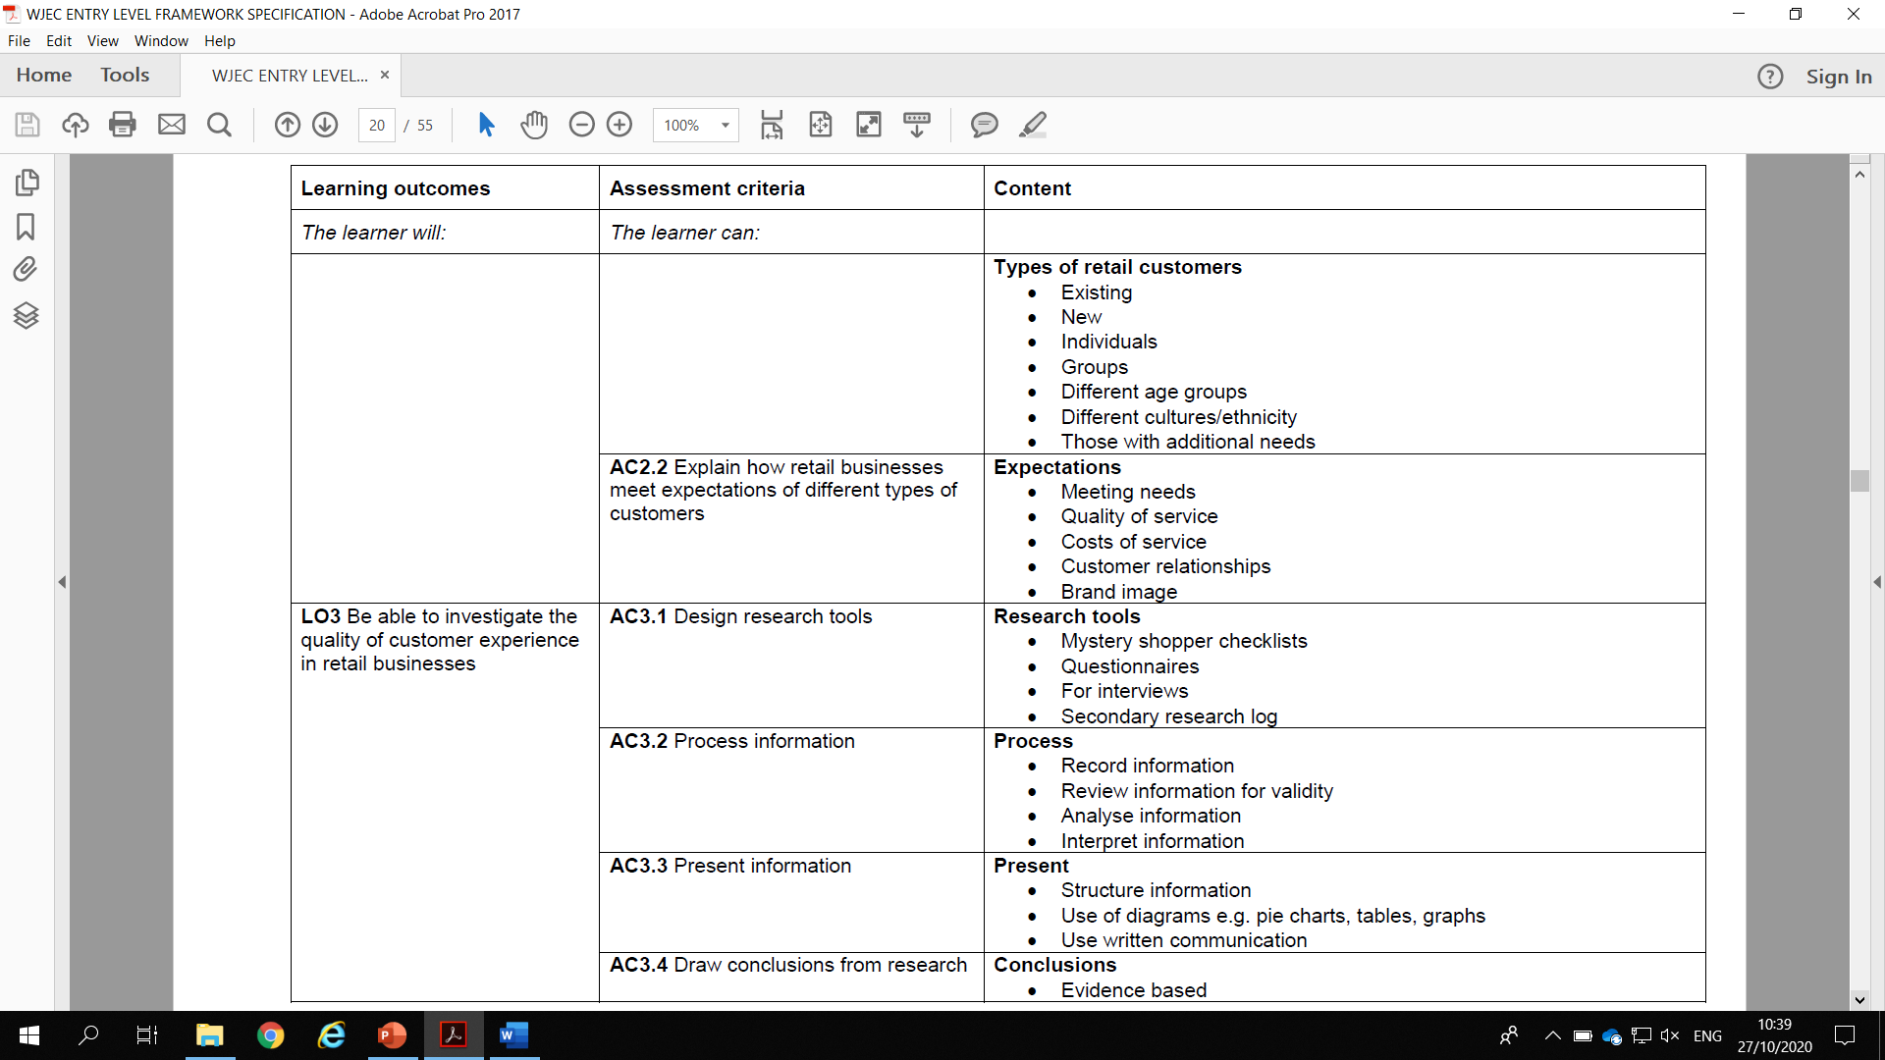
Unit 1

Slide 15
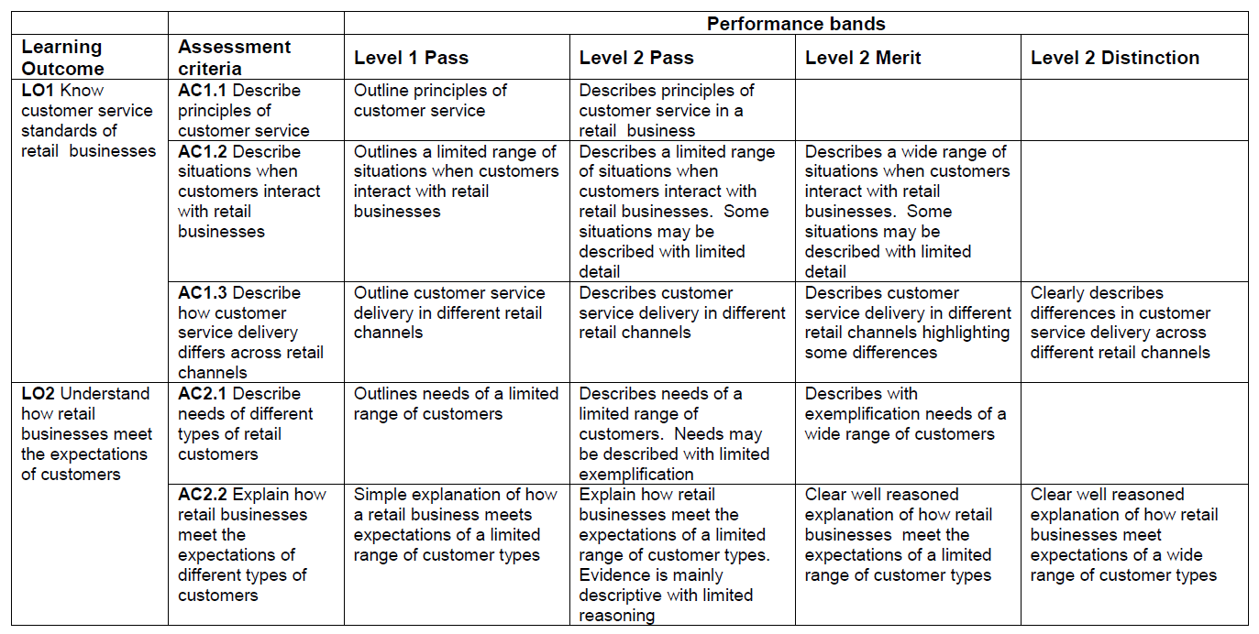
Unit 1

Slide 16
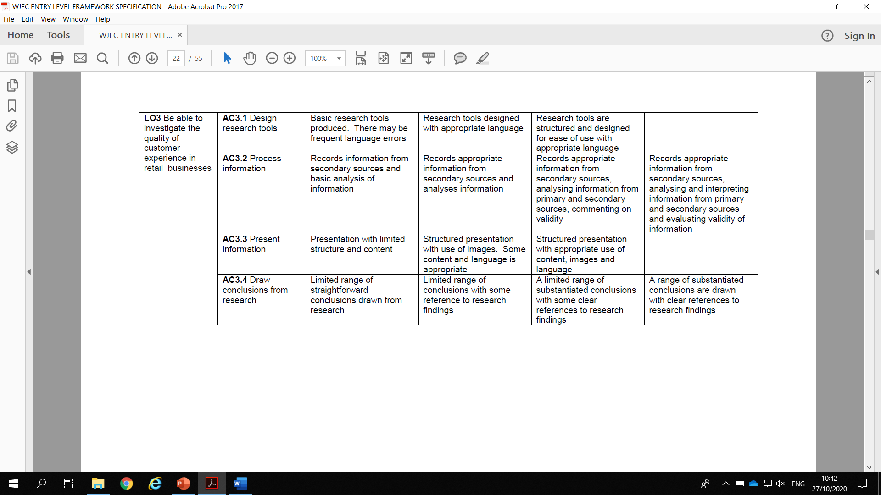
Unit 1

Slide 17
Unit 1
Using practical/vocational context to stimulate learning
Channel 4 – Mary Portas Secret Shopper
The Mystery Shopper: Martin Lewis https://www.youtube.com/watch?v=0K_YwctbxU0
Guest talks by retail managers focussing on Customer Service and Experiences
Business visits
Investigate online reviews prior to visiting, use Flipgrid (Microsoft) or similar technology to get students to vlog their experience compared to reviews.

Slide 18
Unit 3
Unit 3: Retail Operations
Unit entry code: 9783
Guided learning hours: 60
Aim and purpose: The purpose of this unit is for learners to apply their knowledge and understanding of retail operations to propose responses to change

Slide 19
Unit 3
Learning outcomes
LO1 – Know how retail operations are organised
LO2 – Understand interaction between customers and retail activities
LO3 – Understand how retail businesses prepare for changes in the retail environment
LO4 – Be able to propose changes to retail store operations

Slide 20
Unit 3
Delivery model
Deliver the whole content of the specification – getting the students to understand the content
The ability to apply their knowledge is of utmost importance in this unit if students are to access the higher performance bands
When teaching an assessment criterion, ensure that it’s based on a case study (factual or fictional) so that students familiarise themselves with applying knowledge and understanding
Focus on developing the reading skills of your students, the ability to effectively read and comprehend is essential, especially for LO4

Slide 21
Unit 3
New assignment
Available on www.wjec.co.uk
Based on a grocery store (JJ’s)
For summer 2021 centres can chose between the new and old assignment (ElAr Sport) (changed due to Coronavirus)
For 2022 the new assignment must be used

Slide 22
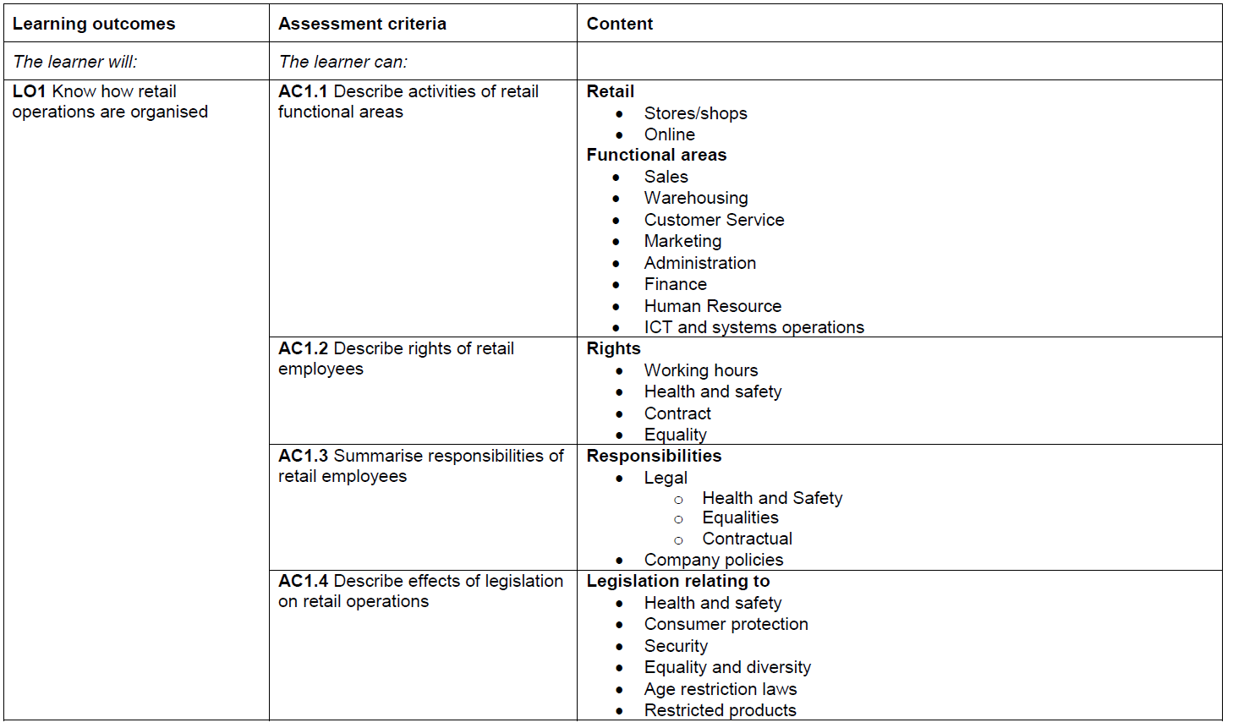
Unit 3

Slide 23
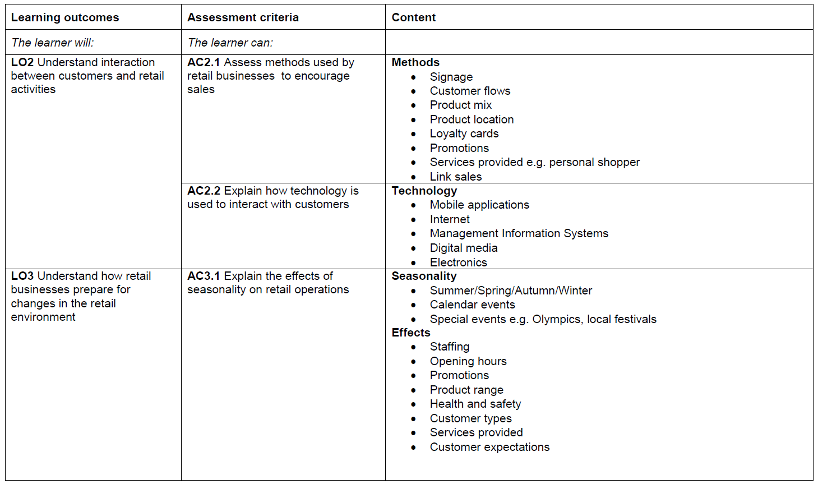
Unit 3

Slide 24
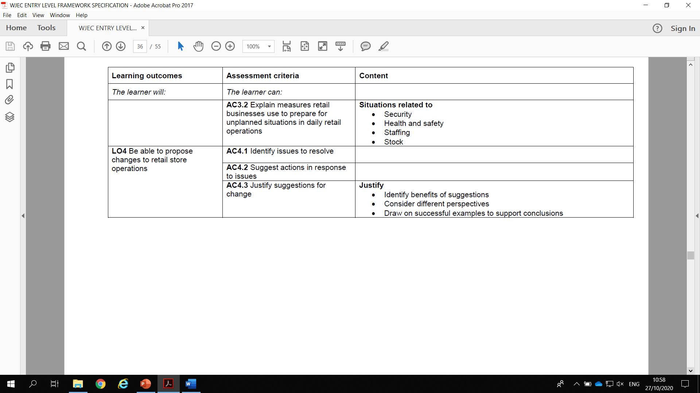
Unit 3

Slide 25
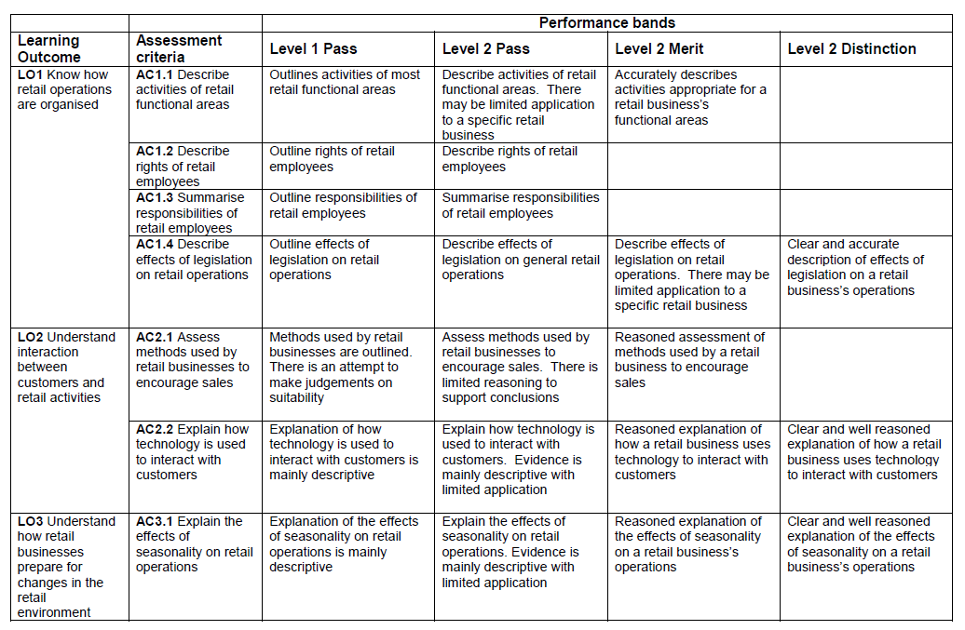
Unit 3

Slide 26
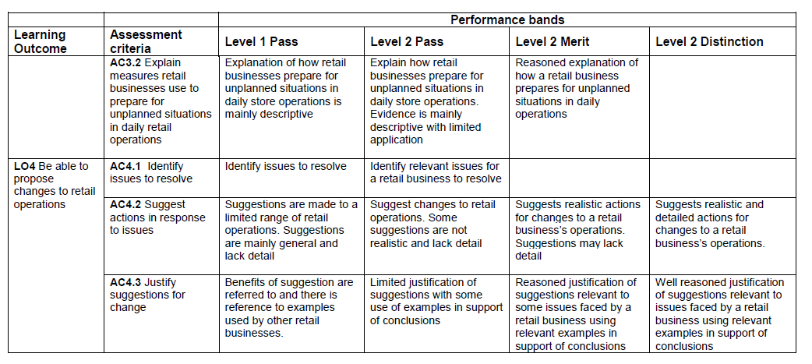
Unit 3

Slide 27
Unit 3
Using practical/vocational context to stimulate learning
As application is required in order to achieve the higher performance bands for several criterions, it is strongly suggested that when teaching the content a practical/vocational scenario is used. Develop the candidates' ability to apply their learned knowledge to various retailers.
Supermarkets are a good basis but vary the examples and try and use retailers of different sizes and different markets. This engages pupils and gives them scope to refer to them as examples to support their suggestions (4.2) and with the justification (4.3).

Slide 28
External Assessment
Units 2: The Examination
60 marks
75 minutes

Slide 29
Unit 2
Unit 2: Retail Business
Unit entry code: 9782
Guided learning hours: 30
Aim and purpose: The purpose of this unit is to enable learners to propose business solutions for a range of issues in the retail sector

Slide 30
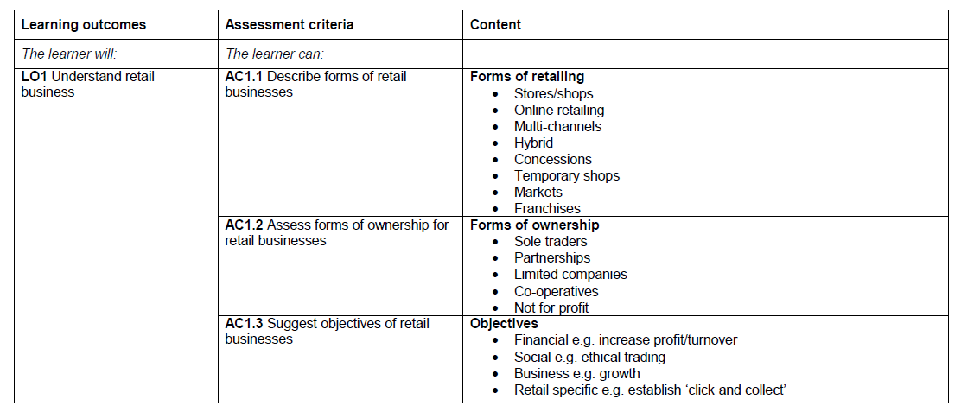
Unit 2

Slide 31
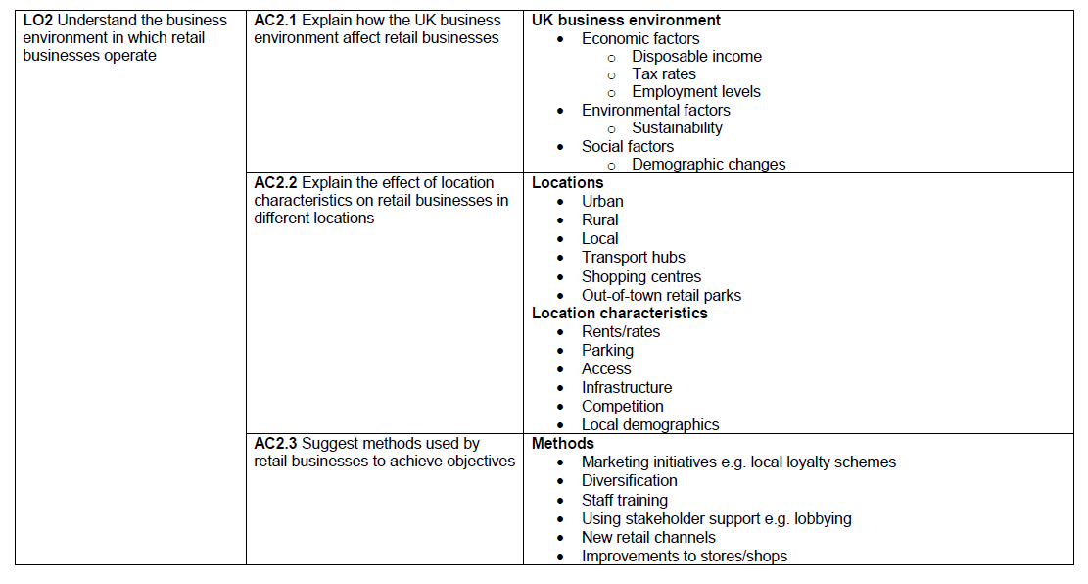
Unit 2

Slide 32
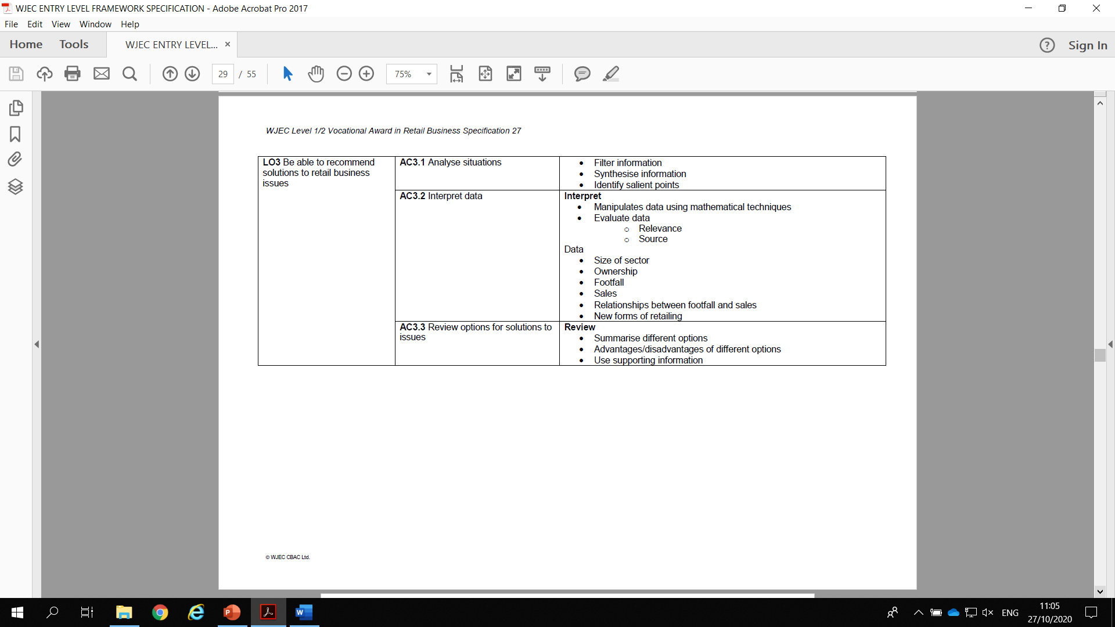
Unit 2

Slide 33
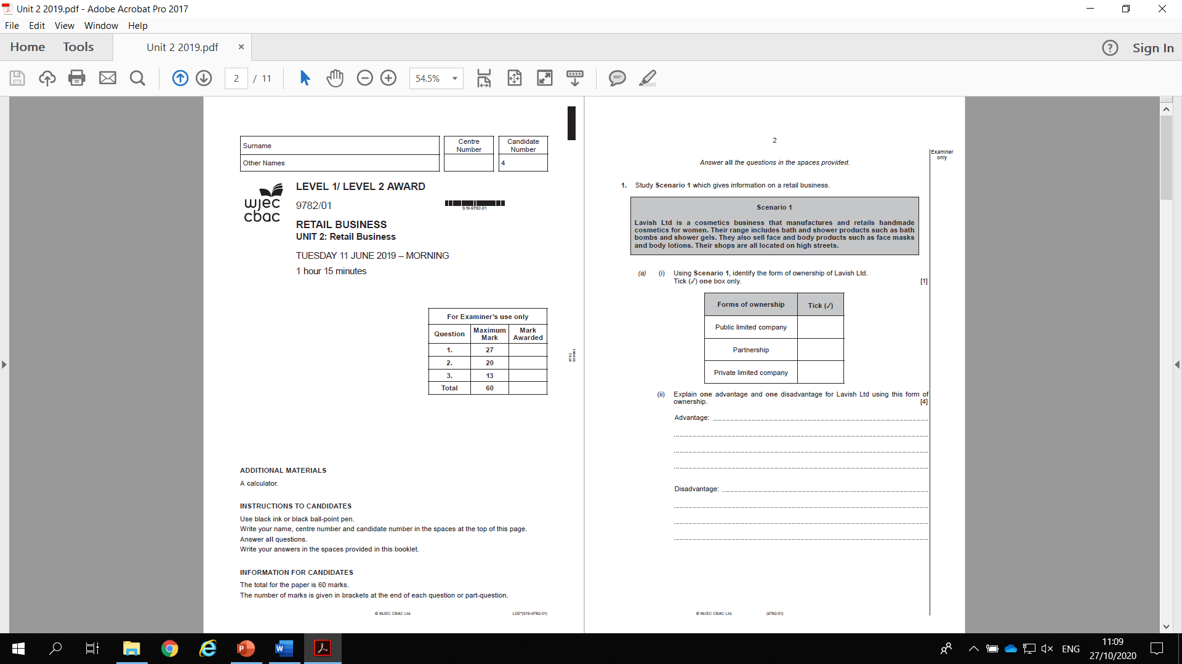
Unit 2

Slide 34
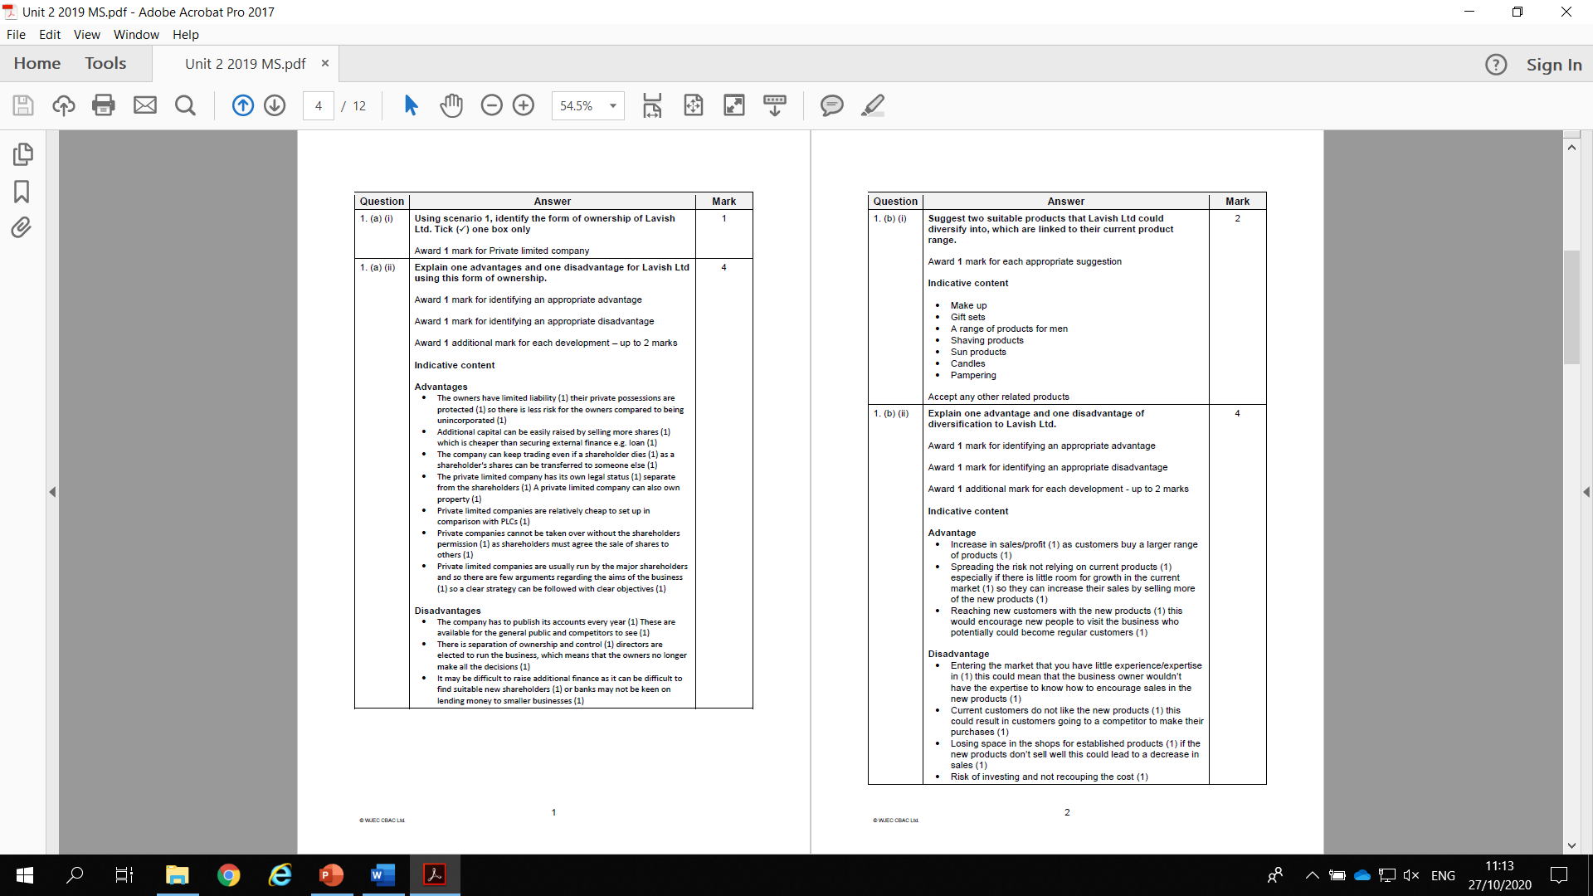
Unit 2

Slide 35
Unit 2
General points
Candidates need to learn the key terms which can be found in the key terms document provided and in the new online resources. Many candidates could improve their answers by demonstrating understanding of the key terms in the question.
Each question starts with a scenario, candidates need to refer to the scenario in their answer. Many candidates lose marks by not applying their answer to the business in the question.
Candidates need to read the scenario carefully - there is information in there to help them answer the question.

Slide 36
Unit 2
General points
Candidates often write simple answers with no development, this will limit what marks they can achieve.
Teaching of good examination technique is vital for candidates. A good number of candidates are clearly not reading the question carefully and ignoring the command word.
Some candidates merely repeat information given to them in the scenario. They need to know that no marks are awarded for doing this.
Many candidates do not consider the viewpoint the question asks for e.g. the business or the customer.

Slide 37
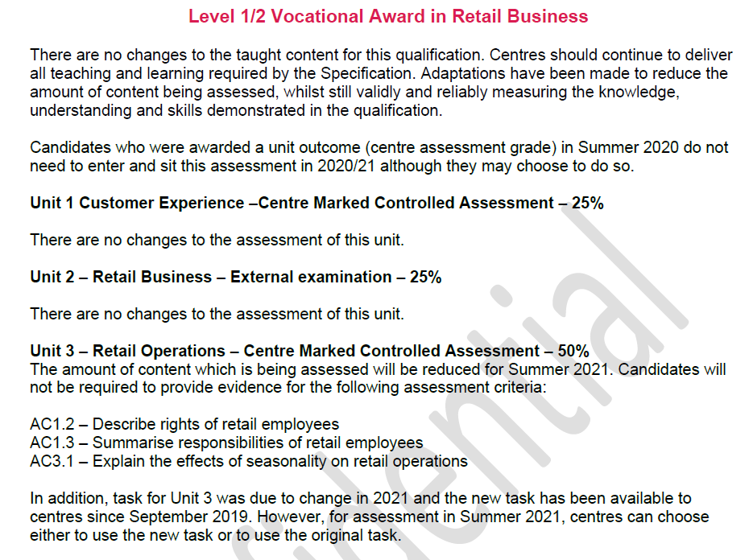
Proposed Adaptations for Summer 2020 ONLY

Slide 38
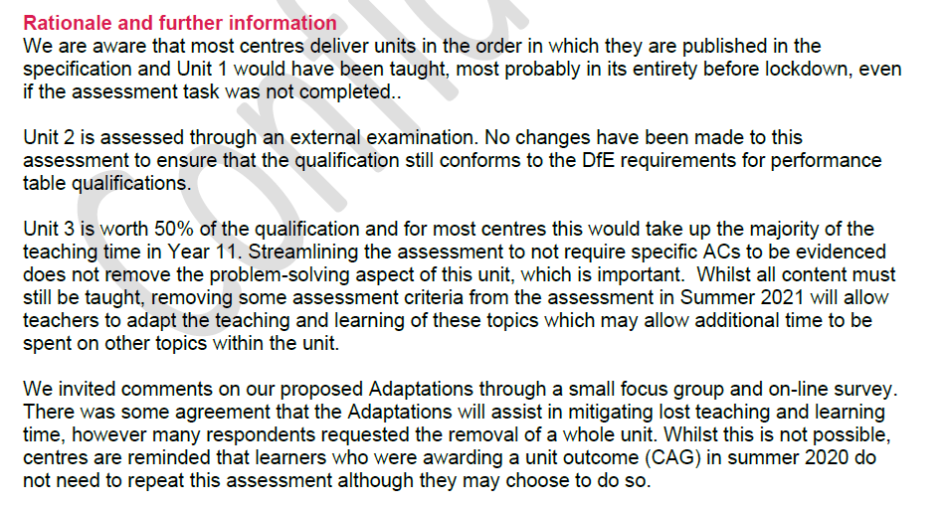
Proposed Adaptations for Summer 2020 ONLY

Slide 39
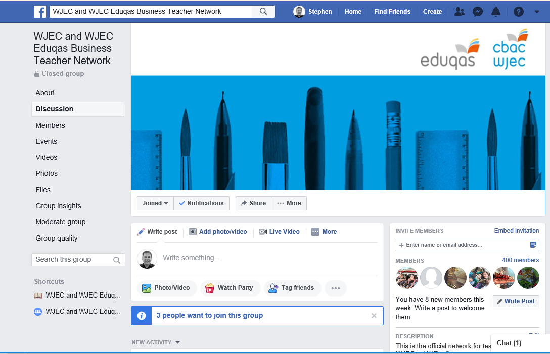
Closed network set up for teachers to communicate with other teachers and to share ideas and resources

Slide 40
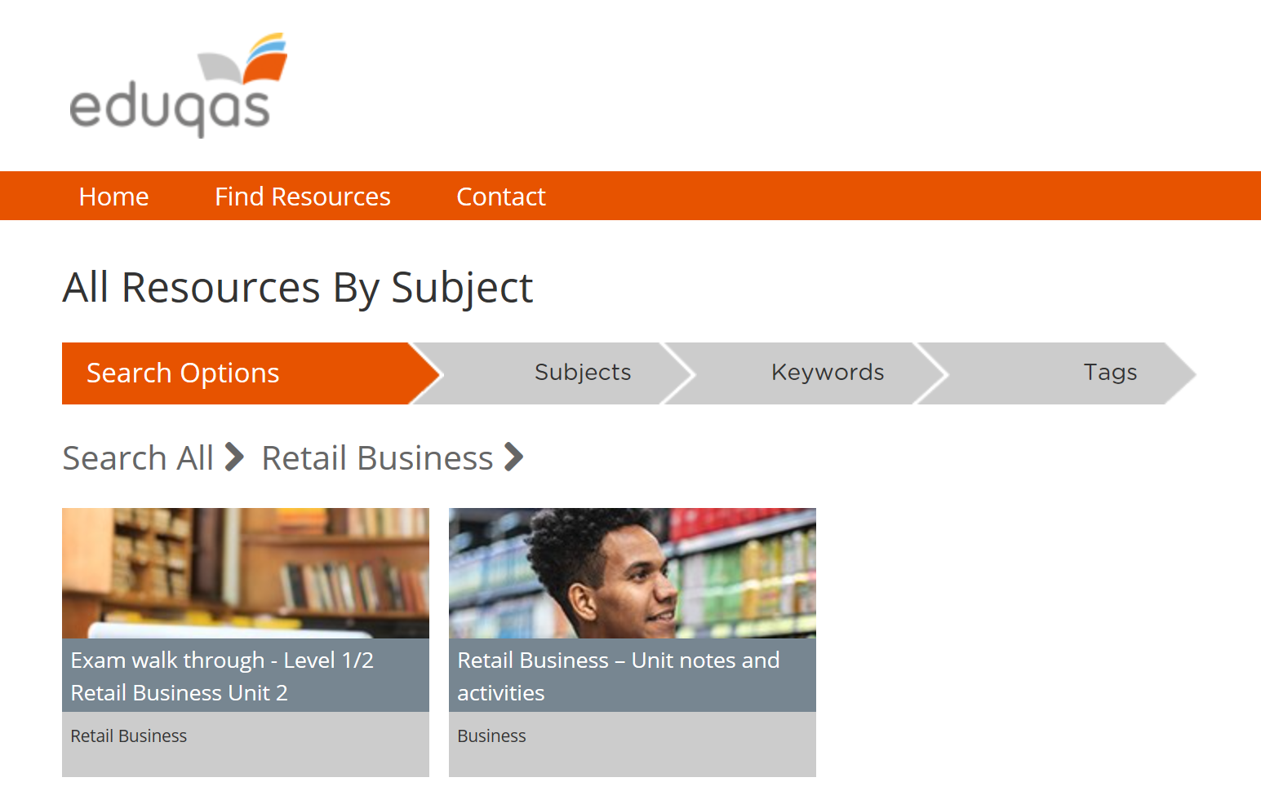
Complete set of digital resources for all three units including content and activities)
Also an exam walk through for Unit 2
https://resources.eduqas.co.uk/Pages/ResourceByArgs.aspx?subId=80&lvlId=0

Slide 41
Useful Links:
Retail Business Homepage: https://www.eduqas.co.uk/qualifications/retail-business-level-1-2/#tab_overview
Key Documents: https://www.eduqas.co.uk/qualifications/retail-business-level-1-2/?sub_nav_level=course-materials#tab_resources
OER: https://oer.wjec.co.uk/Pages/ProjectByArgs.aspx?subId=74&lvlId=8
Past Papers: https://www.eduqas.co.uk/qualifications/retail-business-level-1-2/#tab_pastpapers
Link to Unit 1 & 3 Assignment Briefs, CPD materials & Exemplars: https://www.wjecservices.co.uk/login.asp > Resources (top right) > Subject Specific Support Materials (drop-down menu) > Populate boxes: Retail Business; WJEC; Level 1/2 Award > there it all is

Slide 42
Contacts:
Contact our specialist Subject Officer and administrative support team for your subject with any queries.
business@eduqas.co.uk
TEL: 029 2240 4257

