Slide 1


Thinking about Eduqas GCSE Design & Technology
An introduction for New Centres

Slide 2
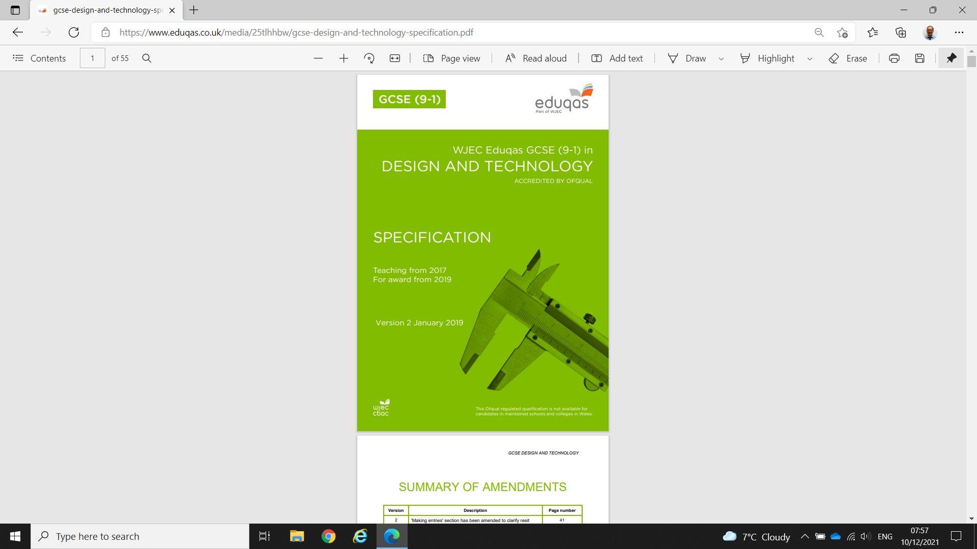

Slide 3
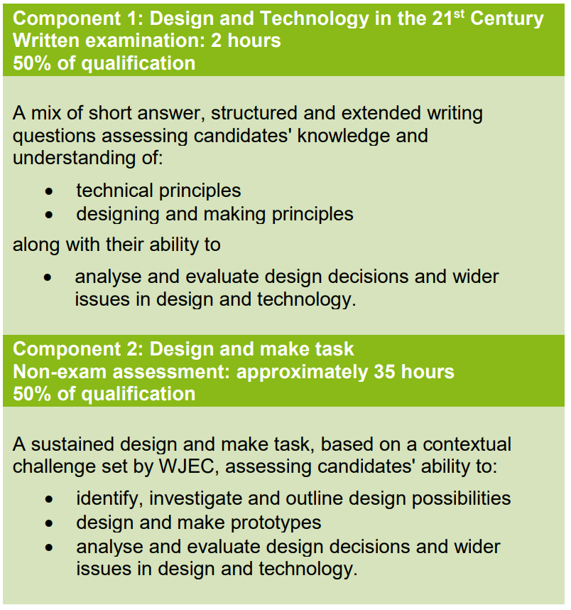

Slide 4
Assessment Objectives
AO1 (10%) EXAM
Identify, investigate and outline design possibilities to address needs and wants
AO2 (30%) NEA
Design and make prototypes that are fit for purpose
AO3 (20%) EXAM (10%) + NEA (10%)
Analyse and evaluate:
  design decision and outcomes including for prototypes made by themselves and others
  wider issues in design and technology
AO4 (40%) EXAM
Demonstrate and apply knowledge and understanding of:
  technical principles
  designing and making principles

Slide 5
Overall Structure

Slide 6
Mathematics
Recognise and use expressions in decimal and standard form | Calculation of quantities of materials, costs and sizes
Use ratios, fractions and percentages | Scaling drawings, analysing responses to user questionnaires
Calculate surface area and volume | Determining quantities of materials

Slide 7
Mathematics
Presentation of data, diagrams, bar charts and histograms. | Construct and interpret frequency tables; present information on design decisions
Plot, draw and interpret appropriate graphs | Analysis and presentation of performance data and client survey responses
Translate information between graphical and numeric form | Extracting information from technical specifications

Slide 8
Mathematics
Use angular measures in degrees | Measurement and marking out, creating tessellated patterns
Visualise and represent 2D and 3D forms including two dimensional representations of 3D objects | Graphic presentation of design ideas and communicating intentions to others
Calculate areas of triangles and rectangles, surface areas and volumes of cubes | Determining the quantity of materials required

Slide 9

Component 1
Externally examined
50% of Qualification
2 Hours in length
100 marks
A mix of short answer, structured and extended writing questions
Based on:
technical principles
designing and making principles
along with their ability to:
analyse and evaluate design decisions and wider issues in design and technology.

Slide 10
Component 1
The overall structure of the paper
2 Hours duration
100 marks
Two sections
Section A 1 - 5 questions
Question 5 does allow the candidate to give answers from their area of study
Section B 1 question from 6 related to area of study

Slide 11
Component 1: Exam
Core knowledge and understanding - five clear and distinct topic areas:
design and technology and our world
smart materials
electronic systems and programmable components
mechanical components and devices
materials
Learners need to:
study all of the content in these five areas with a broad knowledge and understanding of design and technology
be able to apply this knowledge in design and make activities.

Slide 12
Component 1
In-depth knowledge and understanding is presented in six clear and distinct topic areas:
electronic systems, programmable components and mechanical devices
papers and boards
natural and manufactured timber
ferrous and non-ferrous metals
thermoforming and thermosetting polymers
fibres and textiles
Learners are required to study at least one of these six areas, to ensure they have an in-depth knowledge and understanding of a specific material area and/or components and systems to support their design and make activities.

Slide 13
Component 1
Percentages for the paper
Core = 45% Questions 1 - 4
Mathematics = 15% Questions could be across whole paper.
Area of study = 40% Questions 5 and 6

Slide 14
Component 1
Examples of key words in questions and marks awarded
Give State Name Place | 1 mark | These questions are designed to ease the learner into the question. They need a simple statement, a short phrase, tick line etc.
Describe Outline Explain Justify | 2 marks | These questions ask the learner to describe something in detail. The answer will be in sentences and/or in a list. There is a need for detail in the answer with elaboration of the answer. Sometimes the question will ask the learner to use notes and sketches; this means that a clearly labelled sketch or diagram will of course gain the marks.

Slide 15
Component 1
Key words in questions and marks awarded
Evaluate Analyse | Extended marked questions | Evaluate could imply involve assessing or appraising a situation or product or material giving reasons to support their answers. Analyse means examining and dissecting a situation or product giving thoughtful appropriate reasons to support the answer. It could include finding logical chains of reasoning. These questions are designed to test, stretch and challenge the more able learner. The question requires the learner to make a well-balanced argument involving both advantages and disadvantages. A paragraph or a number of sentences extended writing will be required

Slide 16
Component 2: NEA
Approximately 35 hours
50% of qualification
100 marks
Internally marked externally moderated
A sustained design and make task, based on a contextual challenge set by WJEC, assessing candidates' ability to:
identify, investigate and outline design possibilities
design and make prototypes
analyse and evaluate design decisions and wider issues in design and technology.

Slide 17
Component 2
Core knowledge and understanding that learners are required to develop and apply is presented in ten clear topic areas:
• understanding design and technology practice
• understanding user needs
• writing a design brief and specifications
• investigating challenges
• developing ideas
• investigating the work of others
• using design strategies
• communicating ideas
• developing a prototype
• making decisions
Learners are required to cover all of the content in these ten areas, to ensure they are able to apply a broad knowledge and understanding of design and technology principles within design and make activities.

Slide 18
Component 2
In-depth knowledge and understanding is presented in five clear topic areas:
• selecting and working with materials and components
• marking out
• using tools and equipment
• using specialist techniques
• using surface treatments and finishes
Learners are required to cover all of the content in these five areas, in relation to at least one of the topic areas identified in the in-depth knowledge and understanding section of technical principles.
LEARNERS WILL BE TESTED ON KNOWLEDGE AND UNDERSTANDING COVERED WITHIN THIS COMPONENT

Slide 19
Component 2
NEA – Non Examined Assessment – 50% of the qualification
Approximately 35 hours of candidate work
Design & Make Task from a contextual challenge set by WJEC
Worth 100 raw marks
Internally assessed and externally moderated
Visiting moderation

Slide 20
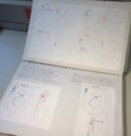
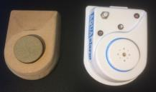
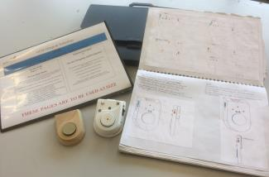
Component 2
What will the NEA task look like?
  A3 Formal Presentation Folio
  A3 Informal Sketchpad Folio
  A fully functioning Final Prototype
  Supporting models, prototypes, tests and iterations
Where do I start?
Analyse the 3 contexts
Focus on user requirements
Evaluate existing products
Research new materials / processes / techniques
Focus on the problem
Look at designers / other practitioners

Slide 21
Component 2
Contextual Challenge
3 very short ‘contexts’ will be provided
Much less detail – more like titles
Broad topics, no structure or guidance
Candidates must do ‘more’ relevant ‘digging’
They must identify multiple design possibilities
To do this they must understand the context
User needs and wants are critical
Selection of the chosen design task to tackle the contextual challenge

Slide 22
Component 2
The following are exemplar briefs
from the Specimen Assessment Materials.
Brief 1: SUSTAINABILITY AND OUR FUTURE NEEDS
Look at an everyday product and consider how it could be redesigned using recycled or waste materials.
Brief 2: IMPROVING THE DAILY LIFE OF ELDERLY PEOPLE
Look at the specific needs of elderly people and design a unique product that would support their everyday lives.
Brief 3: OUTDOOR PURSUITS AND PHYSICAL FITNESS
Look at outdoor activities and physical fitness and consider the needs and wants of people who do such activities.

Slide 23
Component 2
AO1
AO1 Identify, investigate and outline design possibilities to address needs and wants
Definitions used in AO1
Identify | looking at areas and opportunities in which designs can take place
Investigate | pursuing ideas and gathering information relating to a context
 | identify and investigate are interdependent - the processes work together and take place in no particular order
Outline | to produce a design brief and specification to inform AO2

Slide 24
Component 2
INFORMAL Sketchpad
Identifying and investigating design possibilities.
Generating and Developing Design Ideas.
Practical outcomes
Final Prototype (Fully functioning high quality product)
Any supporting practical pieces including models, jigs, formers, patterns, tests, trials, iterations.
FORMAL Presentation Folio
Final Brief and Specification
Final Prototype – Pictorial details
Final Prototype – Technical details
Final Prototype – Production details
Sequence of Production
Evaluation of Final Prototype
Modifications and further developments
Photographs of Final Prototype

Slide 25


Component 2
Formal sketch book or candidate designed page?
It does not matter.
Can teachers design the page?
Yes.
Can you label pages for the candidates?
No. As soon as teachers start to label pages then this leads to prompts for candidates and this is not allowed.
How many pages?
It is not the number but the content on the pages.

Slide 26
Component 2
What if a student has an answer before they start to research or analyse products?
Get them to sketch their thoughts and ask them to detail as best as they can?
Get them to make a prototype a model?
Then get them to question the prototype?
Using the prototype as a starting point, can they think of different issues/problems?
How can they can get over the problems?
Do they now need to do detailed research?

Slide 27
Component 2
Non-exam assessment marking criteria
Assessment Criteria |  | Marks | Assessment Objective
(a) | Identifying and investigating design possibilities. | 10 | AO1
(b) | Developing a design brief and specification. | 10
(c) | Generating and developing design ideas. | 30 | AO2
(d) | Manufacturing a prototype. | 30
(e) | Analysing and evaluating design decisions and prototypes. | 20 | AO3
 | Total | 100
The design context must be analysed critically.
There will be a number of possible design tasks identified.
Detailed and relevant research will be evident
Consider the needs and wants of users
Analysis of existing products
Research into past / present professionals

Slide 28
Component 2
Non-exam assessment marking criteria
Assessment Criteria |  | Marks | Assessment Objective
(a) | Identifying and investigating design possibilities. | 10 | AO1
(b) | Developing a design brief and specification. | 10
(c) | Generating and developing design ideas. | 30 | AO2
(d) | Manufacturing a prototype. | 30
(e) | Analysing and evaluating design decisions and prototypes. | 20 | AO3
 | Total | 100
Opportunities are carefully considered before final brief.
Understand the task and the needs and wants of users.
A clearly defined design brief is evident.
A detailed specification is generated to drive designing.
Measurable criteria included.
The specification is used throughout the designing process.

Slide 29
Component 2
AO2
AO2 Design and make prototypes that are fit for purpose
Definitions used in AO2
Design | the generation and development of ideas that can be presented to a third party, and can be evaluated and tested (however, the actual analysis and evaluation forms part of AO3).
Prototype | an appropriate working solution to a need or want that is sufficiently developed to be tested and evaluated (for example, full sized products, scaled working models or functioning systems).
Fit for purpose (prototype) | in addition to being a working solution, addressing the needs/wants of the intended user.
 | making skills can be assessed through the designing and making of the prototype(s), as well as the nature and quality of the final prototype.

Slide 30
Component 2
Non-exam assessment marking criteria
Assessment Criteria |  | Marks | Assessment Objective
(a) | Identifying and investigating design possibilities. | 10 | AO1
(b) | Developing a design brief and specification. | 10
(c) | Generating and developing design ideas. | 30 | AO2
(d) | Manufacturing a prototype. | 30
(e) | Analysing and evaluating design decisions and prototypes. | 20 | AO3
 | Total | 100
30% of the NEA!
An iterative approach is required.
A range of design strategies.
Clear and effective testing.
Analysis against Spec identifies further refinements.
Testing and selection of :
Materials
Components
Dimensions
Manufacturing / production
Finishing
High level skills evident

Slide 31
Component 2
Non-exam assessment marking criteria
Assessment Criteria |  | Marks | Assessment Objective
(a) | Identifying and investigating design possibilities. | 10 | AO1
(b) | Developing a design brief and specification. | 10
(c) | Generating and developing design ideas. | 30 | AO2
(d) | Manufacturing a prototype. | 30
(e) | Analysing and evaluating design decisions and prototypes. | 20 | AO3
 | Total | 100
Another 30% of the NEA!
Stages of production timeline.
Completed prototype to schedule.
Successful high level making skills.
Excellent appreciation of materials and components
High levels of accuracy in outcome.
Prototype functions perfectly
Meeting the user needs and wants.

Slide 32
Component 2
AO3
AO3 Analyse and evaluate design decisions and outcomes, including for prototypes made by themselves and others wider issues in design and technology
Definitions used in AO3
Analyse | Deconstructing information and/or issues to find connections and provide logical chain(s) of reasoning.
Evaluate | Appraising and/or making judgements with respect to information and/or issues.
 | Analysis and evaluation should draw on underpinning knowledge and understanding.

Slide 33
Component 2
Non-exam assessment marking criteria
Assessment Criteria |  | Marks | Assessment Objective
(a) | Identifying and investigating design possibilities. | 10 | AO1
(b) | Developing a design brief and specification. | 10
(c) | Generating and developing design ideas. | 30 | AO2
(d) | Manufacturing a prototype. | 30
(e) | Analysing and evaluating design decisions and prototypes. | 20 | AO3
 | Total | 100
20 Marks available.
On-going evaluation and analysis of ideas as they develop.
Appraising concepts through the iterative process.
A critical analysis and evaluation of the FINAL prototype.
User trials / testing and opinions of potential users.
Reflection on feedback and further development issues identified.
Detailed suggestions for modifications.

Slide 34
Component 2
Summary
35 hour Design & Make
3 Contextual Challenges available June 1st
Candidates choose to tackle 1 challenge
No CAT Workbook – no pre-printed sheets
Eased up controlled conditions
Full understanding of the context leads to various design problems identified.
Supplementary design work will be submitted
Far more focus on development / testing
More analysis and decision making required

Slide 35
Very testing focussed
Candidates can start the process by modelling
Testing ideas to evaluate their success
How many pages do I need?
As many as it takes!
A much more practical ‘hands on’ approach
This will suit candidates
Introduction of rapid prototyping
Candidates will understand ‘issues’ more clearly
Lean design – cut away the less important aspects

Slide 36
Component 2
5 Assessment Criteria
Marks are in banded descriptors
Total mark reduced to 100
Descriptors are very clear
Less small mark allocations
No easy marks given to candidates
Less structure given to candidates
More freedom but less guidance

Slide 37
Component 2
100 Raw Mark Total
AO1 – setting the scene 20 marks
AO2 – designing, testing, analysing, making 60 marks
AO3 - evaluating and reflecting in an iterative approach – 20 marks.

Slide 38
Component 2
Development bias
Candidates need to test ideas!
Analyse the results
Refine the concept
Test the next Iteration!
Evidence of this informal process is critical
No more one A3 page by page approach
Too contrived! One size does not fit all!
A* candidates will be pleased
C/D candidates will need training

Slide 39
Component 2
Iterative Design Process
No sequential pages – open book approach
Informal sketchbook to cater for an iterative approach to design and development
Multiple starting points for project work
Think – test – reflect
Trialling and evaluating / risk reward
https://www.youtube.com/watch?v=16rGwTX4NcM
https://www.youtube.com/watch?v=WcFSZGvXtjA

Slide 40



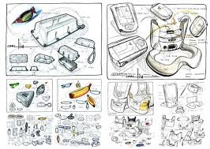
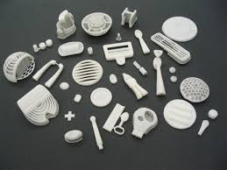
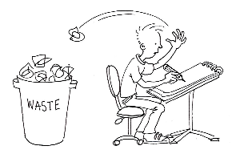
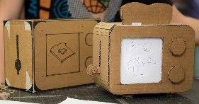

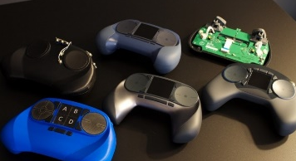
Component 2
Interaction of Mind and Hand
Confronting reality
Outside the head
Imaging and thinking inside the head
First Impressions
Discussion
Exploring
Sketching
Diagrams
Graphs
Speculating
Data
Taking Risks
Modelling
Clarifying
Testing
Validating
Reflecting
Consolidating
Prototyping
Critical Appraisal
Provisional Solution
Potential of more developed thinking Potential of more developed solutions

Slide 41

Any Questions?
Eduqas GCSE Design & Technology team:
designandtechnology@eduqas.co.uk
029 2240 4303

