Slide 1



Level 1 / 2 Performing Arts
(Technical Award)
NEA Admin Walkthough

Slide 2

What We Will Cover
Timeline
Preparing work for upload
Completing the ARS
Inputting marks on IAMIS (Units 1 and / or 2)
Uploading work to IAMIS (Units 1 and / or 2)
Uploading work to Surpass (Unit 3)
Special consideration
Malpractice
The external moderation process
Accessing your report after results day
Key contacts

Slide 3
What We Will Cover
All of the information in this guide is taken from the general E-submission guides that are publicly available and the subject specific upload guidance. We provide links and QR codes to the relevant documents throughout this presentation.
Your exams officer has the login details for IAMIS and Surpass (the portals we use for inputting marks and uploading NEA).

Slide 4
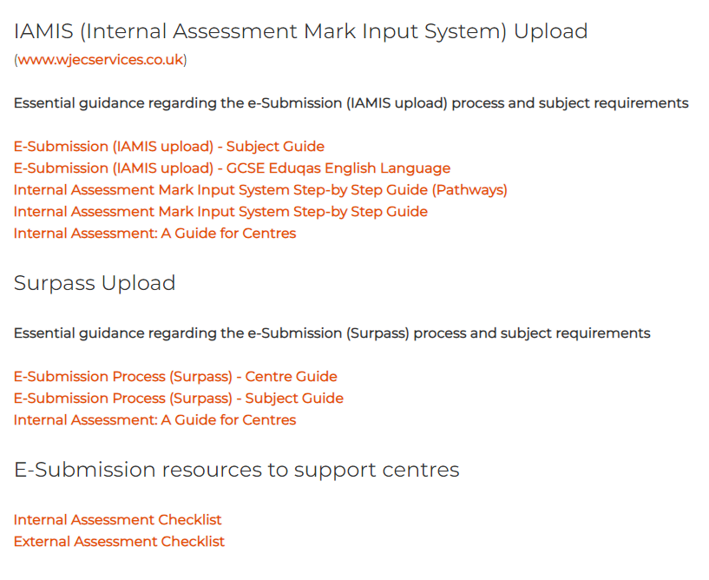
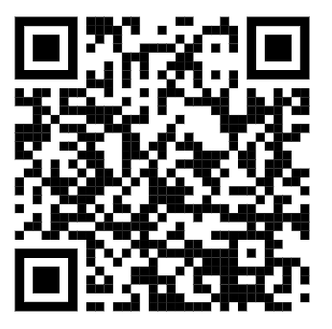
Key Guides
Everything you and your exams officer need to submit marks and upload work is available in our step-by-step guides on the E-Submission site:
E-Submissions Upload Webpage

Slide 5
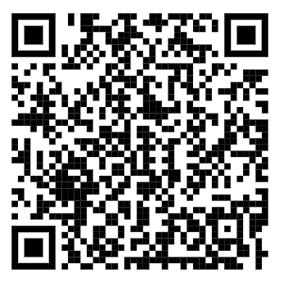
General Internal Assessment Guide
INTERNAL ASSESSMENT - A Guide for Centres

Slide 6
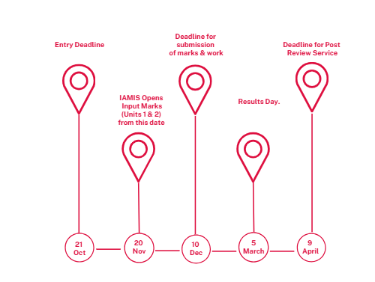
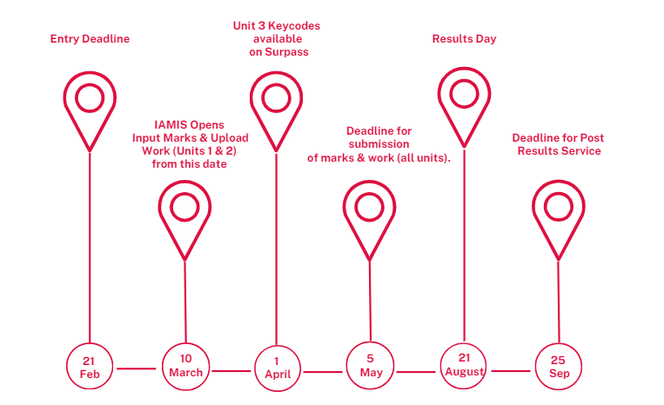
Timeline
Summer Series 2025
Winter Series 2026

Slide 7
Preparing Work for Upload
Preparing the Sample
Preparing evidence in two compressed zip files per candidate, per unit will reduce the number of files you will need to upload. There is an upload limit of 10 individual files per candidate.
Centres may find it useful to convert documents to PDFs before saving them. It ensures there are no formatting issues. Individual tasks can be combined into one PDF document. If you need to reduce or convert video files, then video guidance can be found here.
Candidate Identification
It is vital that all candidates within a group can be easily identified. Candidates should hold up their candidate number and introduce themselves slowly and clearly for the purpose of the visual recording. Performance candidates should also introduce the title of their chosen repertoire (Unit 1). This can be done before or after the actual performance but must be included with the evidence.

Slide 8
Preparing Work for Upload
Unit 1 | Unit 2 | Unit 3
Task 1a - Outline of findings of research. Task 1b - Discussion of how the research will influence performance. Task 2 - Rehearsal plan / schedule. Task 3 - Reflective journal and recordings of key points during the process. Task 4 - Recording of the final performance (3 and 6 minutes long per candidate). (NB: Music Technology can be submitted as an audio file, all other disciplines should be submitted as a video file). Task 5 - Evaluation. | Task 1 - Outline the components of the creative brief. Task 2 - Development Log. Task 3 - Presentation (3 - 10 mins). (NB - There is no requirement for performance candidates to include a separate presentation, although some candidates do like to briefly introduce their piece). Task 4 - Evaluation. | Task 1 - Factors influencing the creation of the proposed work. Task 2 - Plans and ideas. Task 3 - Timeline, personnel and resources. Task 4 - Marketing and public relations. Task 5 - Practical Examples. (NB - The evidence for this task will be assessed as part of the pitch, however please feel free to include separately in addition, particularly if you think something isn’t clear in the recording of the pitch). Task 6 - The pitch. Task 7 - Evaluation.

Slide 9
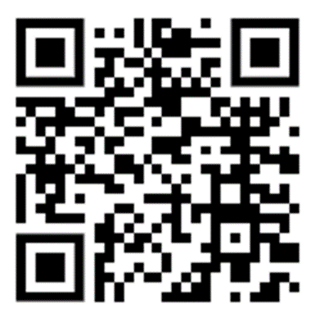
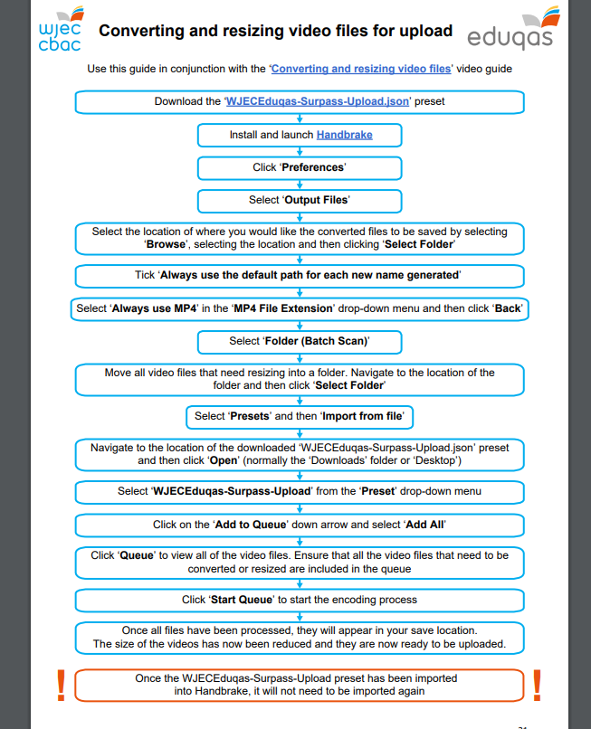
Converting and resizing video files
Appendix 1 in the Surpass centre guide
Eduqas video guide to converting and resizing video files

Slide 10
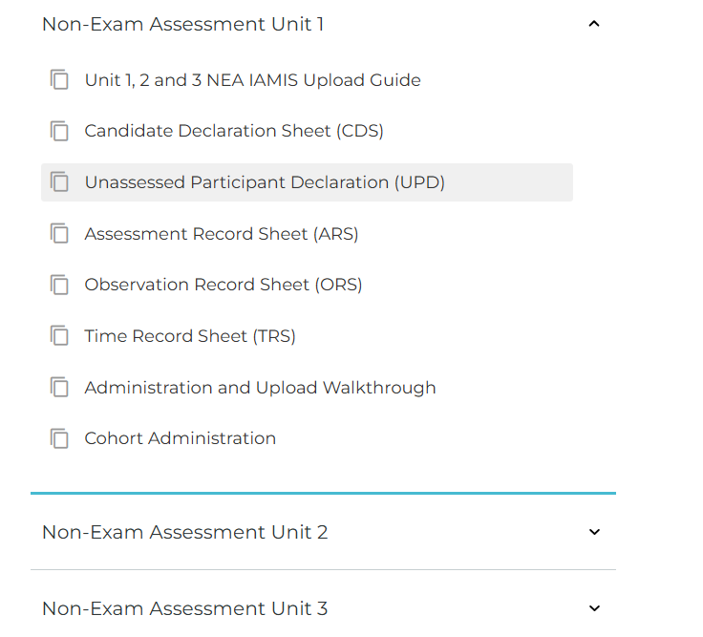
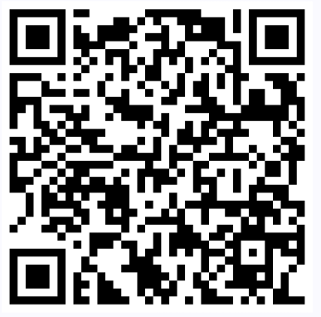
Where to Find the Administration Forms
Level 1 / 2 Performing Arts Subject Page – Key Documents

Slide 11
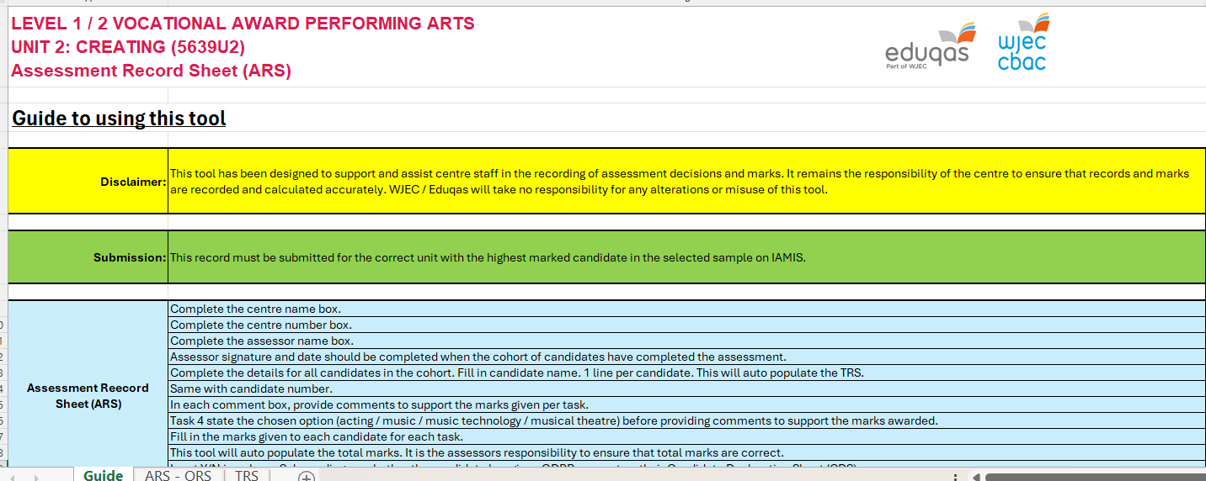
Completing the Administration Document (New Version)

Slide 12
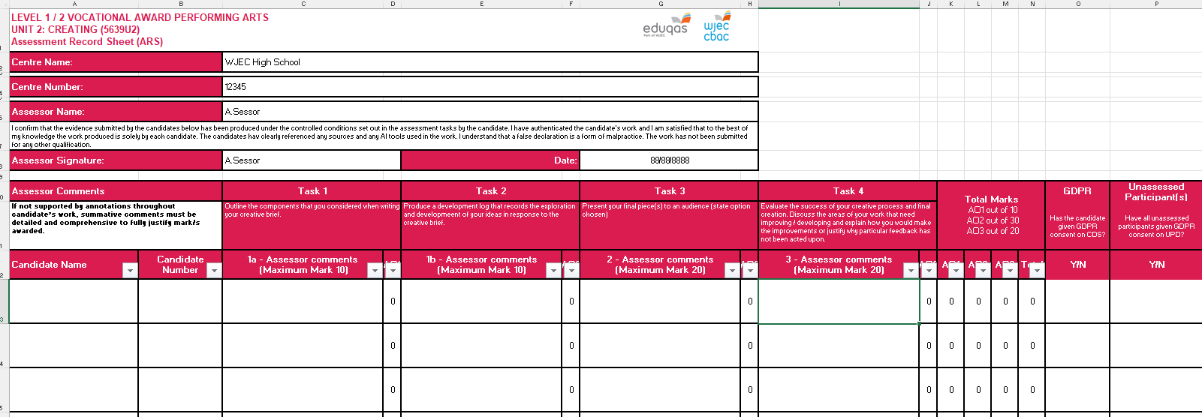
Completing the Administration Document (New Version) Assessment Record Sheet
Please ensure all information and marks are correct and match what has been inputted onto IAMIS.
The Assessment Record Sheet MUST be signed by the teacher, this can be typed.
Declaration now mentions Artificial Intelligence.

Slide 13
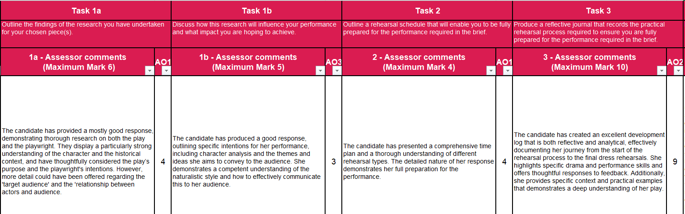
Example Assessment Record Sheet Comments

Slide 14
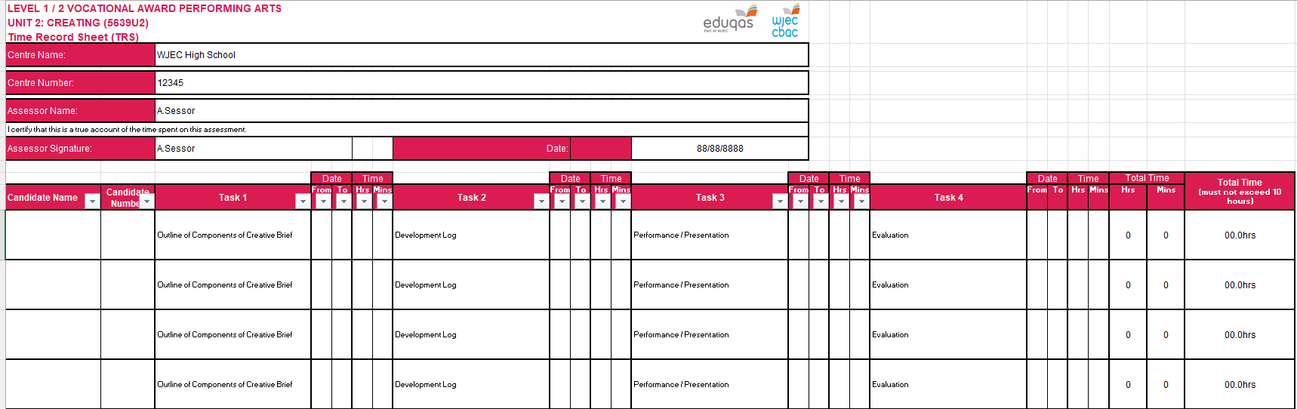
Completing the Administration Document (New Version) Time Record Sheet

Slide 15
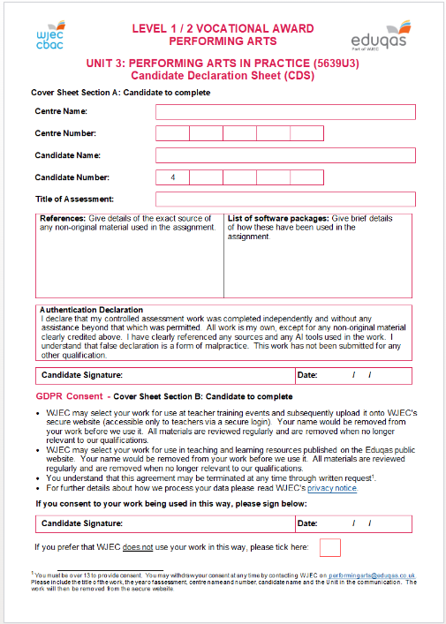
Completing the Candidate Declaration Sheets
Candidates MUST sign the declaration sheets to acknowledge that all work is their own.
These now include reference to the use of Artificial Intelligence.
Candidates do not need to list a full bibliography of research they have made use of unless they have directly used extracts within their own work.
In this form they are also acknowledging if they give permission for their work to be used for exemplar or CPD etc.
These should be completed for all candidates, not just those in the sample and retained by the centre.
Unit 1 Performing
Unit 2 Creating
Unit 3 Performing Arts in Practice

Slide 16
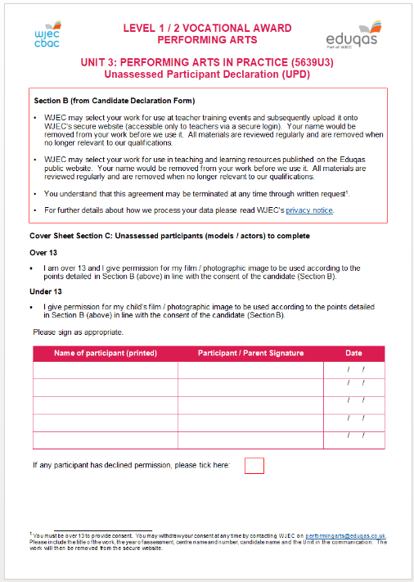
Completing the Unassessed Participant Declaration
Candidates are permitted to use unassessed participants within their practical work if they require. This can include a teacher if necessary.
Anyone in the evidence who is not being assessed will need to complete an Unassessed Participant Declaration to give consent for the work to be used by Eduqas.
As with the candidate declaration forms these should be completed for all candidates where required, not just those in the sample.
Unit 1 Performing
Unit 2 Creating
Unit 3 Performing Arts in Practice

Slide 17
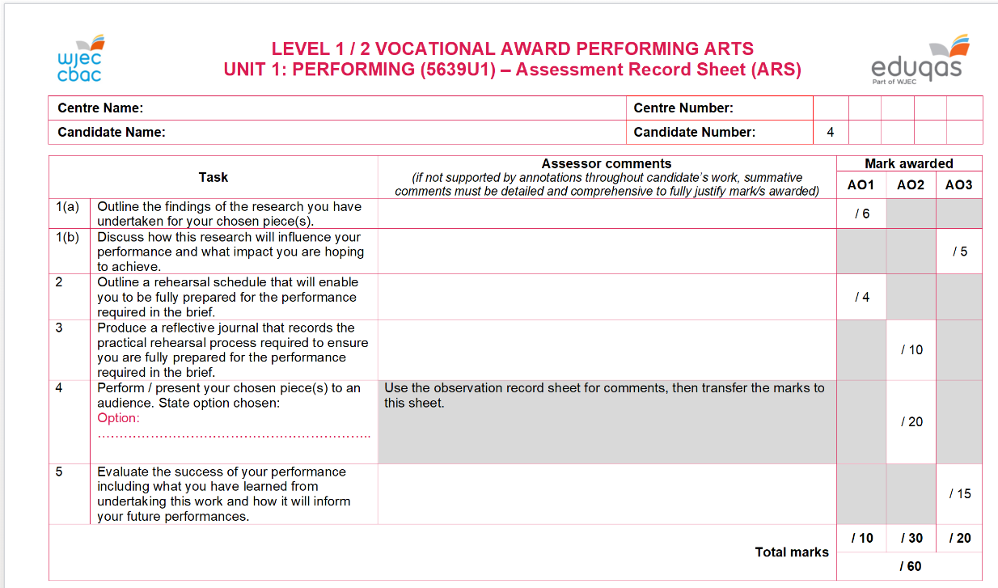
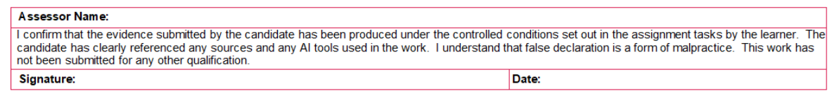
Completing the Assessment Record Sheet (Legacy)
Please ensure all information and marks are correct and match what has been inputted onto IAMIS.
The Assessment Record Sheet MUST be signed by the teacher.
Signatures can be typed.
Declaration now mentions Artificial Intelligence.
Unit 1 Performing
Unit 2 Creating

Slide 18
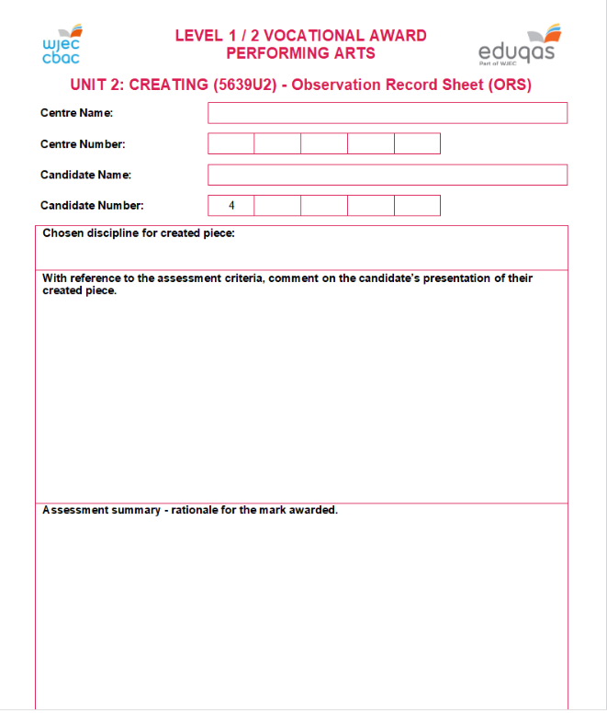
Completing the Observation Record Sheet (Legacy)
The Observation Record Sheet is your opportunity to highlight anything you feel is particularly relevant about the candidates’ performances.
Remember that you will have seen these live, your moderator will be watching the recorded evidence, so you may want to draw attention to anything you feel is not so obvious on the recording, subtle facial expression etc.
If candidates are working in groups this is also a useful place to highlight individual contributions, particularly in Unit 2 Creating.
Unit 1 Performing
Unit 2 Creating

Slide 19
Example Observation Record Sheet Comments
Box 1 - Comments which specifically focus on the assessment criteria (think of this as Stage 1 in the Assessor Pack – e.g. deciding on the band).
X has demonstrated excellent application of knowledge and understanding of the skills used to develop an original piece(s) of devised drama by displaying highly effective use of vocal skills to demonstrate character, for example use of tone and pause when communicating the higher status of the character.
X has demonstrated a good application of knowledge and understanding of the methods used to develop an original piece(s) of choreography by displaying effective knowledge of the choreographic processes during the presentation (e.g. through the use of canon - particularly evident at 1:30 of the recording).
Box 2 - Comments which specifically focus on the rationale for the actual mark (think of this as Stage 2 in the Assessor Pack – e.g. deciding on the mark.
A mark of 16 has been awarded for Task 3 as X has created an effective performance which is suitable for the brief and their overall intention of …………….
X meets all criteria in Band 4 with occasional evidence meeting Band 5 criteria (you might also want to highlight any other specific examples of supporting evidence here too – e.g. risk assessment, score, script etc, or highlight key moments within the presentation which you have not already referred to).
If you have multiple teachers delivering the specification, you might also want to reference internal standardisation here.

Slide 20
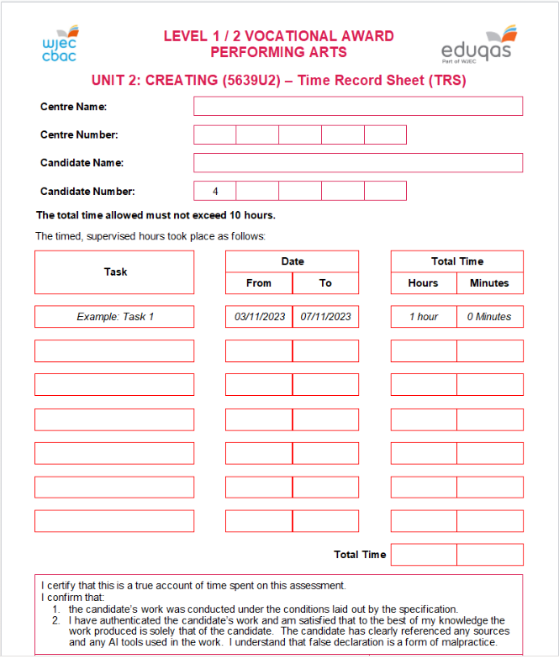
Completing the Time Record Sheet (Legacy)
For the Time Record Sheet you will record the total amount of controlled assessment time spent on each task.
If you have broken tasks up - for example the reflective / development logs, there is no need to list each date this took place and the individual length of time spent, the date window and the total time is what is required.
Remember that these also require a teacher signature. Electronic signatures are acceptable.
Unit 1 Performing
Unit 2 Creating
Unit 3 Performing Arts in Practice

Slide 21
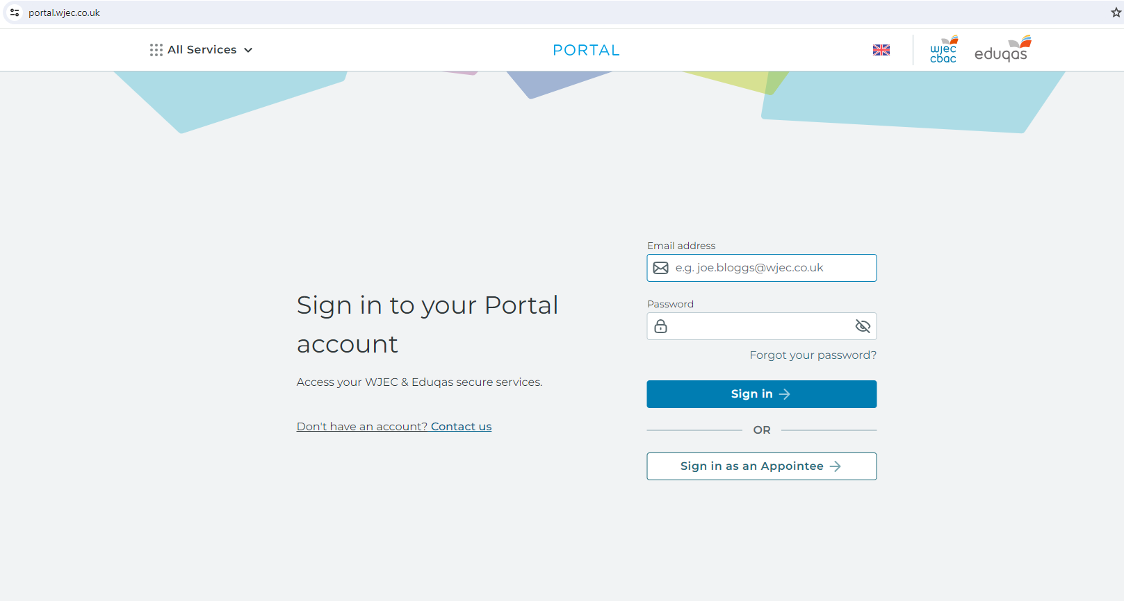
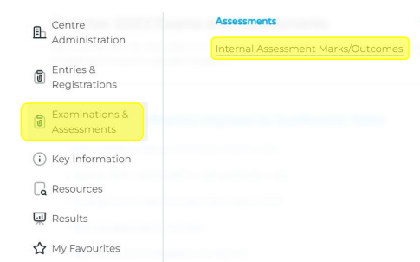
Inputting Marks on IAMIS (Units 1 and / or 2)
For internal assessment (Units 1 and / or 2) candidates must be informed of their centre assessed marks so that they may request a review of the centre’s marking before marks are submitted to Eduqas.
Before submitting marks, please ensure you have followed your centre’s internal appeals procedure.
You can access IAMIS (Internal Assessment Mark Input System) via WJEC Portal. Your exams officer will have the login details.

Slide 22
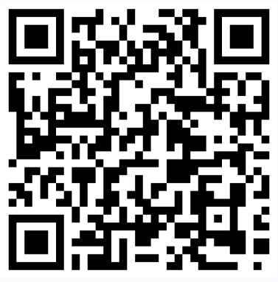
Inputting Marks on IAMIS (Units 1 and / or 2)
Internal Assessment Mark Input System.
IAMIS opens on 10th March (Summer) and 20th November (Winter).
Double-check that all marks are correct and match what is on the Assessment Record Sheet.
Once you have entered marks, the sample will be automatically generated, you will be able to see this if you refresh the page.
Step by Step Guide

Slide 23
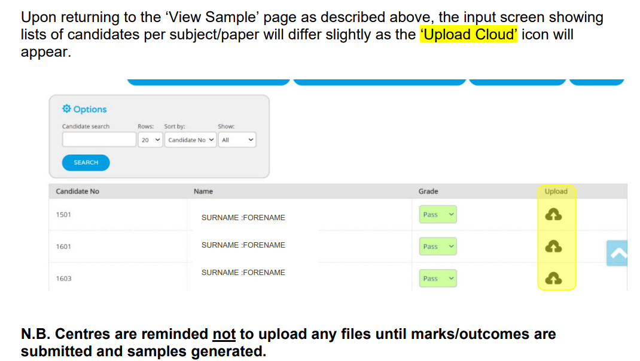
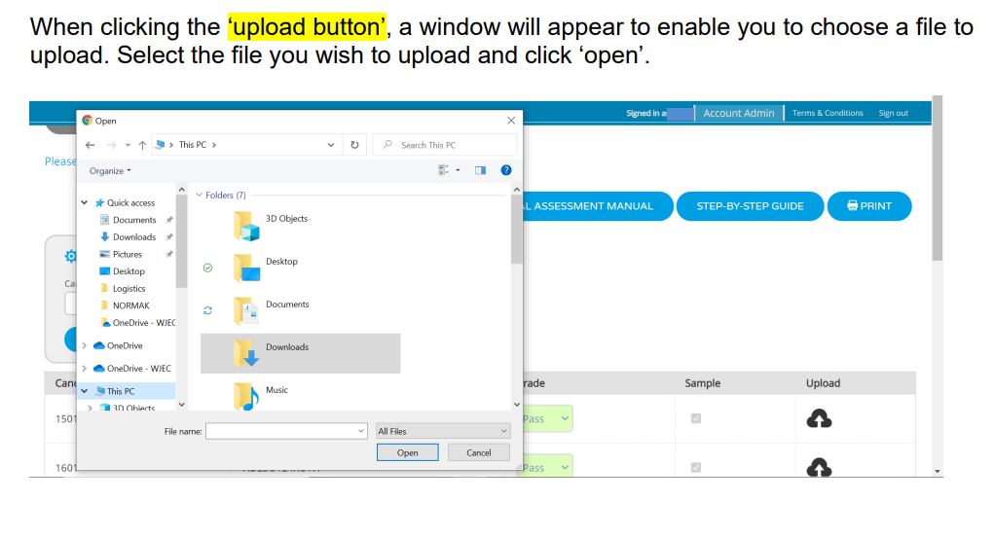
Uploading Work to IAMIS (Units 1 and / or 2)

Slide 24
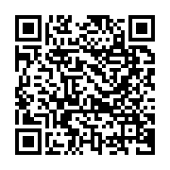
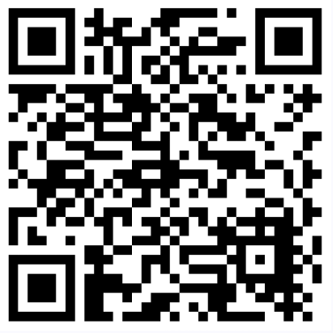
Surpass (Unit 3)
General information on the Level 1 / 2 Performing Arts upload process can be found in the Surpass Guide.
External Assessment (Unit 3) – Page 22.
Further specific guidance can be found in our subject specific guidance.

Slide 25
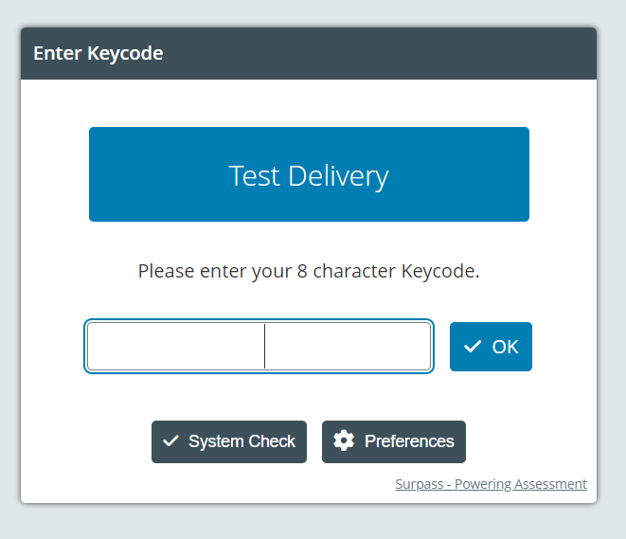

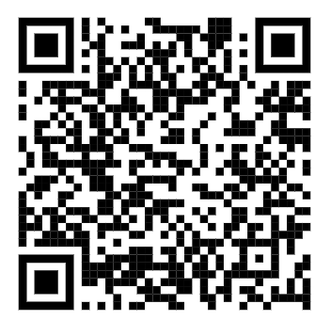
Surpass
Exams Officers
Surpass System
(to access keycodes)
Teachers
Surpass Upload Portal
(to upload work)
Surpass Centre Guide

Slide 26
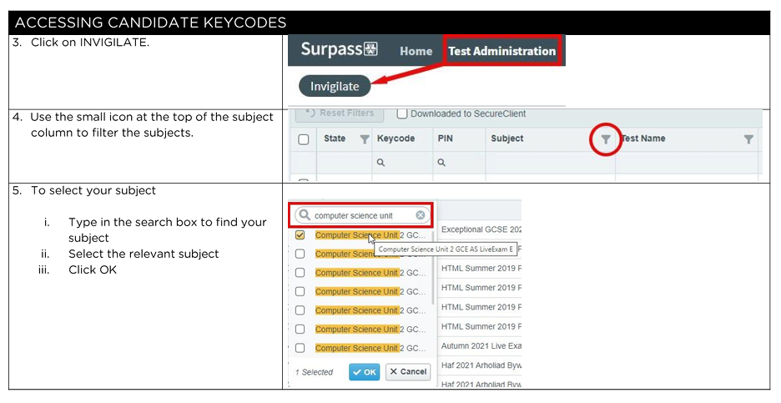
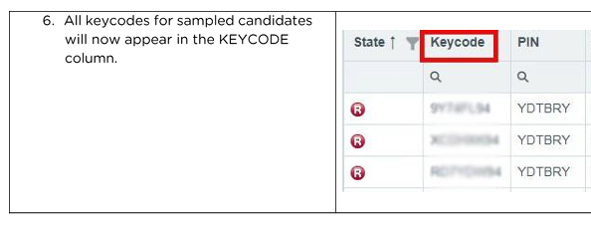
Keycodes

Slide 27
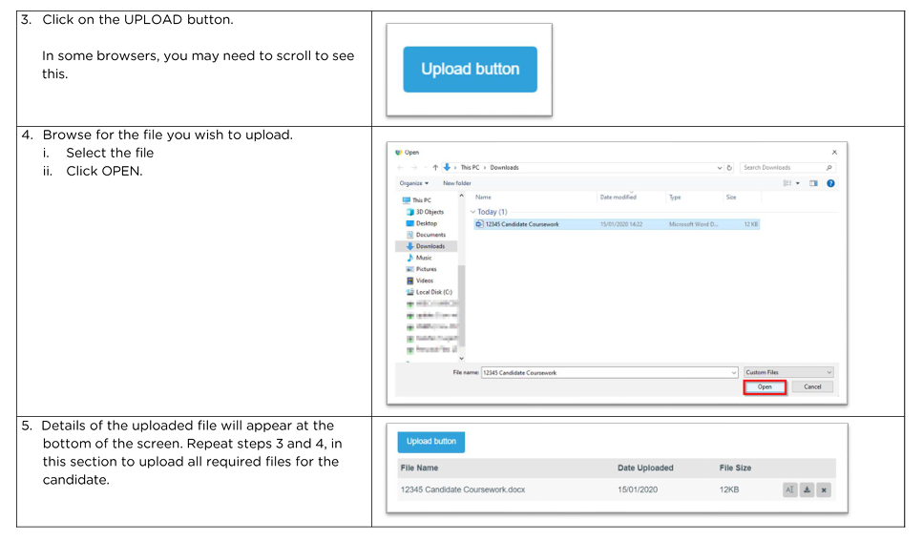
Uploading Work to Surpass

Slide 28
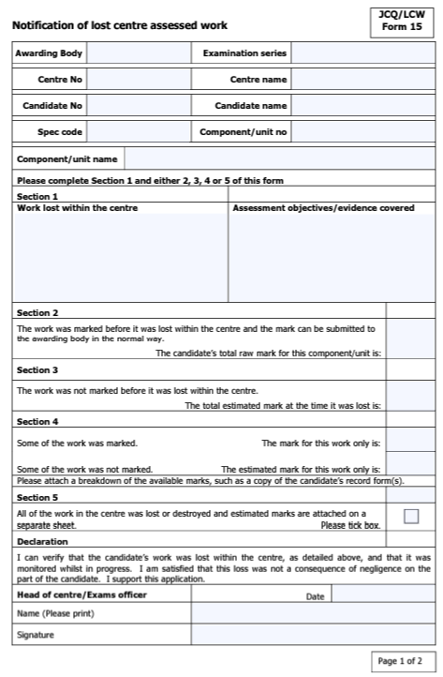
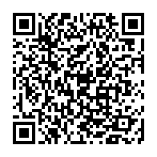
Lost Work
If work has been lost through no fault of the candidate’s own, you must submit a JCQ Form 15 and send it to:
specialrequirements@wjec.co.uk
Form 15 – Notification of Lost Centre Assessed Work

Slide 29
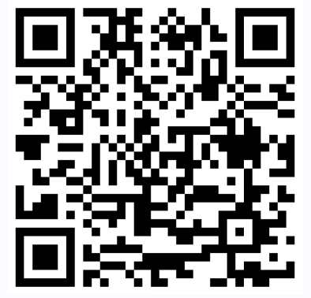
Special Consideration
If you have a candidate whose performance may have been impacted by circumstances beyond their control (e.g. illness or injury) then they may be entitled to special consideration.
You will need to complete a JCQ Form 10 and email this to specialrequirements@wjec.co.uk
Special Requirements (eduqas.co.uk)

Slide 30
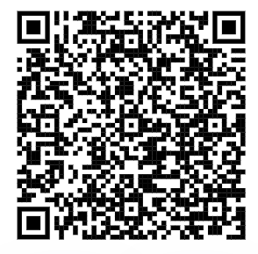
Malpractice / Plagiarism
If the candidate has not yet signed the declaration form and the work has not been uploaded with the cover sheet, malpractice / plagiarism should be dealt with internally in your centre.
If the cover sheet is signed and all work uploaded, then any malpractice / plagiarism cases will be investigated by our malpractice team.
The full malpractice / plagiarism guide can be found here.

Slide 31
What Happens Next?
The external moderation process
Requesting additional samples
Unsigned declarations
Scaling
Moderator report
Principal Examiners’ Report

Slide 32
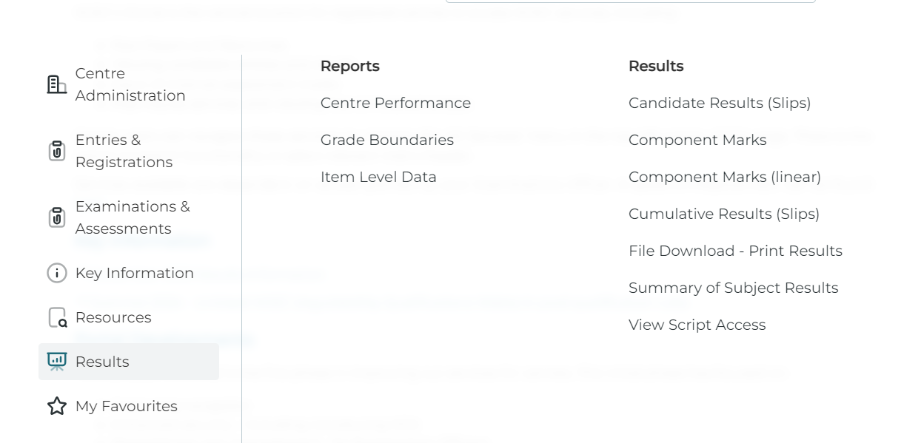
Results Day
You can access your results and your moderation report for Unit 1 and / or 2 via Portal on results day.
We encourage you to read your report carefully.
It will indicate if your centre has been scaled and comment on how work was assessed.
You will also be able to access the grade boundaries for each unit.
Portal
All Services
Internal Assessment Mark/Outcomes
Series Table
Examinations and Assessments

Slide 33
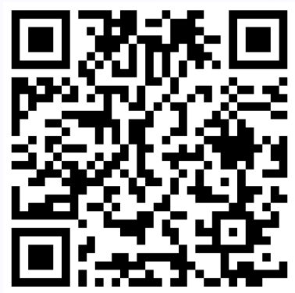
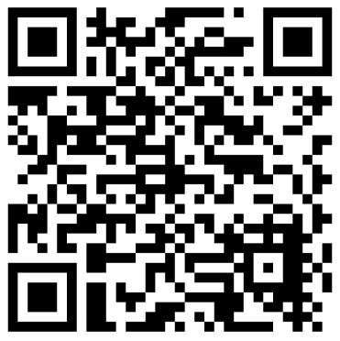
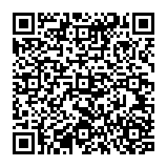
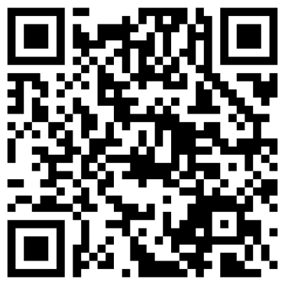
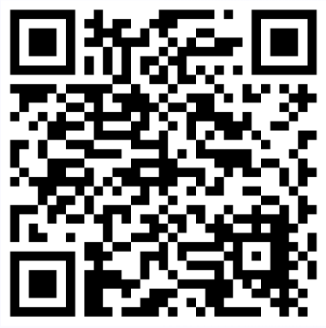
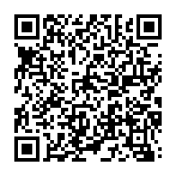
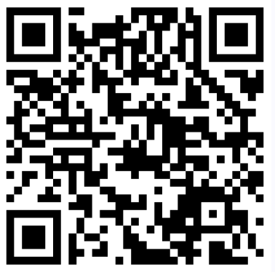
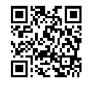
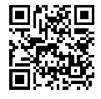
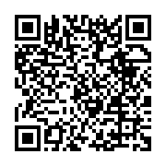
Level 1 / 2 Performing Arts
Key Information and Useful Guides
UMS
Key Dates
Specification
Assessment
CPD
Briefs Released
Unit 2 – 1st September
Unit 3 – 1st September
January Series
(Units 1 and / or 2)
Entry Deadline – 21st October
Submission – 10th December
June Series (All Units)
Entry Deadline – 21st February
Submission – 5th May
 | Unit 1 | Unit 2 | Unit 3 | Overall
L1P | 18 | 18 | 24 | 60
L1M | 27 | 27 | 36 | 90
L1D | 36 | 36 | 48 | 120
L1D* | 45 | 45 | 60 | 150
L2P | 54 | 54 | 72 | 180
L2M | 63 | 63 | 84 | 210
L2D | 72 | 72 | 96 | 240
L2D* | 81 | 81 | 108 | 270
Max | 90 | 90 | 120 | 300
Delivery Guide
Surpass
Newsletters
FAQs
Access to Brief
Exemplar
Contact Us
Examiners’ Reports

Slide 34



Subject Officer: Victoria Husband
Subject Support Officer: Mike Saltmarsh
Thank You
performingarts@eduqas.co.uk 029 2026 5470
e-submission@eduqas.co.uk 029 2240 4310

