Slide 1
GCSE Media Studies: Component 3: How to complete the Coversheet

Slide 2
Some general points:
AI disclaimer for 2024
PDF and Word versions available
Completed digitally or by hand
Notes:
The coversheet has been updated for first submission in 2024 to include a disclaimer about the use of AI and this is available for download from the Eduqas website. However, we will accept the old version of the coversheet in 2024.
We also have a PDF version of the coversheet that is also available from the website. This has been designed to be easier to use, to complete accurately, and to submit. For 2024 submission, centres are permitted to use either the PDF or the Word version.
It’s important to remember that the form can be completed digitally or by hand. We can accept digital (typed) signatures from candidates, teachers and unassessed participants.
If you do prefer to complete the form by hand, the PDF or the Word version can be printed out and completed, then must be scanned in as one document for submission.

Slide 3
Aims
To help teachers feel confident about how to complete the Coversheet
To support teachers in guiding learners to complete their sections with the correct information
Notes:
The aim of this walkthrough is to help centres feel confident about how to complete the coversheet correctly and to support teachers in guiding candidates through completing their sections throughout the Component 3 process. There will also be some general guidance about the administration of the Coversheet throughout the walkthrough.

Slide 4
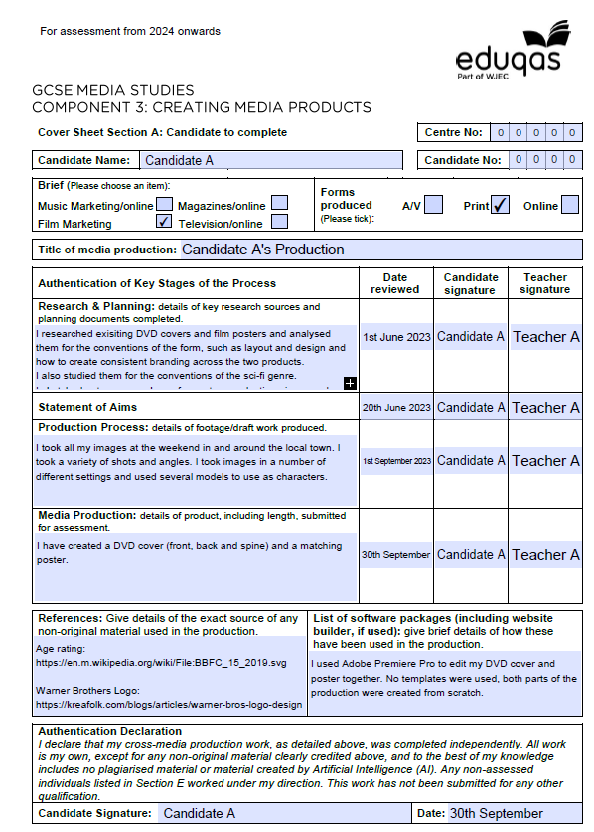
Coversheet: Section A
Notes:
This is Section A of the Coversheet and this section should be completed by the candidates. This should be introduced to candidates at the start of the Component 3 unit after they have decided on which brief they are going to complete. Candidates should complete their personal details at the top of the page and select which brief and forms they have chosen.
If you are completing the Word version of this form, this information will need to be input on each page. If you are using the PDF version, filling it in in Section A will autocomplete the information in the other sections.

Slide 5
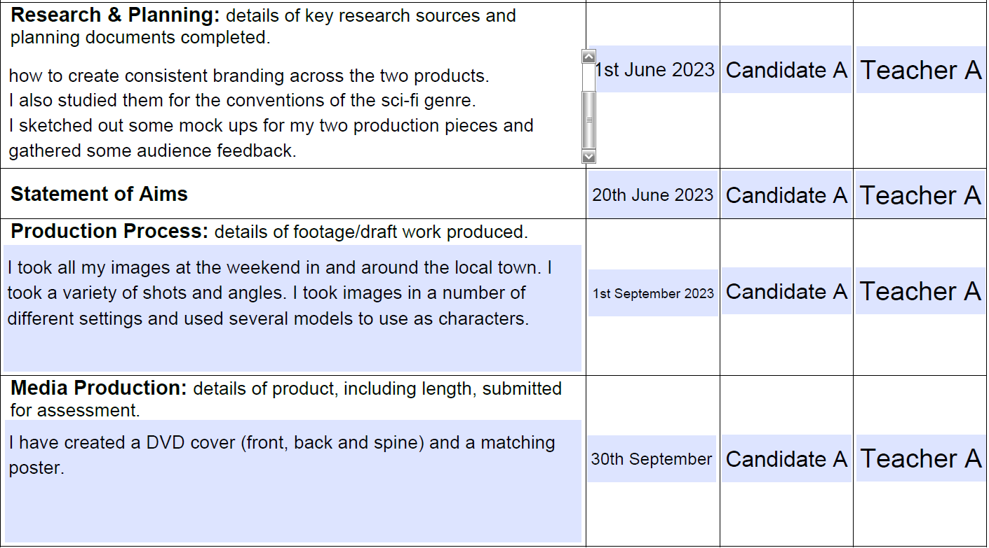
Coversheet: Section A
Notes:
This section should track the candidate’s progression through the process of their NEA production, providing a signature and date at each milestone stage. Where the candidate is required to write notes, these can be written in note form, bullet points, or in full sentences. On the PDF version of the form, a blue box indicates which sections should be completed.
If you’re using the PDF version, all text boxes will ‘expand’ to allow more characters than fit in the box as it looks; the box will scroll to allow sight of all of the writing.
Once the candidate has completed research and planning, they should re-visit this document and complete the ‘Research & Planning’ section giving a brief overview as to what they have done in this stage, this should be no more than 100 words This should then be dated and signed by both the candidate and the teacher.
The statement of aims should be completed at this point in the process and this date can be added and signed off by the candidate and the teacher. There is no requirement to add comments related to the Statement of Aims.
At this stage, the statement should be added to Section B of the Coversheet.
The ‘Production Process’ section should be completed after the production. Candidates should give a brief overview of the production process and explain any details of footage/image production and any draft work produced. This should be no longer than 100 words. Once this stage is complete, it should be dated and signed off by the candidate and the teacher.
The final section called ‘Media Production’ should be completed right at the end of the process when the work is submitted. This should specify what the candidate has produced for submission for the final assessment. Again, this needs to be signed off by the candidate and the teacher.

Slide 6
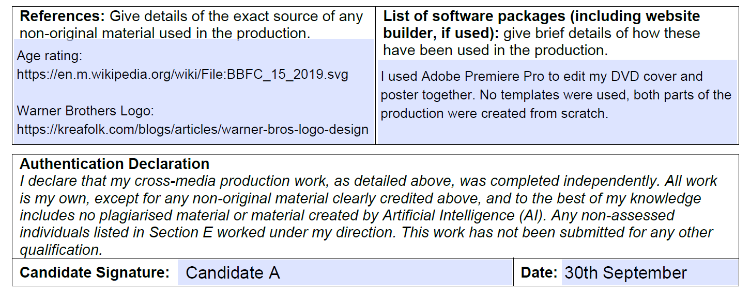
Coversheet: Section A
Notes:
At the bottom of section A, candidates are required to put references for any non-original material. It is often useful to do this throughout the process as and when these may be used. This might include age rating logos, for example.
There is also a space for software to be listed. The candidate must then read and sign the Authentication Declaration and date.

Slide 7
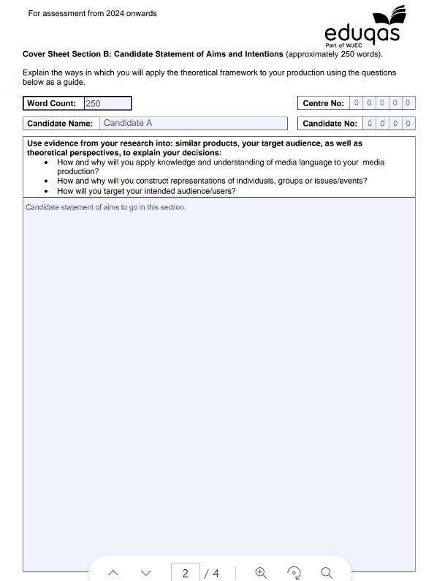
Coversheet: Section B
Notes:
Section B provides a space for the Statement of Aims to be dropped in.
Candidates must also complete the word count box.

Slide 8
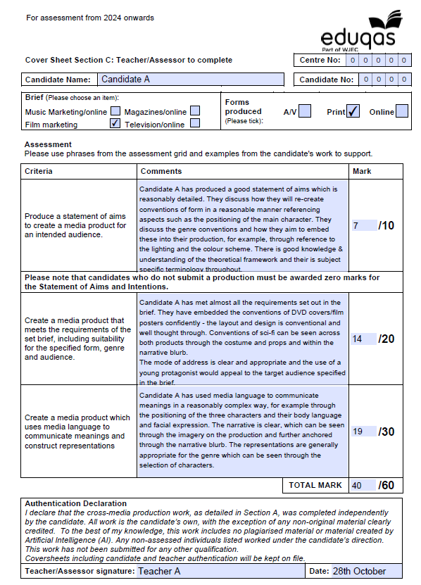
Coversheet: Section C
Notes:
This is Section C of the Coversheet and this section should be completed by the Teacher/Assessor. On the PDF version of the form, the candidate information should have pre-populated so does not need completing again.
The comments provided in this section are incredibly important in helping moderators to understand how and why marks have been awarded. Best practice is to use language from the correct band of the assessment grid and make specific reference to the candidate’s work that evidences the mark awarded.

Slide 9
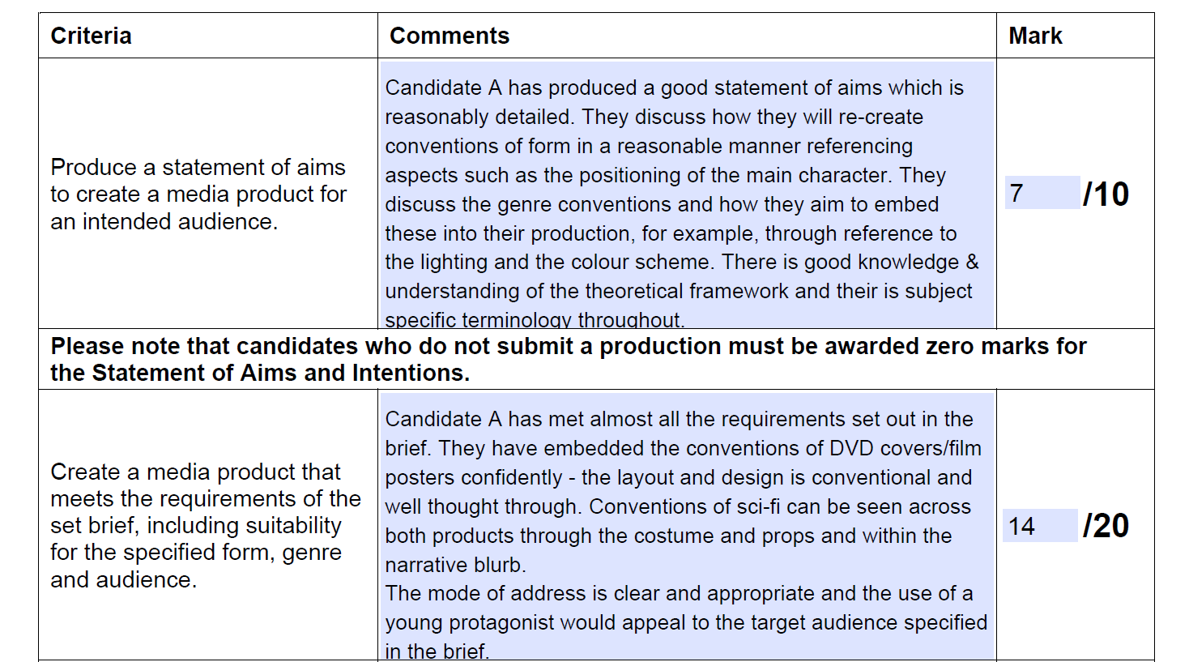
Coversheet: Section C
Notes:
The first box in this Section is related to the Statement of Aims and is out of 10 marks. Within the comments section it is incredibly useful to give an overview about how the mark given can be justified. As you can see in the exemplar, language is taken directly from the correct band in the assessment grid and specific examples from the candidate’s work is given.
There is a reminder written into the Coversheet about candidates who do not submit a production. In these cases, the Statement of Aims must be awarded zero.

Slide 10
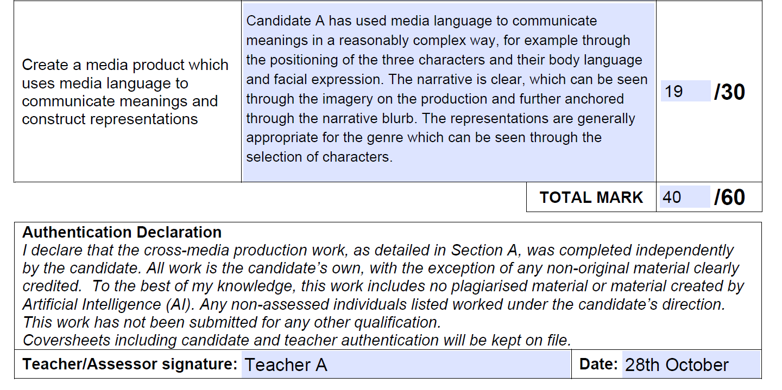
Coversheet: Section C
Notes:
The third box refers to column three on the assessment grids and is out of 30 marks. This section is concerned with how well the candidate has used media language to communicate meanings and construct representations. As demonstrated in the exemplar, the descriptors from the assessment grid have been used to justify the candidate mark. Some examples have also been pulled out to highlight where the candidate has met the requirements for that mark band.
On the PDF version, completing the marks for each section will give an accurate total for the folder. If you’re using the Word version, it is imperative that you add the marks accurately to give the total. The Teacher/Assessor must then sign the Authentication Declaration and date.

Slide 11
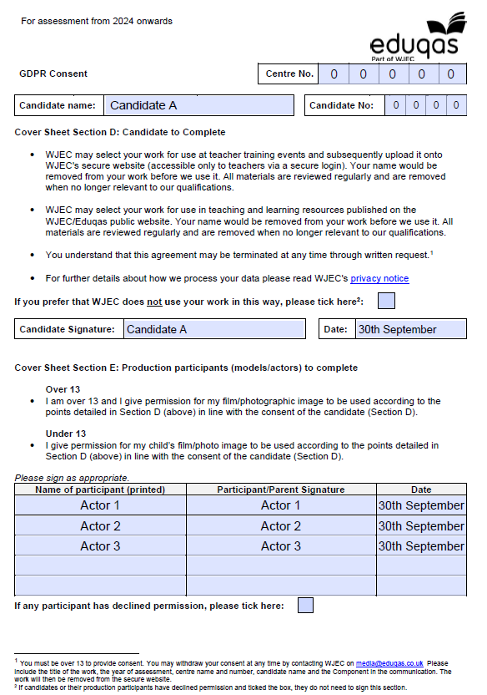
Coversheet: Section D&E
Notes:
Section D is the GDPR disclosure for the candidate and any unassessed participants whose face or voice feature in the candidate’s work.
Candidates should read and sign this section. If this section is signed, it means that Eduqas are permitted to use the work as exemplar in CPD events and as exemplar on the secure website, which is incredibly useful for teachers and centres.
If the learner does not want their work to be used in this way, they can tick the box.
In Section E, unassessed participants must also sign to say that they are happy for the work to be used. If they prefer that the work is not used in this way, they can tick the box below the table.

Slide 12
Uploading the work:
Uploaded in original form
Uploaded as one document
Notes:
When uploading the document, it must be uploaded as one file, and must be uploaded as a Word document if you are using the Word version, and a PDF if you are using the PDF version. This will make sure that moderators are able to see all of the information included .

Slide 13
Thank you! Contact: media@eduqas.co.uk

