Slide 1
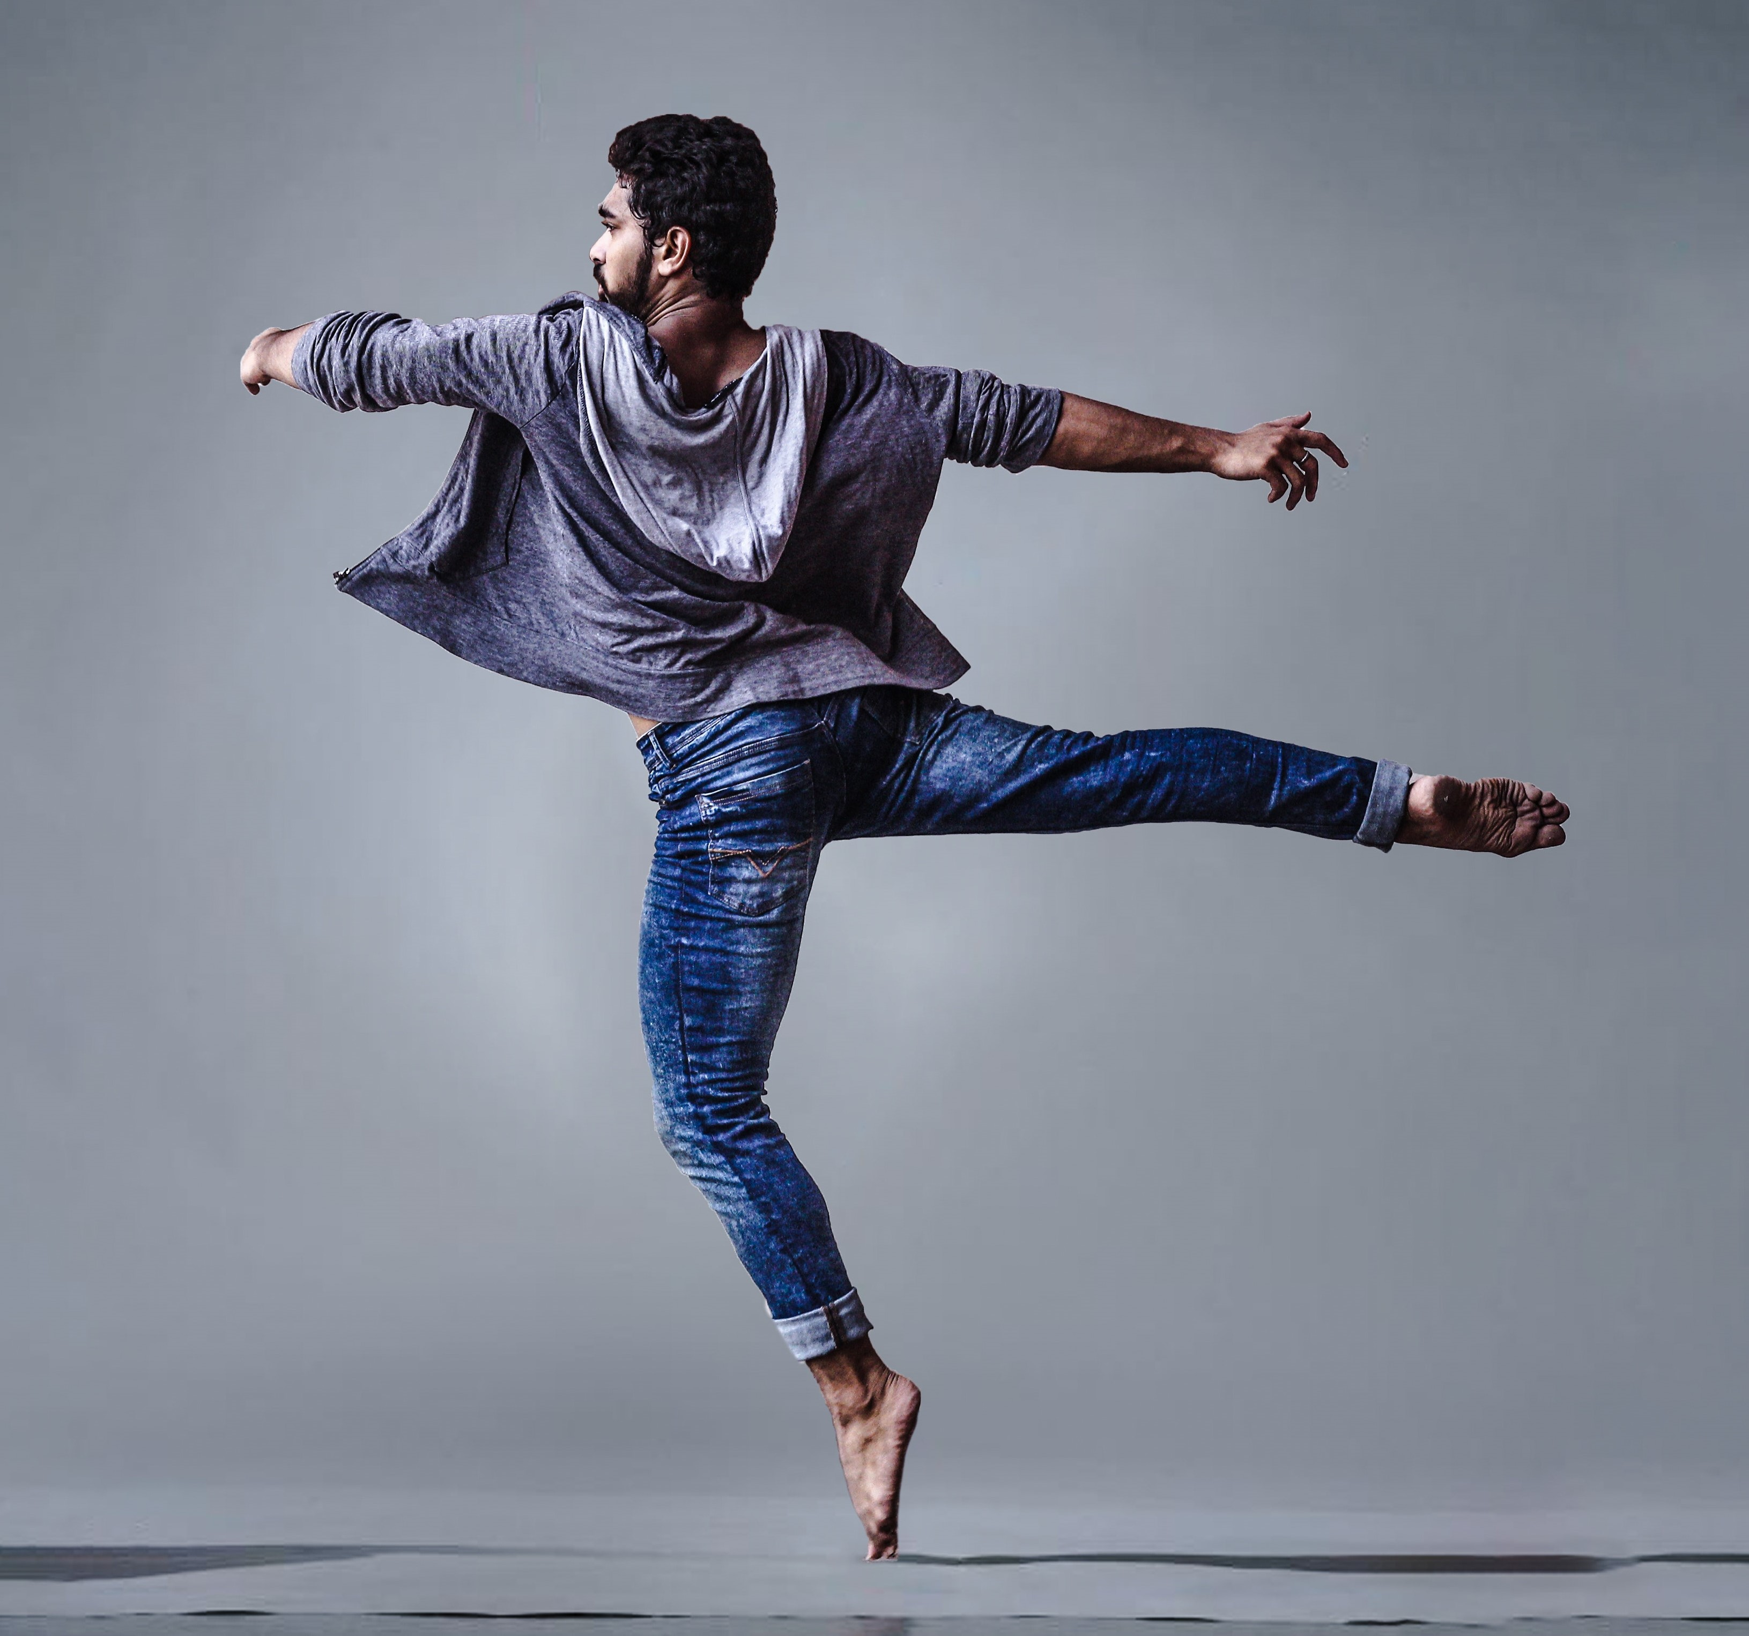
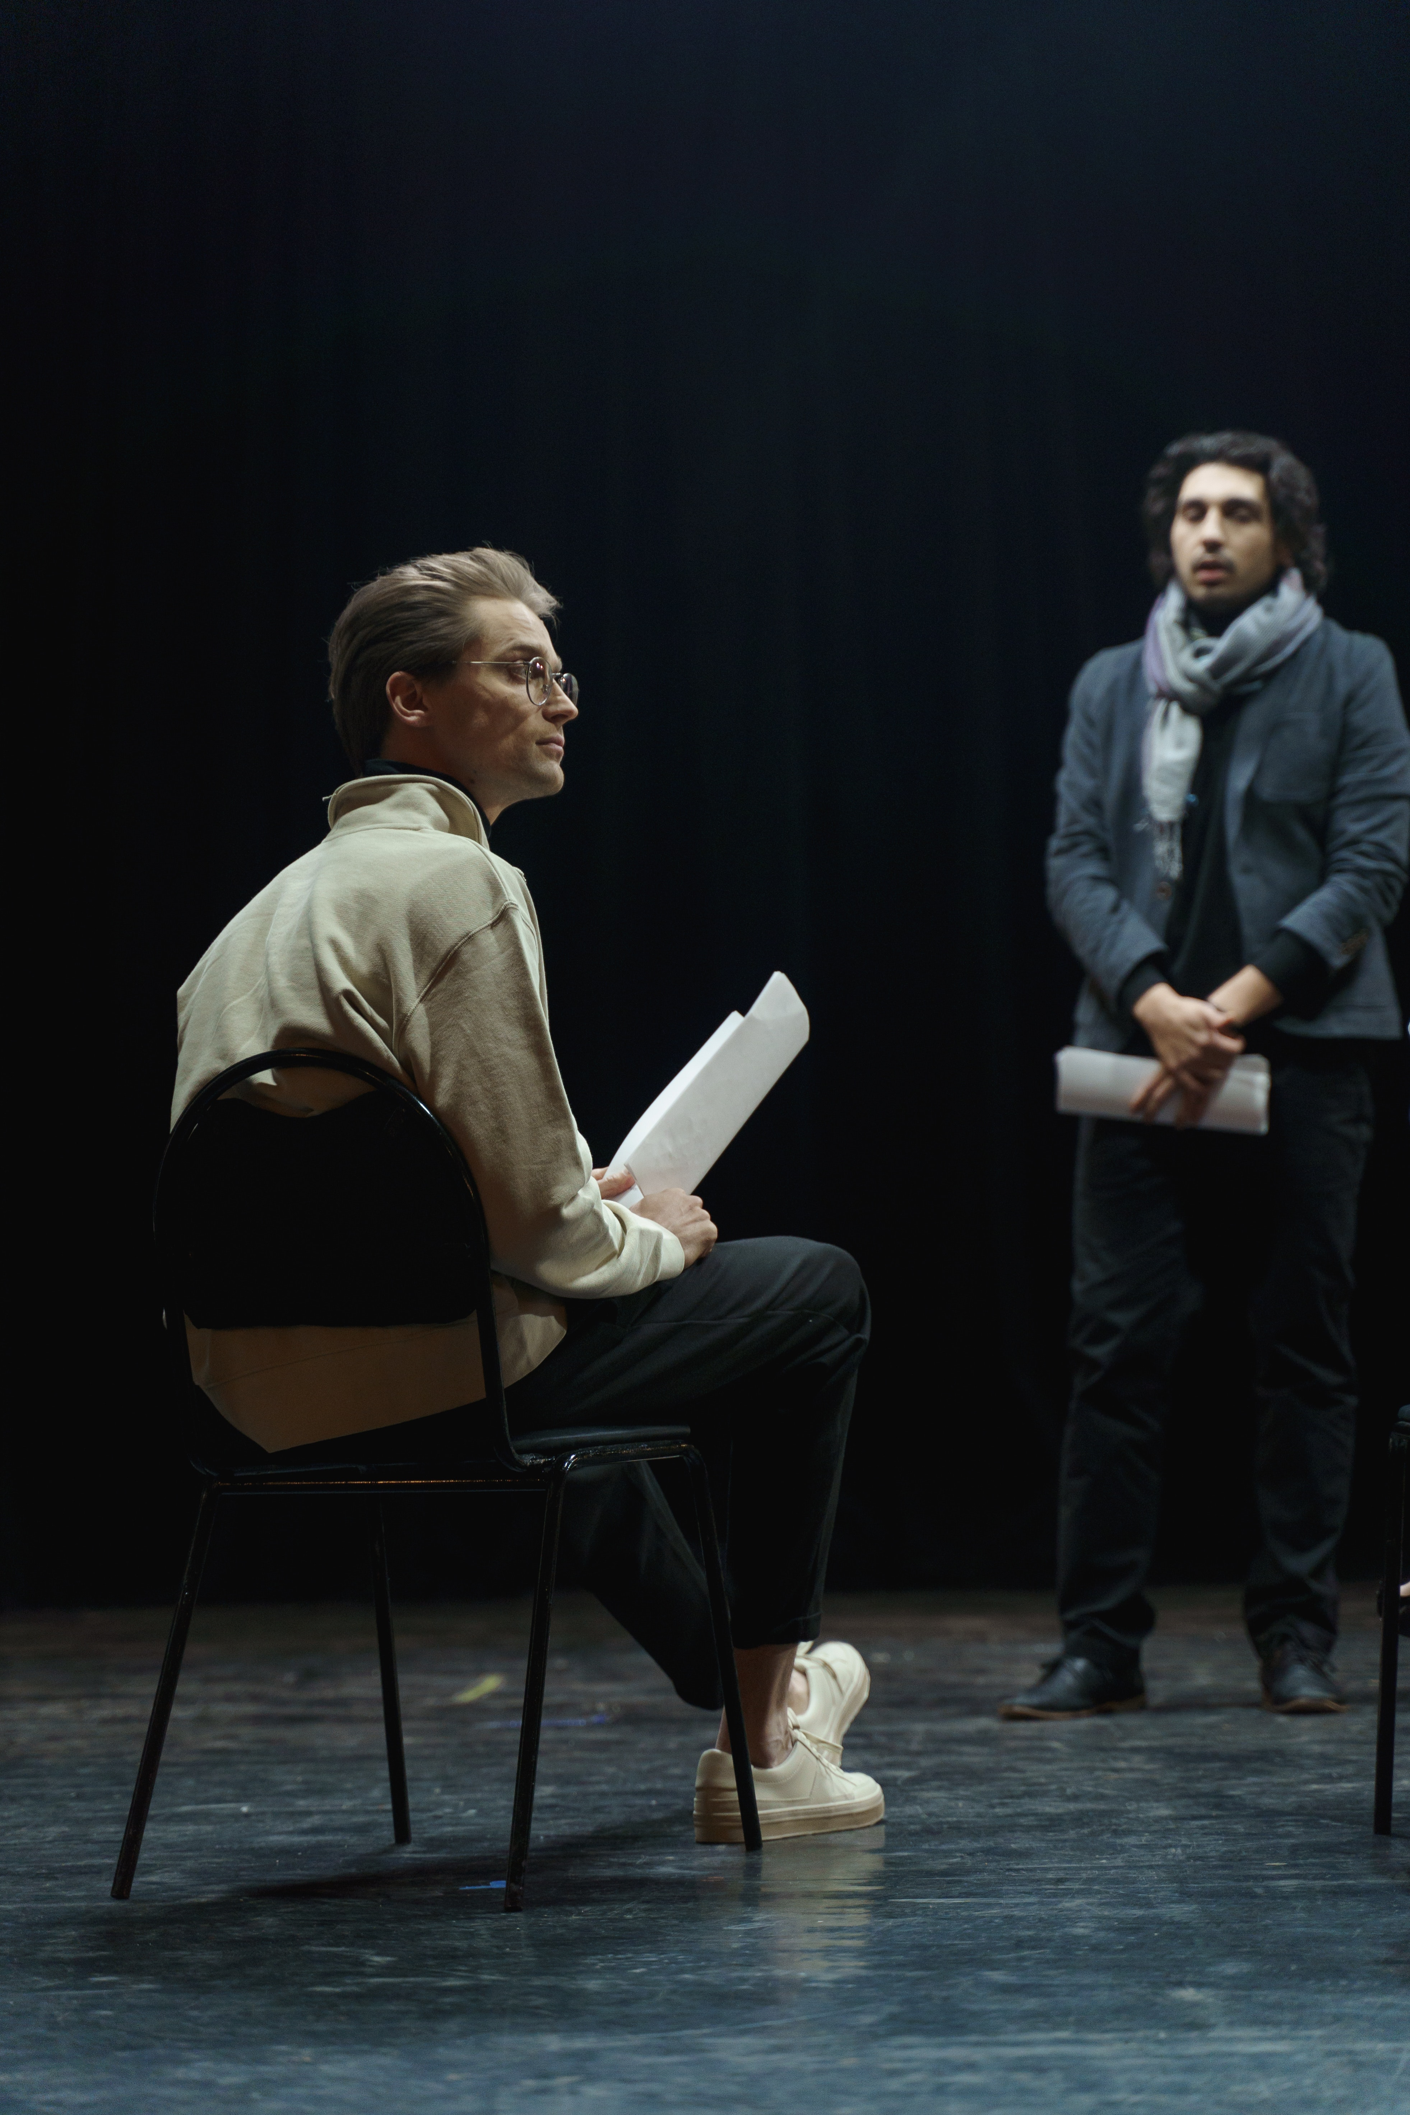
LEVEL 1/2 PERFORMING ARTS (TECHNICAL AWARD)
Unit 1 Performing
Industry Insights Series

Slide 2
Episode 1 - Musical Theatre
Isabel Canning
Currently on tour in Sister Act The Musical
Sister Mary Patrick
Training: Mountview
Theatre credits include:
Ethel / Ensemble in At Last It’s Summer (London Palladium)
Tessie / 1st cover Martha / 2nd cover Betty in White Christmas (UK Tour)
Walking cover Baker’s Wife in Into The Woods (Bath Theatre Royal)
Ensemble in The Witches of Eastwick (Sondheim Theatre)
Emma / cover Fanny Brice in Funny Girl (Theatre Marigny, Paris)
Click on image to play

Slide 3
Unit 1 Performing
Unit 1 provides learners with a holistic knowledge and understanding of the skills and techniques needed to reproduce an existing piece of professional / published work.
This unit can be completed through any one of the following disciplines:
Drama
Music
Music Technology
Musical Theatre (candidates will be required to demonstrate their skills in at least two out of the three disciplines of singing, dancing and acting).
6 Tasks
Application of Application of Research &
Research
Application of Research & Aims
Rehearsal Schedule
Reflective Journal
Performance (3-6 minutes)
Evaluation

