Slide 1
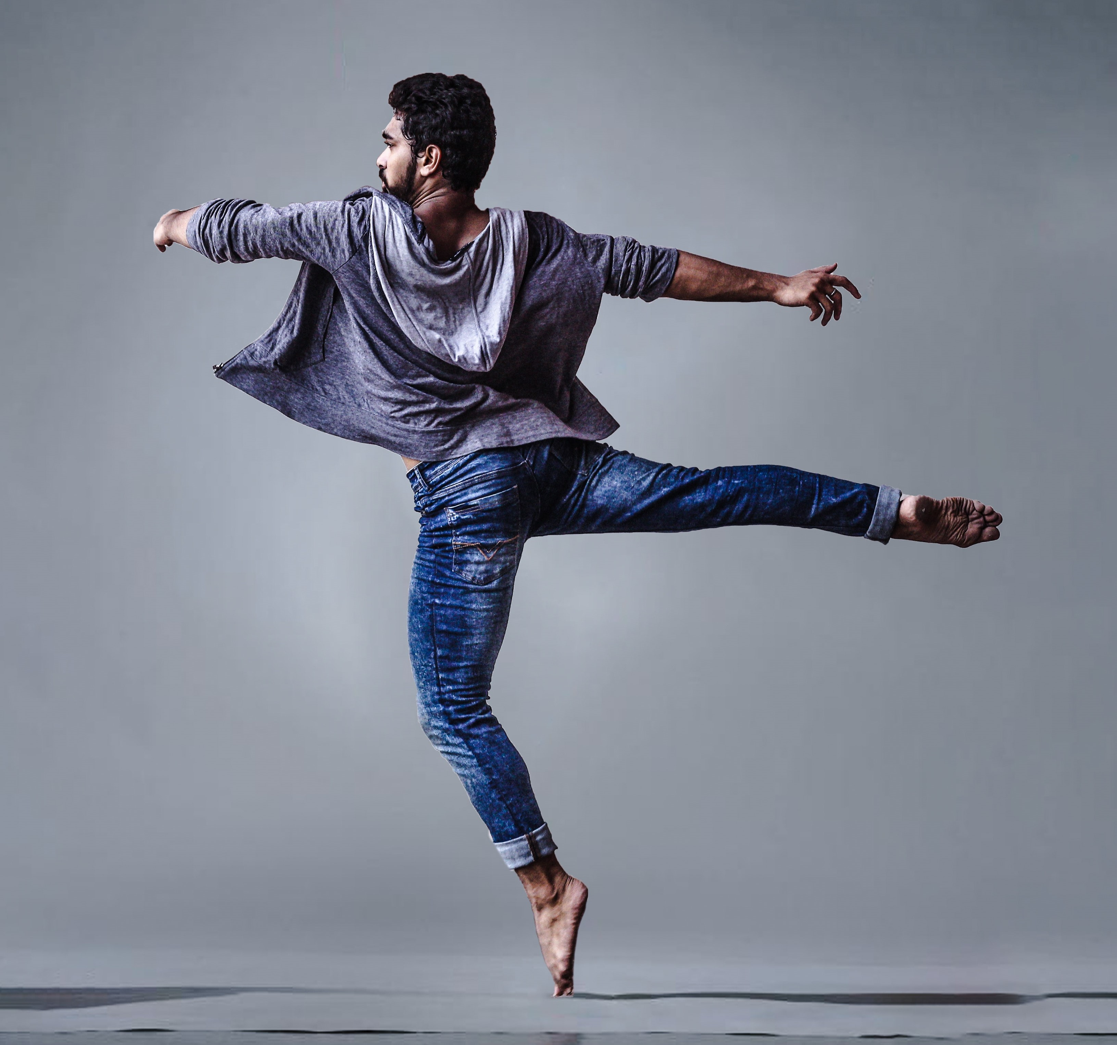
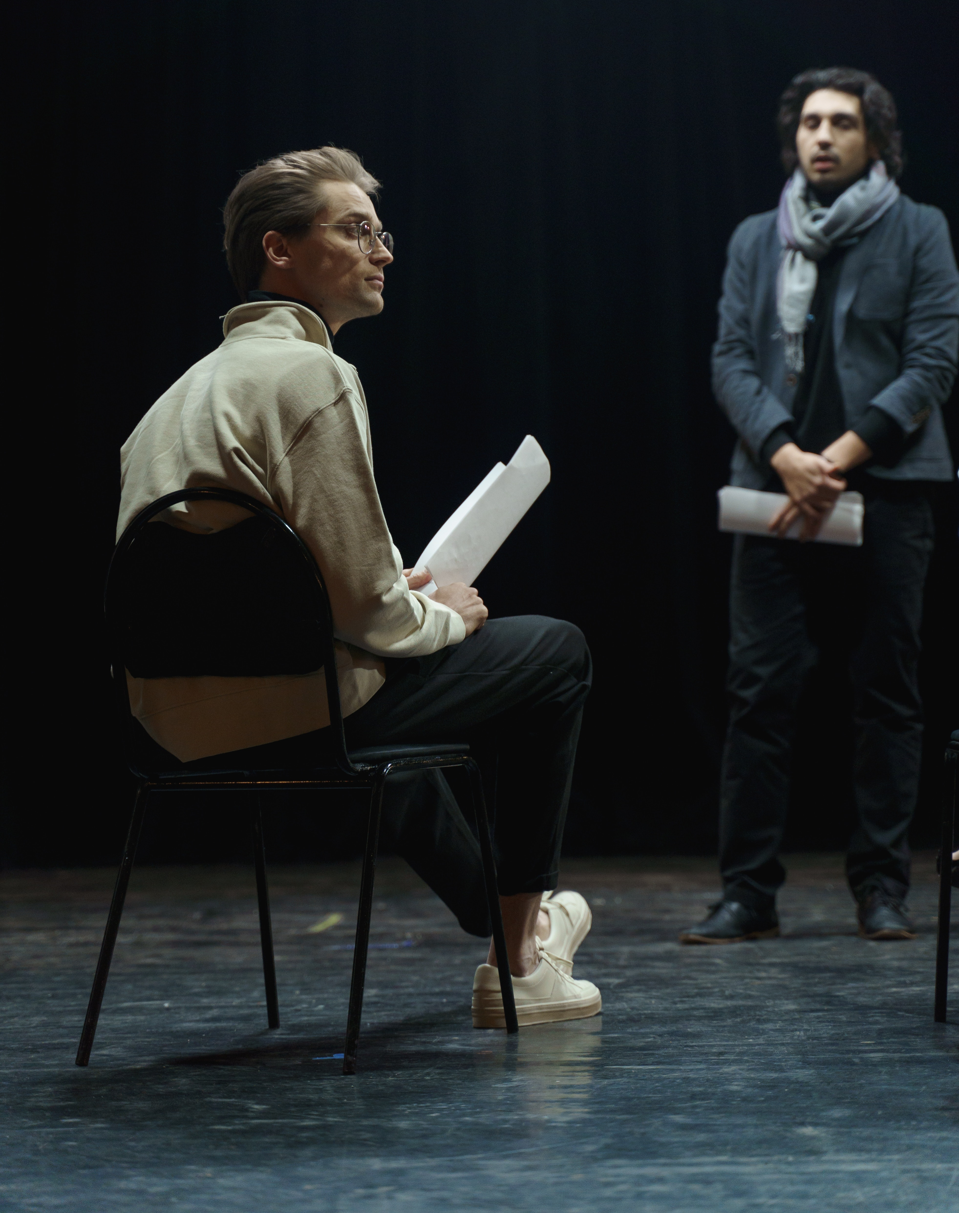
LEVEL 1 / 2 PERFORMING ARTS (TECHNICAL AWARD)

Slide 2
SUMMARY OF ASSESSMENT
Unit 1
Unit 2
Unit 3
Performing 30%
Creating 30%
Performing Arts in Practice 40%
Internal - Portfolio
Internal - Portfolio
External - Portfolio
36 GLH (10 hrs)
36 GLH (10 hrs)
48 GLH (20 hrs)
Research and rehearse
Perform repertoire
Review and reflect
Explore and develop
Create and perform original work
Review, reflect, refine
Plan a performance from a brief
Promote and pitch
Evaluate and reflect

Slide 3
Unit 1 Performing
Unit 1 provides learners with a holistic knowledge and understanding of the skills and techniques needed to reproduce an existing piece of professional / published work.
This unit can be completed through any one of the following disciplines:
Drama
Music
Music Technology
Musical Theatre (candidates will be required to demonstrate their skills in at least two out of the three disciplines of singing, dancing and acting).
6 Tasks
Application of Application of Research &
Research
Application of Research and Aims
Rehearsal Schedule
Reflective Journal
Performance (3-6 minutes)
Evaluation

Slide 4
Unit 2 Creating
Unit 2 provides learners with the opportunity to gain, develop and demonstrate knowledge and understanding of the skills and techniques needed to create and refine original work in the performing arts.
Performance disciplines
• Devised drama
• Choreography
• Composition
• Composition using technology
:
4 Tasks
Application of Application of Research &
Components of a Creative Brief
Development Log
Production disciplines
• Costume design (for at least two characters)
• Lighting design
• Sound design
• Make-up and hair design (for at least two characters)
• Set design.
Presentation (3-10 minutes)
Evaluation

Slide 5
Unit 3 Performing Arts in Practice
Unit 3 introduces learners to areas of the performing arts that need to be considered when responding to an industry commission.
Learners will need to draw on their knowledge of the skills and techniques needed to reproduce an existing piece of professional / published work from Unit 1 alongside their knowledge and understanding of the skills and techniques needed to create and refine original work from Unit 2.
7 Tasks
Application of Application of Research &
Evaluation
Factors Influencing Proposal
Plans and Outline of Proposal
Timeline, Personnel and Resources
Marketing and Public Relations
Prepare Practical Examples
Pitch

Slide 6
WHY CHOOSE US?
Written by subject experts and practicing teachers with over 30 years teaching experience.
Unit 1 brief is set for the lifetime of specification giving greater flexibility for delivery.
Practical work is an integral part of the specification
and evident in all 3 units.
Greater flexibility for groupings (1-10)
Range of disciplines to choose from to support
learner development.
Friendly and straightforward advice and
administrative support.
Assessed tasks form a natural part of the performance process.
A wide range of resources to assist with delivery and planning (all of our digital resources are free)
Learners can present evidence in a range of formats with no minimum or maximum word count.
Direct access to the Subject Officer who has over 20 years of experience both in the industry and teaching.

Slide 7
COMPARING SPECIFICATIONS
Learners can select different pathways for each unit, including music, music technology, drama, musical theatre (dance), production. | x | Discontinued | No equivalent on DfE Performance Tables
Awarded on an 8 point scale (including L1 Distinction*) | x
Unit 1 Brief remains the same for the lifetime of the specification | x
Unit 2 Brief released in September each year for both January and June submission | x
Learners can work as an individual in all units if they prefer. | x
Learners can present work in a variety of formats to suit their needs | 
Separate teacher guides per unit | x
One entry code per unit | x
60% internally assessed and 40% externally assessed | 
No written examination, all work is portfolio in response to set briefs | 

Slide 8
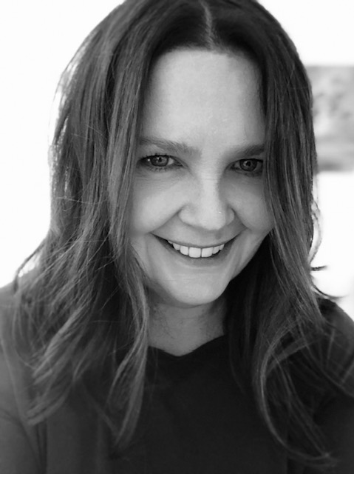
WORKING TOGETHER
Teachers
Free Webinars
Free Digital Resources
Delivery and Admin Guide
SAMs
FAQs
Unit Guides
Assessment Guide
Exemplar Material
Knowledge Organisers Organisers
Learners
Unit Resources
Performing Arts Course Companion Book
Wellbeing Guide
Instagram
Design Tools
Learner Focused Resources
Open Evening Information
Here to Support
Our Regional Support Team is on-hand to make sure you receive all the support and guidance you need.
Our team covers all areas of England and can provide face-to-face and online advice at a time which is convenient to you

Slide 9
Further support
Newsletter
Course Companion Book
Face to Face CPD Spring Term – Approaches to Delivery
Digital Resources – Knowledge Organisers
Unit Delivery Guides
Upload Guidance
Secure Website – for access to exemplar material and the Unit Briefs
Free resources
Secure website

Slide 10
WHY CENTRES TRUST US
“I couldn’t be happier having made the switch to Eduqas, the level of support from subject specialists is excellent, they are always very quick to respond to any queries. Our students love the flexibility of this course and we’ve been able to cater to the needs of all students by giving them bespoke pathways. Rather than a distant awarding body I definitely feel like Eduqas work with teachers and I feel very much part of a team, working for the best interests of students”.
Lucy Clafton
Subject Lead Drama
St Thomas a Becket School, Wakefield.

Slide 11
HAVE A QUESTION ABOUT OUR LEVEL 1/2 PERFORMING ARTS TECHNICAL AWARD?
I’m Victoria Husband
Subject Officer
Performing Arts
performingarts@eduqas.co.uk
029 2026 5470

