Slide 1
Evidence and Records
Presentation 3

Slide 2
Evidence
Plan of when and what practical activities will be undertaken to ensure that the requirements of the CPAC, incorporating skills and techniques detailed will be covered over the course of the two-year A level course
Records of each practical activity undertaken and the date on which it was completed
Record of the CPAC criteria being assessed in each practical activity
Record of which learners met the CPAC criteria and which didn’t for each practical activity
Learner work showing evidence required for task with date
Learner attendance register

Slide 3
Teacher Records
^{Spreadsheet from open website}
Shortcut to chemistry spreadsheet

Slide 4
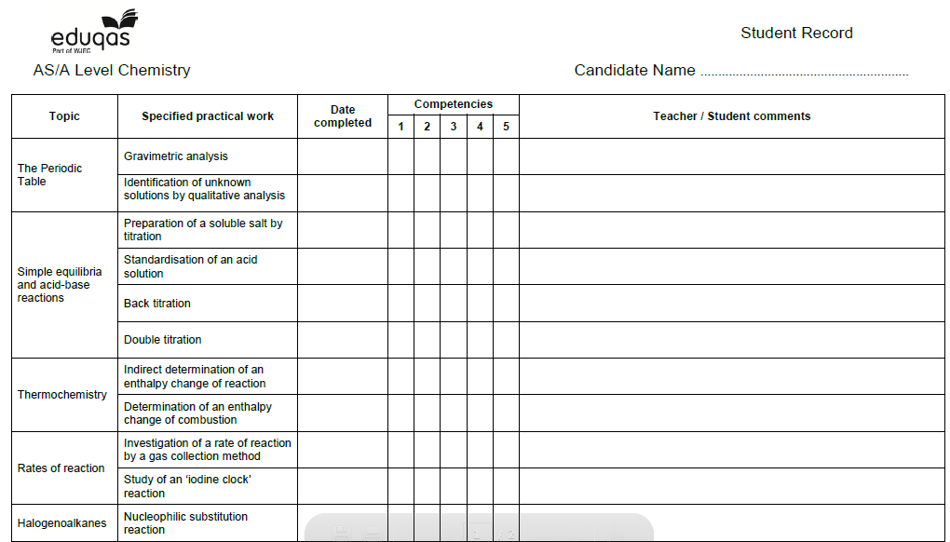
Learner Records
^{Copy available on open website}

Slide 5
Learner Records
Sampling

Slide 6
Resources for Teachers
Supporting teaching and learning
Teacher guides Biology Chemistry Physics
Lab books Biology Chemistry Physics
Additional biology resource: Microscopy skills resource
Guidance on general practical skills Biology Chemistry Physics

Slide 7
Any Questions?
Contact our specialist Subject Officers and administrative team for your subject with any queries.
helen.francis@eduqas.co.uk
@eduqas
eduqas.co.uk

