Slide 1
WJEC Eduqas
GCSE English Language
Component 2

Slide 2
Component 2-Aims of Session
Brief reminder of Reading and Writing assessment objectives
To consider the Principal Examiner’s key messages and lessons learnt (June 2019 series)
To focus on Reading skills of analysis (AO2) and evaluation (AO4)
To review a number of candidate responses focusing on Q02, Q04 and Q22 (the prom letter) with marking exercises
To consider possible approaches to teaching transactional writing and resources available

Slide 3
COMPONENT 2 ASSESSMENT OBJECTIVES – READING
Identify and interpret explicit and implicit information and ideas
(assessed in Question 11 and 13)
Select and synthesise evidence from different texts
(assessed in Question 15)
AO2 Explain, comment on and analyse how writers use language and structure to achieve effects and influence readers, using relevant subject terminology to support their views
(assessed in Question 12 )
AO3 Compare writers' ideas and perspectives, as well as how these are conveyed, across two or more texts
(assessed in Question 16)
AO4 Evaluate texts critically and support this with appropriate textual references
(assessed in Question 14)
Each Reading question targets ONE assessment objective.
AO1

Slide 4
Component 2 Reading:
Principal Examiner’s Key Messages
Read the instructions at the start of each question carefully to avoid answering on the wrong text
Don’t lose marks in Q11 and Q13 by not reading the question properly
Remember the mark tariff per question and plan time accordingly e.g. synthesis question is worth 4 marks and should be dealt with fairly quickly
Keep the focus of the question firmly in mind e.g. the focus for Q16 was ‘the day of the rescue’
Support points with appropriate evidence

Slide 5
Component 2 Reading:
Principal Examiner’s Key Messages
Use relevant terminology where AO2 is assessed. Avoid feature spotting or making terminology the starting point for a comment
Select relevant evidence and detail and, where appropriate, comment on/explore the impact of the detail
Avoid quoting facts/statistics unless they are worthy of greater exploration
The synthesis question is best tackled by dealing with the details from each specific text before considering any details that appear in both texts
Use the bullet points in Q16 to structure a response and make it clear which text is being referred to.

Slide 6
Question 12
AO2 Explain, comment on and analyse how writers use language and structure to achieve effects and influence readers, using relevant subject terminology to support their views.

Slide 7
Component 2 Assessment in Practice
Question 12
How does Jeffrey Brown try to show how hard it was for the trapped miners during their ‘long ordeal underground’?
You should comment on:
what he says
how he says it
Other ways he tries to show how hard it was for the trapped miners [10]
You must refer to the text to support your comments.
Indicates that AO2 is being assessed and that language and structure should be commented on and analysed
Focus of the question
Same message as Component 1-consider what is said as well as how it is said.

Slide 8
Characteristics of a successful response
Clear focus on the ‘hardships’
Methodical tracking of the text
There are a range of relevant points
Points are supported with appropriate evidence from the text
The impact of the details are explored effectively
Analysis of the writer’s techniques and use of language is focused and coherent
Use of subject terminology is relevant and is embedded in the response

Slide 9
Characteristics of a less successful response
Points made do not always focus on the question
There is limited tracking of the text
Devices are ‘spotted’ with little explanation of effect
Little attempt to analyse language or probe the details of the text
Range is limited for a 10 mark question
There is an awareness of ‘what’ but not ‘how’

Slide 10
Question 14
AO4 Evaluate texts critically and support this with appropriate textual references.

Slide 11
Component 2 Assessment in Practice
Question 1.4
‘In the first three paragraphs of the account, the writer gives the impression that the accident was so serious that the trapped miners would not be found alive.’
How far do you agree with this statement?
You should comment on:
what he says
how he says it
You must refer to the text to support your answer. [10]
Focus of question
Indicates AO4 is being assessed
Opinions should be supported with aptly selected textual evidence. What does the writer say that makes you think/feel a certain way?

Slide 12
Activity Exemplar 1
Read this candidate’s response and, using the marking scheme provided, decide which Band is most appropriate. What could be done to improve this response?
“Thousands were seen rushing to the spot.” This implies that the whole cave had collapsed and everyone rushed up there to see what happened but also implies that the miners were dead so people wanted to pay their respects.
“It agreed that the only hope.” This implies that they only had one thing to do and if they don’t do it then they could die or have already died.
“Whether the collapse had buried them alive.” There is little hope that the miners are alive.

Slide 13
Activity: Exemplar 1
Needs a clearer sense of whether they agree/partly agree with the statement or not
Needs to range across the text more
Does select some basic textual evidence but with limited explanation as to how the selected text supports opinions.
Not always useful to start with a quote and the use of quotations could be more secure
Needs to track the details more carefully

Slide 14
Characteristics of a successful response
Focuses on the statement given in the question and all points linked to it
Supports opinions with textual evidence
Clear point of view and clarity of thought
Evaluation of authorial methods and how these methods have shaped opinions (aware of the text as a piece of non-fiction)
Clear evaluation based on a good range of evidence ‘…tracks the details in order to sustain or develop their viewpoint.’ (Component 2 Principal Examiner’s Report June 2019)

Slide 15
Characteristics of a less successful response
No clear focus on statement given in question
Opinions are not supported with appropriate textual evidence
Lack of range of points (limited to one paragraph or part of the text)
Opinions lack clarity of thought
Limited comment on how the writer has helped shape opinions
Assertions rather than supported opinions

Slide 16
Component 2 Example Question Stems
AO1: Identify and interpret explicit and implicit information and ideas
Give one example…
List …
How many…
Give two details…
AO1: Select and synthesise evidence from different texts
According to both writers…
Using information from both texts…

Slide 17
Component 2 Example Question Stems
AO2: Explain, comment on and analyse how writers use language and structure to achieve effects and influence readers, using relevant subject terminology to support their views
How does the writer of the article/letter/report etc…show…?
How does the writer present…?
How does the writer try to show …
AO3: Compare writers' ideas and perspectives, as well as how these are conveyed, across two or more texts
Compare:
What the writers say about…
How the writers get across…
The writers’ attitudes towards/views on…

Slide 18
Component 2 Example Question Stems
AO4: Evaluate texts critically and support this with appropriate textual references
Statement/Viewpoint/Quote followed by:
How far do you agree with this view?
To what extent do you agree with this view?
How successfully/effectively does the writer…?
What do you think and feel about…?

Slide 19
Section B:
Transactional Writing

Slide 20
COMPONENT 2
ASSESSMENT OBJECTIVES - WRITING
WRITING (50% of the overall qualification)
AO5 Communicate clearly, effectively, and imaginatively, selecting and adapting tone, style and register for different forms, purposes and audiences;
Organise information and ideas, using structural and grammatical features to support coherence and cohesion of texts.
AO6 Candidates must use a range of vocabulary and sentence structures for clarity, purpose and effect, with accurate spelling and punctuation. (This requirement must constitute 20% of the marks for the specification as a whole.)

Slide 21
Principal Examiner’s Key Messages
Split time equally between the two tasks
Write at sufficient length to develop ideas, opinions and information effectively
Address the audience and purpose given in the task
Adopt an appropriate tone for the task
Format letters appropriately and include a suitable greeting and sign off
Spend time checking basic punctuation and grammar
Take time to plan and structure responses
Sequencing of ideas is important in developing an argument/point of view
Depth and detail will help to develop convincing responses

Slide 22
Transactional Writing
This is not a definitive list but pupils should practise writing the following in preparation for Component 2, Section B:
Article e.g. Newspaper or Magazine
Informal Letter
Formal Letter
Report
Speech/talk
Guide (on a specified topic) e.g. a guide for GCSE students on how to manage exams
Review
Please note that leaflets are no longer a valid transactional task as this type of writing would make it potentially difficult for candidates to achieve the criteria in the highest bands.

Slide 23
Question 22

Slide 24
Component 2 Assessment in Practice
Question 22
Your headteacher has decided that there should not be an end of year celebration such as a school prom or party. The headteacher believes it would just be an excuse for students to show off in an expensive way.
Write a letter to your headteacher giving your opinion on this.
[20]

Slide 25
Comparative Judgement
Read exemplars 1 and 2.
Which exemplar is better and why?
Using the marking scheme and additional task specific guidance in your ‘Excerpts from Marking Guidelines 'booklet, highlight which AO5 and AO6 skills are being demonstrated in these responses
Teaching tip: Ask pupils to do a similar activity highlighting the key skills they can identify.

Slide 26
Component 2 Assessment in Practice
Sequencing and shaping ideas–excerpt from Principal Examiner’s Report
‘The second task required some shaping of arguments…and how to present the arguments in the most convincing way.’

Slide 27
Component 2 Assessment in Practice
Sequencing and shaping ideas
Activity:
Read the three plans in response to the prom letter in the back of your Component 2 booklet.
Which example is likely to be most successful and why?
Which example is likely to be least successful and why?
Discussion:
How could this sort of task be used with pupils to help them think about sequencing and developing details? What other approaches to teaching these skills have worked well in the classroom?

Slide 28
Characteristics of a successful response
Clear understanding of the audience (the headteacher in this instance) and formality needed
The right tone is adopted for the purpose and audience
Clear understanding of purpose (to give and support opinions)
Maintains point of view throughout
A range of specific details relating clearly to the task set to develop a clear line of argument
Sustained piece to develop key points in enough detail
Overall control of spelling, punctuation and grammar
Logical sequence of paragraphs/ideas
Accurate use of vocabulary suited to the audience

Slide 29
Characteristics of a less successful response
Not addressing the specified audience
Insecure understanding of purpose
Limited range of specific details
Brief response that doesn’t develop a coherent argument
Basic technical errors throughout the response
Lack of paragraphs/topic sentences to organise the response
Vocabulary used isn’t suited to task/audience

Slide 30
Possible approaches to teaching transactional writing
Task: Write a letter to your headteacher giving your views on a proposal to introduce a strict healthy eating menu and exercise regime at school.
Starter: Hand out the sentence stem cards- one per pair.
Divide the class into FOR or AGAINST the proposal.
Pupils to plan an argument using the sentence stems as an opening.
E.g. It is difficult to understand but not all pupils enjoy exercise…
Teacher to hear the class findings as a debate and record the ideas on the board for the next task.

Slide 31
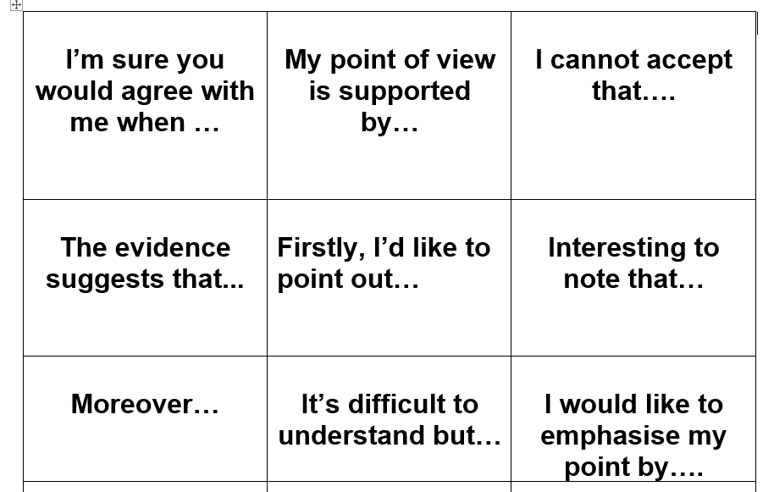
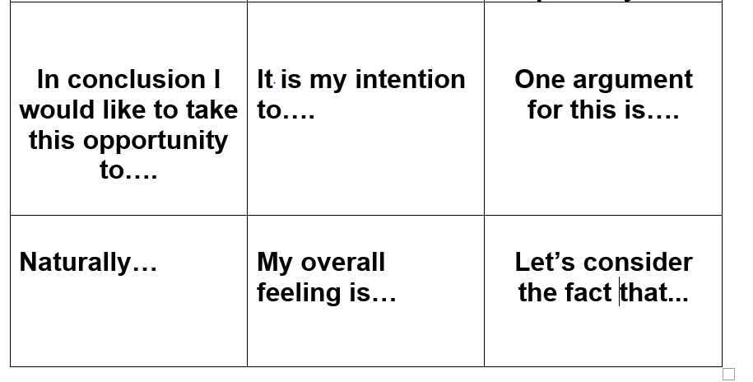
Use the sentence starters to help you organise and formulate your arguments.

Slide 32
Next steps…
Task: In pairs work on the for and against ideas.
Using the letter format, pupils are to compose a response using the sentence stems as a framework.
One pupil focuses on for and the other on against.
They can then help each other with the counter-arguments.
Whole class feedback and discussion.

Slide 33
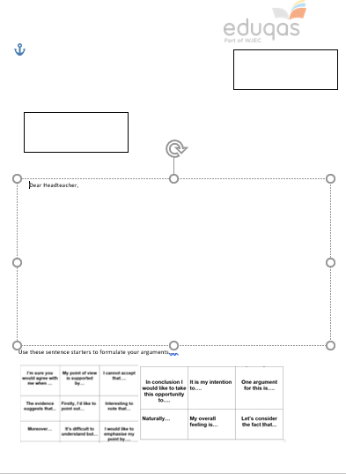
Use the letter format to organise your ideas.
The sentence stems are a guide to introduce your points.
Use examples and anecdotes to expand on these arguments
Once completed- read aloud to your partner to hear the opposing view.

Slide 34
Useful Websites
British Library https://www.bl.uk/
The British newspaper archive
Englicious http://englicious.org/
Grammar and punctuation exercises
Tes secondary English resources

