Slide 1
WJEC Eduqas
A Level English Language and literature
CPD Autumn 2017
Component 4: NEA

Slide 2
Overview of Unit
Section A: Genre study
Learners are required to submit a 1500-word study based on the reading of a prose text (selected from a prescribed list) and related wider reading from one of the following literary/non-literary prose genres:
Gothic
science fiction
romance
dystopia
crime
satire/comedy
historical fiction
war/conflict
adventure/journeys
life writing
journalism
travel
identity/the outsider

Slide 3
Section A - Assessment Objectives
AO1
apply concepts and methods from integrated linguistic and literary study, using associated terminology and coherent written expression
use English appropriately and accurately and engage in a clear academic style and register
AO2
analyse the ways in which meanings are shaped
AO3
show understanding of the contexts in which texts are produced and received
AO4
show understanding of the ways in which texts relate to each other

Slide 4
Overview of Unit
Section B: Related creative writing
Learners will produce two pieces of original writing: one must be literary in style and the other non-literary. One of the pieces of writing must be in the same genre as that studied in Section A. Both pieces of writing must be informed by the research and study completed for Section A.

Slide 5
Section B- Assessment Objectives
AO5
use a range of techniques to produce texts informed by wider reading
use English appropriately, accurately and creatively to communicate in different ways
synthesise and reflect on their knowledge and understanding of linguistic and literary concepts in the study of their genre texts.

Slide 6
Key Issues from the Moderator Report
Text Selection
Selection of texts is important - candidates could select texts from differing historical periods, narrative perspectives etc… Selecting texts which are too similar can be limiting
Main texts must be selected from the Appendix in the Specification. Texts examined elsewhere on the Specification (even if they are not texts studied in the Centre) should not be used for the non-examination assessment

Slide 7
Key Issues from the Moderator Report
Task Setting/Essay Structure
Candidates should select a sufficiently narrow focus
Candidates should plan 3-4 key areas of argument - each paragraph should start with a comparative topic sentence
Make the introduction work hard! A good introduction should pick up AO marks

Slide 8
Key Issues from the Moderator Report
Context and Genre
Contextual detail should be embedded into the argument - link it to quotation analysis
Candidates would benefit from including further reference to the conventions of their chosen genre - other forms of context were used much more often

Slide 9
Key Issues from the Moderator Report
Linking Texts
Genre studies should be comparative from the outset - it shouldn’t be left to the last 500 words of the essay
Candidates should plan their response comparatively - selection of wider reading texts is key here

Slide 10
Key Issues from the Moderator Report
Creative Writing
First person narrative or monologue? Editorial or review? Make sure the task fits the concept and the candidate
Candidates could include a brief text descriptor to provide clarification for the link to the genre study
Proof reading

Slide 11
Key Issues from the Moderator Report
Creative Writing
Originality! Candidates should avoid basing their writing on existing characters and narratives
Consider audience and purpose of non-literary texts
The writing pieces do not need to be linked

Slide 12
NON-EXAMINATION ASSESSMENT (NEA) - Activities

Slide 13
Activity One

Slide 14
AO3 - Exploring Genre
Table Discussion:
How do you ensure your candidates have an overview of their chosen genre?

Slide 15
Using Moving Image/Podcasts
Suggestions from Teachers:
https://www.youtube.com/user/britishlibrary/playlists - clips on romance, gothic and dystopia genres
https://www.coursera.org/learn/historical-fiction/lecture/RCDcg/the-global-reach-of-the-historical-fiction-genre - overview of historical fiction genre
https://itunes.apple.com/gb/podcast/geeks-guide-to-galaxy-science-fiction-interviews-sci/id395738416?mt=2 - science fiction podcast
https://www.youtube.com/watch?v=fdgDoT8LJaM&t=9s - a lecture on gothic fiction by David Punter

Slide 16
Creating a Timeline:
Candidates can explore examples of texts from different points on the timeline and consider the similarities and differences.
How do they reflect/subvert the typical conventions of the genre?

Slide 18
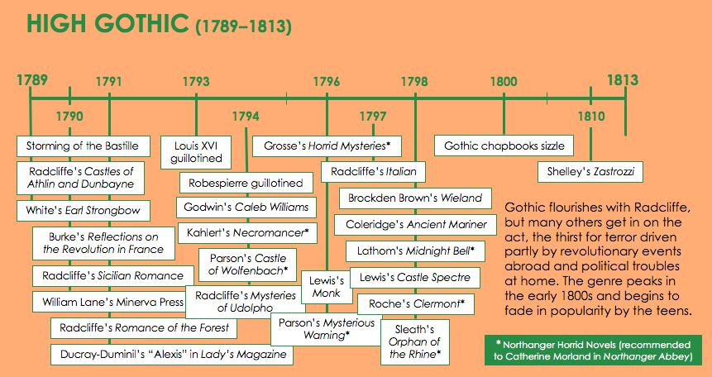

Slide 21
Extracts through the Ages:
Candidates conduct independent research into the cultural, historical and social issues from points in the timeline.
Then, candidates explore a series of extracts and discuss the how the genre has evolved.

Slide 22
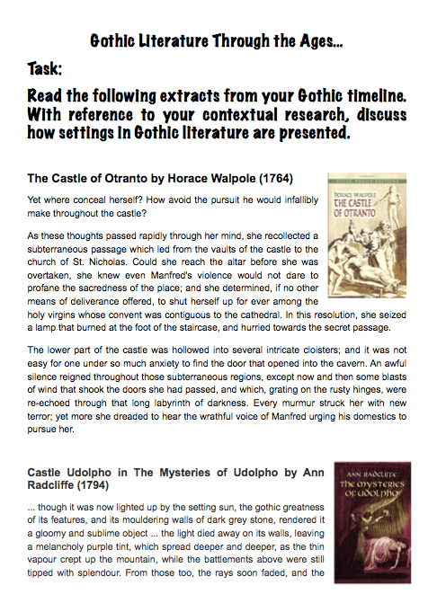
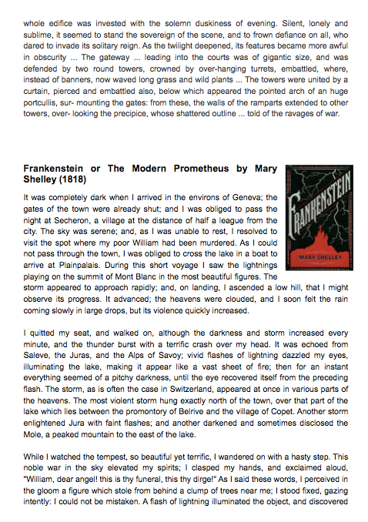

Slide 23
Activity Two

Slide 24
Assessment Task
Read Candidate A’s folder.
What mark would you award this folder for each AO?

Slide 25
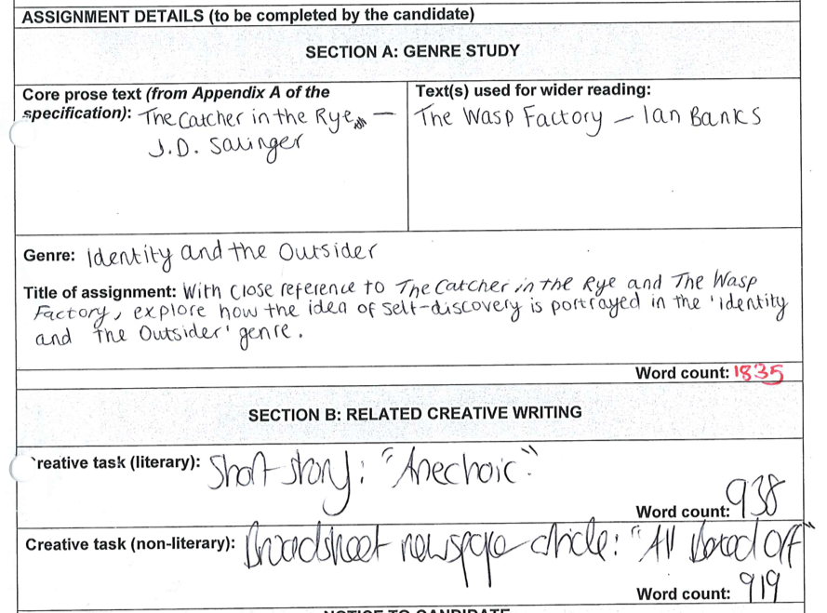

Slide 26
Principal Moderator’s Comments: Section A

Slide 27
AO1
Confident academic tone (Band 5)
Clearly focused on the question (Band 5)
Purposeful application of terminology but could develop this further as the range isn’t wide enough (Band 4)
Ideas are well organised but topic sentences could have been refined in places (Band 4)
8/10 Band 4

Slide 28
AO2
Perceptive analysis of how language choices affect meaning but needs a wider range of terminology (Band 5-)
Matured and assured reading of texts (Band 5)
Confident understanding is shown throughout (Band 5)
9/10 Band 5

Slide 29
AO3
Confident grasp of overview (Band 5)
Confident and purposeful references to relevant historical and cultural contexts (Band 5)
Clear awareness of the genre but could develop this more explicitly (Band 4)
9/10 Band 5

Slide 30
AO4
Confident comparative approach from the outset (Band 5)
Astute and illuminating connections between the texts (Band 5)
Purposeful and productive comparisons (Band 5)
10/10 Band 5

Slide 31
Total Section A Mark: 36/40

Slide 32
Principal Moderator’s Comments: Section B

Slide 33
Literary Piece
AO5
Clearly inspired by the Identity and the Outsider genre (Band 5)
Very effective characterisation (Band 5)
Writing is original and engaging (Band 5)
Effective linguistic choices and use of imagery (Band 5)
18/20 Band 5

Slide 34
Non-literary Piece
AO5
Style is confident and tone is appropriate for audience and purpose (Band 5)
Clear links to the genre study (Band 5)
Secure levels of technical accuracy (Band 5)
Effective literary and linguistic choices (Band 4)
Clear sense of genre (Band 4)
17/20 Band 5

Slide 35
Total Section B Mark: 35/40

Slide 36
Total Folder Mark: 71/80

Slide 37
Any Questions?
gceenglish@eduqas.co.uk
Rhodri Jones: Subject Officer
029 20 265188
Mike Williams:
Subject Support Officer
029 20 265129
@eduqas_english
eduqas.co.uk

