Slide 1
Starting from September 2017
GCSE Electronics
Accredited by Ofqual
Designated by Qualifications Wales
Phil Glover
Subject Officer
Dennis Price
Chief Examiner

Slide 2
GCSE Electronics
Agenda
9.30 – 9.40 Introduction
9.40 – 11.00 Summary of specification content
11.00 – 11.15 Coffee
11.15 – 12.15 Assessment objectives and question types
12.15 – 13.15 Lunch
13.15 – 14.30 Non-Exam Assessment (NEA)
14.30 – 14.45 Coffee
14.45 – 15.15 Resources
15.15 – 15.30 Questions and close

Slide 3
GCSE Electronics
Contact details
Subject Officer: Phil Glover
philip.glover@eduqas.co.uk
029 2026 5477
Subject Support Officer: Matthew Roberts
matthew.roberts@eduqas.co.uk
029 2026 5380

Slide 4
GCSE Electronics
Introducing EDUQAS
In light of the diverging qualifications between England and Wales, WJEC has developed a new brand: Eduqas.
Eduqas will be the brand that provides schools with WJEC’s newly reformed Ofqual regulated GCSEs, AS and A levels.
Eduqas enables teachers to clearly distinguish between legacy qualifications in Wales and reformed qualifications in England.

Slide 5
GCSE Electronics
EDUQAS outside England
Eduqas qualifications will primarily be available in England but also in Northern Ireland, Isle of Man and the Channel Islands at any schools offering Ofqual regulated qualifications.
Qualifications Wales (QW) has designated WJEC Eduqas Electronics for teaching in Wales from September 2017.
'Designated' qualifications are listed on the database of regulated qualifications in Wales (QiW), may be delivered by schools and colleges in Wales and will be eligible for funding by Welsh Government.

Slide 6
GCSE Electronics
Specification
Phil Glover
Subject Officer
Dennis Price
Chief Examiner

Slide 7
GCSE Electronics
Layout of specification
In addition to the content, each topic contains the following information:
Overview
This summarises the content of each topic.
Electronic skills
This summarises how skills may be developed in the topic.
Mathematical Skills
This includes ideas of how and where mathematical skills can be developed in the topic. Further details are given in Appendix C in the specification.

Slide 8
GCSE Electronics
Making entries
All components will be available in 2019 (and each year thereafter) and the GCSE qualification will be awarded for the first time in summer 2019.
All assessments must be taken at the end of the course.
Where candidates wish to re-sit the qualification, all components must be re-taken.

Slide 9
GCSE Electronics
Summary
of
Assessment
Component 1: Discovering Electronics Written examination: 1 hour 30 minutes 40% of qualification
A mix of short answer questions, structured questions and extended writing questions, with some set in a practical context
Component 2: Application of Electronics Written examination: 1 hour 30 minutes 40% of qualification
A mix of short answer questions, structured questions and extended writing questions, with some set in a practical context
Component 3: Extended system design and realisation task Non-exam assessment 20% of qualification
An extended system design and realisation task to assess electronics skills

Slide 10
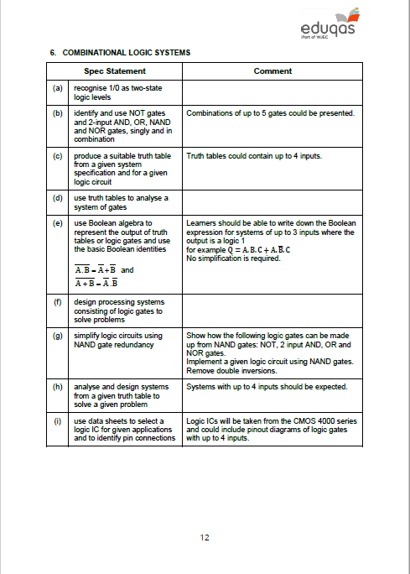
GCSE Electronics
Guidance for Teaching

Slide 11
GCSE Electronics
Component 1 – Discovering Electronics
Written examination: 1 hours 30 minutes
40% of qualification – 80 marks
This component covers the following topics:
1. Electronic systems and sub-systems | 4. Switching circuits
2. Circuit concepts | 5. Applications of diodes
3. Resistive components in circuits | 6. Combinational logic systems

Slide 12
GCSE Electronics
Component 2 – Application of Electronics
Written examination: 1 hours 30 minutes
40% of qualification – 80 marks
This component covers the following topics:
1. Operational amplifiers | 4. Interfacing digital to analogue circuits
2. Timing circuits | 5. Control circuits
3. Sequential systems

Slide 13
GCSE Electronics
Overview of main changes to content
New topics for AQA centres | New topics for WJEC centres
Mosfet I_{d} = g_{m} x V_{gs} -3
Use of Zener diode
Simple Boolean expressions | Half wave rectifier
NAND gate implementation
2 bit counter using D-types
Dedicated binary and BCD counter
Single digit count and display system
Transistor calculation I_{C} = h_{FE} x I_{B}
Schmitt inverter
Inv, non inv, and summing op-amp
Gone from AQA | Gone from WJEC
FWR | Thyristor
Radio systems

Slide 14
GCSE Electronics
Component 3 – Non-exam assessment (NEA)
Extended system design and realisation task
20% of qualification – 40 marks
Task
A design and realisation task based on an individually identified problem, context or opportunity.
Research and analysis of the problem to develop a design specification.
Develop a system from a series of sub-systems which will be tested individually before assembly and tested as a complete system.
Evaluate the performance of developed system against the design specification and suggest improvements that could be made.

Slide 15
Any Questions?
Contact Details
Phil Glover
Subject Officer
philip.glover@eduqas.co.uk
029 2026 5477
Matthew Roberts
Subject Support Officer
matthew.roberts@eduqas.co.uk
029 2026 5380

