Slide 1
Autumn 2016
2015 SPECIFICATION FOR FIRST AWARD IN 2017
GCSE ENGLISH LITERATURE

Slide 2
Frequently Asked Questions
Legacy specification re-sit opportunity in January 2017
Are candidates able to carry-forward marks from units that were previously cashed-in?
Does the 40% terminal assessment rule still apply?
Can candidates enter new written controlled assessment for Unit 3?
Will there be any further re-sit opportunities for literature?

Slide 3
Key features
GCSE English Literature will:
Be assessed by examination and non-examination assessment
Have tiered examination units
Be unitised, with assessment in the summer series for Units 1, 2 and 3 and an assessment opportunity for Unit 1 available in January (2017 will be the first January assessment opportunity but there will be no Cash In available in January)
Require the study of whole texts
Require the study of Welsh writing in English through the poetry NEA
Be graded A* to U

Slide 4
Key changes
The discrete study of 15 poems is no longer required for Unit 1, and there is no requirement to send in a list of the poems studied
Unit 2 will have the discrete marks previously available for SPaG removed so Unit 2 will be marked out of 60 rather than 68
SPaG will now be termed ‘Assessing Writing’ and will be assessed holistically
Controlled tasks are now known as ‘non-examination assessment’
Unit 3 will require two separately marked pieces of non-examination assessment
Unit 3 will now require the study of a Shakespeare text (Section A) and the study and comparison of poetry from Wales (Section B)
WJEC’s Poetry Collection will no longer be used in Unit 3. 15 thematically linked poems will be taken from the Library of Wales anthology Poetry 1900-2000: One hundred Poets from Wales.
The comparison will now be in Section B only
Unit 3 will be marked out of 48 in total. 24 for Section A and 24 for Section B
No notes may be taken into the non-examination assessment sessions

Slide 5
Assessing writing
All units in English Literature involve extended writing, and candidates will be assessed on the accuracy and organisation of their writing within the overall assessment of each unit. Candidates are reminded of this in the rubric for question papers.
Mark schemes include the following specific criteria for the assessment of writing within levels of achievement descriptors:
Communication and organisation (meaning, purpose, readers and structure); and
Writing accurately (language, grammar, punctuation and spelling).

Slide 6
Assessment objectives
Learners must demonstrate their ability to:
AO1 – Respond to texts critically and imaginatively; select and evaluate relevant textual detail to illustrate and support interpretations
AO2 – Explain how language, structure and form contribute to writers’ presentation of ideas, themes and settings
AO3 – Make comparisons and explain links between texts, evaluating writers’ different ways of expressing meaning and achieving effects
AO4 – Relate texts to their social, cultural and historical contexts; explain how texts have been influential and significant to self, and other readers in different contexts and at different times

Slide 7
Why take both GCSE english language and GCSE english literature?
Specifications are co-teachable
Offers students a broader and more varied English curriculum
Transferable skills e.g. analysis of a writer’s choice of language
Prepares students for further study
A range of resources and subject support available through your consortia to support you

Slide 8
RESOURCES FOR TEACHERS
Supporting teaching and learning
Free subject specific resources available for all to download from our website. You can access our SAMs, Specs, Teacher Guides and Principals’ Reports from here:
wjec.co.uk/qualifications/english/english-literature-gcse/
The digital teacher guide gives detailed advice on planning and implementation. It can be found here:
http://www.wjec.co.uk/wjec-gcse-eng-lit-wales-teachers-guide-teaching-from-2015-e.pdf?language_id=1
The extensive resources produced by WJEC on behalf of the Welsh Government to support the teaching of the non-examination assessment poetry unit may be found here: http://resources.wjec.co.uk/Pages/ResourceSingle.aspx?rIid=711 The Dylan Thomas poems are on the secure website due to copyright restrictions. They can be accessed here:
https://www.wjecservices.co.uk/

Slide 9
RESOURCES FOR TEACHERS
Supporting teaching and learning
Further digital resources to support the teaching and learning of a broad range of subjects can be found here:
resources.wjec.co.uk
Our free Online Exam Review allows teachers to analyse item level data, critically assess sample question papers and receive examiner feedback. It can be found here:
oer.wjec.co.uk

Slide 10
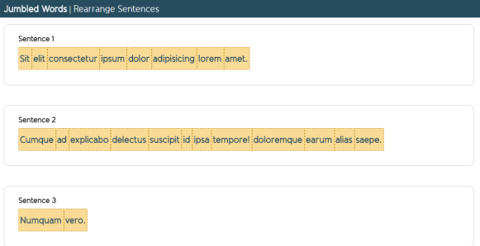
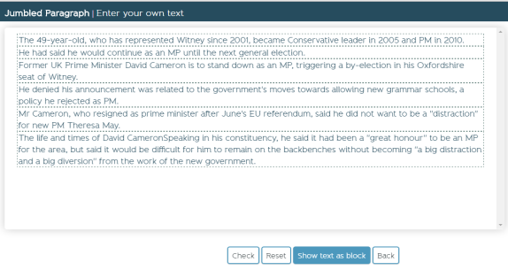
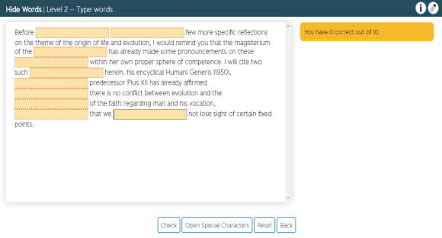
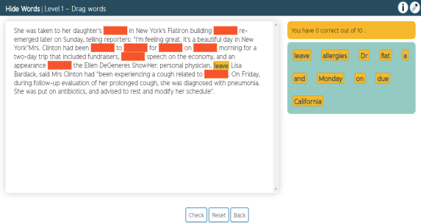
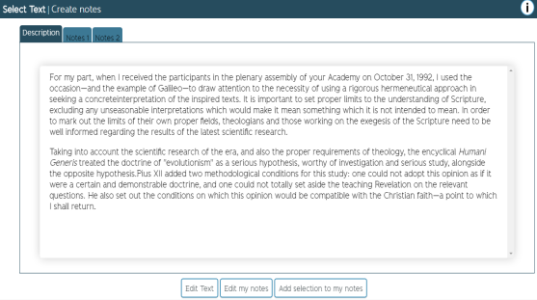
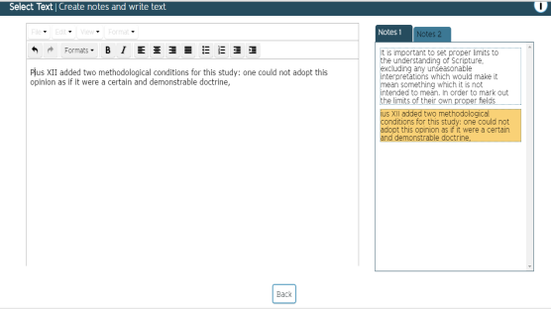
Jumbled words
Jumbled paragraph
Hide the word
Hide the word
Create notes
Create notes
These tools will be added to the GCSE Literature subject page shortly.

Slide 11
Contacting Us
GCSE English Subject Officers
Julia Harrison (Literature)
gcseenglish@wjec.co.uk
029 2026 5374
GCSE English Subject Support Officers
Matt Oatley Lewis Beecham
029 2026 5054 029 2026 5051
gcseenglish@wjec.co.uk

Slide 12
Any Questions?
Contact our specialist Subject Officers and administrative support team for your subject with any queries.
gcseenglish@wjec.co.uk
@wjec_cbac
@WJECGCSEEnglish
wjec.co.uk

