Slide 1
Eduqas GCSE English Language
Writing Tasks
Reviews

Slide 2
Aims of this presentation
introduce review writing
discuss features of review writing
revisit previous review writing tasks
share tips and look at how to write a successful review
consider sample plans and extracts
provide full marked examples
link to a revision sheet on review writing

Slide 3
Introduction to review writing
What do you need to know?
Topic
What are you reviewing? How do you feel about the topic? What are your views about it?
Audience
Have you been given a specific audience? Who is the review aimed at? What do you need to include to engage the audience?
Purpose
What does your review aim to achieve? Are you trying to persuade others to watch/not watch a film? Are you reviewing something positive or negative?

Slide 4
Introduction to review writing
What do you need to know?
Register
What is the appropriate tone for your writing?
When writing a review you need to consider the tone of your writing. If you love what you are reviewing, your tone will be positive, light and fully engaging. If you dislike what you are reviewing you may be sarcastic, negative, dismissive and rude about it.
Format
What do you need to know about layout?
There are no specific rules for writing a review but you should give your review a clear title. All reviews should be organised into paragraphs. Make sure you conclude your review with final recommendations and perhaps a rating.

Slide 5
Sample examination questions
Writing a review– exam tasks:
2019
Write a review for a teenage magazine of a book, film or TV programme/series that you have enjoyed in the last year and why it might appeal to others of your age. Write your review. [20]
Writing a review– sample tasks:
Write a review of your school or college based on your experiences there. Write your review. [20]
Write a review of a book, CD or film of your choice. Write your review. [20]
Sample exam questions

Slide 6
Getting to grips with writing a review
A review is an evaluation. You can review most things - books, articles, films, cars, buildings, art, fashion, restaurants, music, and many more. In an exam, it is likely that you would be asked to review something familiar to you.
A review makes an argument - it is a commentary, not just a summary. Unless you are specifically told to write a positive review, you can choose what you say about the thing you are reviewing. Always state your opinions, give some supporting reasons, and add a conclusion with recommendations and perhaps a rating.
Reviews share some common features:
A review gives the reader a short summary of the piece. This can include a brief description.
A review offers a critical assessment – you need to include your opinions or reactions to the work being reviewed. Consider if it was effective or persuasive. Did you love it or hate it?
A review often suggests whether or not the reader would appreciate or like it.

Slide 7
Getting to grips with writing a review
Top Tips for Writing a Review
In your plan, write down the points you want to get across.
Mention the name of the author/director or anything specific and clearly name the thing being reviewed in the title and first paragraph.
Try to get the main theme/idea of the thing you are reviewing across at the beginning of the review. Your reader should immediately know what it is about.
Think about the wider aspects of what you are reviewing. Consider actors, sequels, music, similarities to other things…
What do you like or dislike about it? Try to be blunt. Is it funny? What bores you about it? What is the author's/narrator's "voice" like?
Use a few short quotes or examples to illustrate your points. This is a good way to give your reader a sense of your style.
Make sure your review explains how you feel and why, not just what it is about. A good review should clearly express your opinion.
Be honest – say what you are thinking but try to justify your views.

Slide 8
Getting to grips with writing a review
Write a review of a book, CD or film of your choice.
Write your review. [20]
First choose what you are going to review. Then, to help you plan, answer the following questions?
Questions
Do you know the types of features you might see in an review?
Have you been given a specific audience? What will readers want to know about what you are reviewing? How will you appeal to your reader? What tone or techniques will you use?
Make a list of the main things that you are going to write about. What will be most interesting for a reader?
What do you think about the book, CD or film? How will you get across your opinions to your reader?

Slide 9
Features of review writing
Feeling Icy About Frozen?
Last weekend I was forced to endure a new DVD that has been added to my little sister’s ever- growing Disney collection. Frozen 2. For those of you who have been living on a different planet for the last few years, the Frozen franchise is big business for any girls under the age of around 7 or 8.
I have to admit, I was pretty reluctant to watch it. The first version of Frozen followed the usual Disney drama of: boy meets girl, dramas occur, friends are made and annoyingly catchy songs are sung. There were the usual talking animals too and (I have to admit it), a cute little snowman. However, having sat through the whole of the movie, it actually wasn’t too bad.
The music is actually slightly better than the first one. In Frozen 2, there are some instrumental versions of songs and the riffs are well pitched and engaging. This was a definite plus for me, although I was a little annoyed when I started humming the tune on the school bus yesterday morning!
As for the characters… Elsa and Anna are still the leading ladies with Sven, Olaf and the talking reindeer, whose name I can’t actually remember! Elsa is still a little too overly heroic as she constantly runs off to try and fix things with the usual ‘we know it’s going to end badly’ music tinkering away in the background…
Include a heading. If you can,
try to think of something
catchy. You could use a pun, a
question or even hint at how you
feel about the topic.
Your personal opinion is vital in a review. Make sure your voice is clear in your writing.
Always organise your writing
into paragraphs. It will help you to make your ideas clear and easy to follow.
Appeal to your reader. Use your tone to make the reader feel like you are sharing personal information and advice.
Vary your punctuation, where relevant. Different sentence types can make your writing more engaging and effective. Brackets, commas and dashes can highlight subordinate clauses where you add extra information and give your opinions.
Use language to appeal to the reader. Try to use topic specific language too.

Slide 10
Planning an answer
Write a review for a teenage magazine of a book, film or TV programme/series that you have enjoyed in the last year and why it might appeal to others of your age.
Write your review.
Ask yourself the following questions to help you plan your answer:
Who is the audience for the writing?
What is the topic of the review?
Do any of the words in the tasks suggest the tone for your writing (‘enjoyed’)?
How can you appeal to the audience?
Can you think of any features of a review?
Can you think of any techniques that you might like to include?
What will your recommendations and rating be?
What specific details will be useful to your reader?

Slide 11
Review writing – sample extract
Write a review for a teenage magazine of a book, film or TV programme/series that you have enjoyed in the last year and why it might appeal to others of your age.
Write your review. [20]
Game of Thrones
Is it just me or did the ending of Game of Thrones manage to ruin a perfectly brilliant series? Having spent a good proportion of the last few years watching this series and waiting for the next, I feel truly robbed by the rubbish ending of the final series. It was terrible. It was worse than terrible and now I feel gutted that it is all over.
Look at the opening paragraph of this review. Can you answer the following questions?
What is being reviewed?
Who is the audience?
What does the writer think about
the series they are reviewing?

Slide 12
Using parenthesis in a review
One way of impressing a reader is by using parenthesis in your writing. If you want to add extra detail to a sentence (using a subordinate clause) you can use a pair of either:
brackets
commas
en dashes
Parenthesis is very effective in a review. In a way, it allows you to talk directly to the reader giving extra details and opinions.
Look at the paragraph opposite and see if you can spot where parenthesis has been used.
Can you see how it allows the writer to give their opinions?
Cobra Kai – hit or miss?
Netflix have excelled themselves (in my opinion) with their latest hit, Cobra Kai. Based on the 1984 film, Karate Kid, Cobra Kai jumps to present day where all of the characters have now grown up. Using some of the originally cast actors – William Zabka and Ralph Macchio – this modern version is awesome. The first series (we are now awaiting series 4) starts from Johnny’s perspective as he seeks to reopen the Cobra Kai karate dojo….

Slide 13
Review writing – sample answer
Write a review of a book, CD or film of your choice.
Write your review. [20]
The following slides contain a marked answer to this task. Read the review and complete the following:
Read the review and see where you can amend or improve the punctuation.
Highlight any vocabulary that you could improve and write down more interesting or engaging words that could be used instead.
Look at the section about Voldemort. How could you improve this to make it more interesting and specific?
Does the student give enough personal opinion? Where could this be improved?

Slide 14
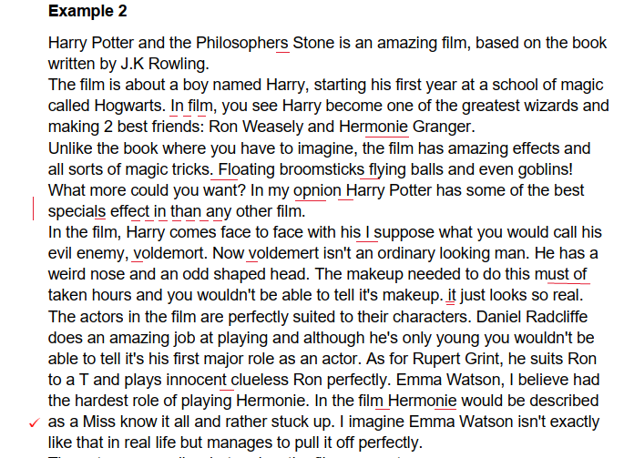
Review writing – sample answer

Slide 15
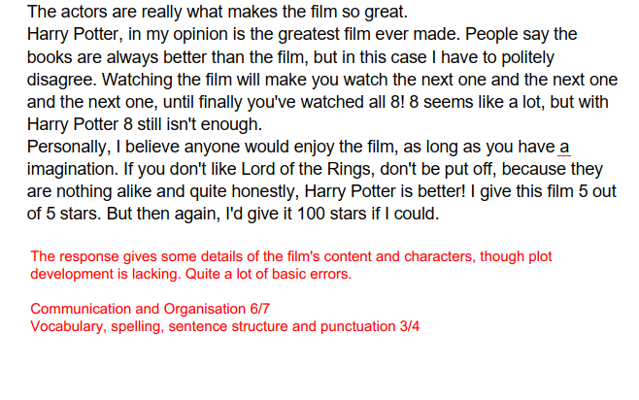
Review writing – sample answer

Slide 16
Review writing – task
Write a review of your school or college based on your experiences there.
Write your review. [20]
The example that you looked at on slides 14 and 15 included a range of details but could have been more effectively organised. There was plenty of room to add more specific details and evaluation.
Use the guidance on how to plan from the previous slides in this presentation and plan your own answer to this question.
When you have a plan that you are happy with spend 25-30 minutes writing an answer to this question.

Slide 17
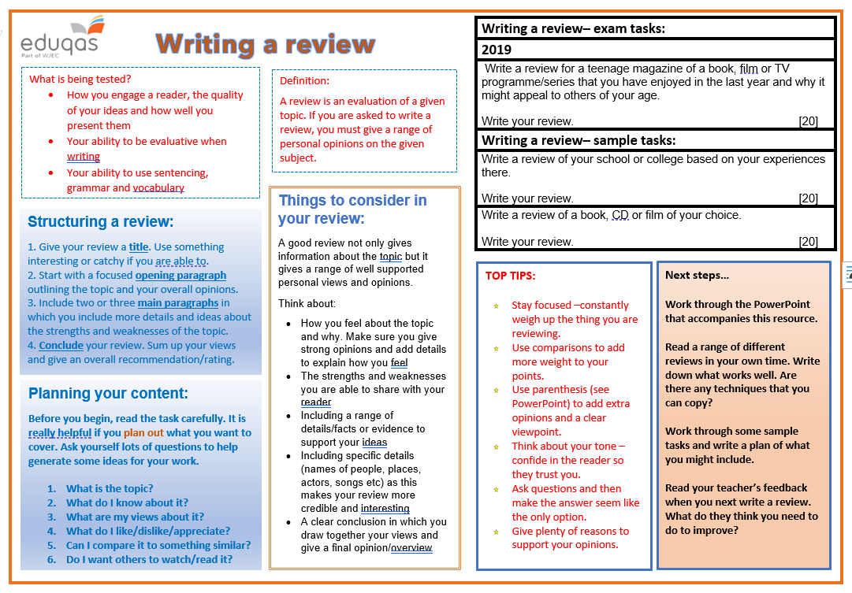
Revision sheet

Slide 18
Finally…
We hope this resource has been helpful to you.
For further information and resources for GCSE English Language you can visit the digital resources section of our website. The following link will take you there:
https://resources.eduqas.co.uk/Pages/ResourceByArgs.aspx?subId=11&lvlId=2

