Slide 1
A level English Language
Component 2

Slide 2
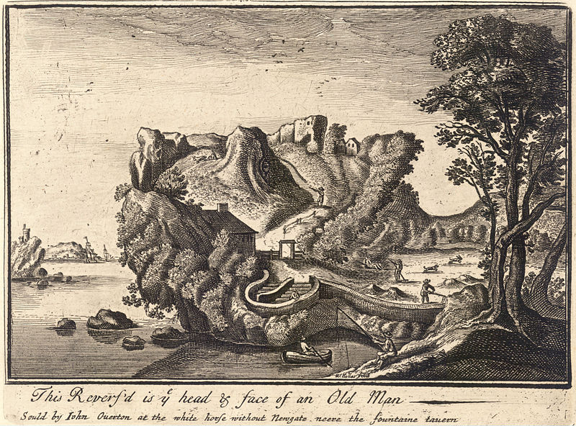
Language Change over Time

Slide 3
Slide 3

Slide 4
Slide 4
Question 1(b)
What does the spelling of the examples below tell us about language change? Make two points and refer to the examples using appropriate terminology.
made (Text A, line 8) mad (Text A, line 10)
preparacion (Text A, line 3) lamentation (Text A, line 5)

Slide 5
Slide 5
Characteristics of a successful response
Question 1(b) Commentary
ü
The verbs ‘made/mad’ are spelled differently showing that
ü
there was inconsistency due to a lack of standardisation.
ü
The nouns ‘preparacion’ and ‘lamentation’ show there was
inconsistency in suffixes as the first uses a ‘ci’ and the second a
ü
‘ti’ to make the same sound. Again this is due to a lack of
standardisation and no Samuel Johnson’s 1755 dictionary.

Slide 6
Slide 6
Testing word class knowledge 1
the
The dog ran down our road.

Slide 7
Slide 7
Question 2
In your response, you must:
explore connections across the texts
consider relevant contextual factors and language features associated with the construction of meaning
demonstrate understanding of relevant language concepts and issues.
Analyse and evaluate Texts A, B and C as examples of diaries, written by different people in different times.

Slide 8
Slide 8
Characteristics of a successful response
Question 2 Commentary
ü AO4 (link)
Each of these texts is descriptive in approach, but in very different ways.
ü AO4 ü
Text A uses many proper noun phrases to reference people and they
AO2
help to contribute to a lexical field of royalty and status; for example, the
ü AO4 AO2 (apt examples)
formal titles with honorifics “Sir Thomas Seimour”, “Lord Sudley”, the
AO3 (evaluating)
Erle of Hartford” and “Lord Lisle (ll.8-16). These details are important
ü AO3 (context)
for Edward to demonstrate his knowledge of key figures in the monarchy
ü AO3 (interpreting)
and show his respect for them.

Slide 9
Slide 9
Testing word class knowledge 2
tree
The old apple tree fell over in the storm.

Slide 10
Slide 10
Classification of nouns
NOUNS
COMMON
concrete
abstract
PROPER

Slide 11
Slide 11
What makes this a successful response?
This paragraph links the texts effectively and confidently explores details: the discussion is productive and demonstrates close reading. Engagement with meaning is good with some perceptive comments. There is a clear sense of development in the argument and the AOs are all addressed appropriately.

Slide 12
Slide 12
What makes this a successful response? (cont.)
There are points where discussion could go further (e.g. status in Text A; the contextual factors in Text B; specific example to support discussion of Text C), but the approach here is confident. Expression is fluent and polished (although the subordinating conjunction ‘whereas’ should not be used to start a sentence).

Slide 13
Slide 13
Question 3
In your response, you must refer to the set of data (Texts 1-6), but, in addition, you may wish to draw on your own examples. You must also:
consider relevant contextual factors and language features associated with the construction of meaning
Apply appropriate methods of language analysis, using associated terminology and coherent expression
demonstrate understanding of relevant language concepts and issues.
Using your knowledge of twenty-first century English, analyse and evaluate the ways in which contextual factors affect the lexical and grammatical choices in Facebook posts.

Slide 14
Slide 14
Testing word class knowledge 3
book
The book was on the table.
Can you book the table for tonight?

Slide 15
Slide 15
Question 1(d)
Analyse features of the grammatical structure and punctuation that are typical of Early Modern English in the extract from Text A below. Make three points and select an appropriate example to support each point.

Slide 16
Slide 16
after the death of King henry th'eight, his Son edward, prince of Wales, was come to at Hartford by th'erle of hartford and Sir anthony brown, master of t'horse, w for whom befor was made great preparacion that he might created prince of Wales, and after ward was brought to Enfild, whear the Death of his father was first shewed him, and the same day the Death of his father was shewed in London, wher was great lamentation and weping and sodenly he proclaimed King. […]
Al this thinges wer don, the King being in the towre. After wardes al thinges being prepared for the corronation, the King being then but nin yere old, passed through the cite of London and as hiertofore hath ben used, and cam to the palace of Whestmuster; and the next day cam into Whestmuster Hall.

Slide 17
Slide 17
Testing word class knowledge 4
daily
The daily service to London was suspended.
You should eat ten portions of fruit and veg daily.

Slide 18
Slide 18
Question 2
In your response, you must:
explore connections across the texts
consider relevant contextual factors and language features associated with the construction of meaning
demonstrate understanding of relevant language concepts and issues.
Analyse and evaluate Texts A, B and C as examples of diaries, written by different people in different times.

Slide 19
Slide 19
Question 3
In your response, you must refer to the set of data (Texts 1-6), but, in addition, you may wish to draw on your own examples. You must also:
consider relevant contextual factors and language features associated with the construction of meaning
Apply appropriate methods of language analysis, using associated terminology and coherent expression
demonstrate understanding of relevant language concepts and issues.
Using your knowledge of twenty-first century English, analyse and evaluate the ways in which contextual factors affect the lexical and grammatical choices in Facebook posts.

Slide 20
Slide 20
Tricky words: exclamative vs exclamatory
Exclamatives
What a fantastic day (it’s been)!
What a clever dog (you are)!
How quickly she ran!
How nice (is that)!
Didn’t they do well!
Exclamatory
I was really excited!
Hell yeah!

Slide 21
Slide 21
Meeting the AOs Question 1
CHARACTERISTICS OF A SUCCESSFUL RESPONSE | WEAKNESSES
Concise responses with very focused content | Missing the focus of the question
Precise and accurate linguistic labelling of examples | Errors in basic word classes
Clearly expressed descriptions of distinctive EME features | Vague descriptions of EME language change features
An analytical (rather than an observational) approach | Lack of appropriate terminology

Slide 22
Slide 22
Tricky words: vocatives vs proper nouns
Vocatives
Hey, you! How’ya doing?
Julie, are you listening?
I wish, BFF, you were here with me now.
Proper nouns
We gave Philip a present.

Slide 23
Slide 23
Close reading: annotating texts
evaluative adjective archaic: report, account proper noun (focus)
[A true Relation of one Susan Higges,
non-finite post-modifying clause (background information)
dwelling in Risborrow a Towne in
proper nouns (place = typical of journalism)
Buckinghamshire],

Slide 24
Slide 24
Testing word class knowledge 5
ukelele
The ukelele was in its case.
Can you play a ukelele?

Slide 25
Slide 25
Close reading: annotating texts
noun clause noun phrase with enumerator (dramatic)
and [how shee lived 20. yeeres,
prepositional phrases (providing information)
by robbing on the High-wayes], yet
non-finite clause (dramatic)
[vnsuspected of all that knew her], …

Slide 26
Slide 26
Close reading
Task 2: understanding the content
Text A
A cruell murther committed lately vpon the body of Abraham Gearsy, who livd in the Parish of Westmill, in the County of Harford; by one Robert Reeve, and Richard Reeve, both of the same Parish:

Slide 27
Slide 27
Close reading
Task 2: understanding the content
Text A (cont.)
for which fact Robert was prest to death on Munday the 16. of March, and the Tuesday following Richard was hanged; and after both them were hangd vp in chaynes, where now they doe remaine, to the affrightment of all beholders.

Slide 28
Slide 28
Testing word class knowledge 6
more
I want more cake.
I want more.
The sky is more cloudy than yesterday.

Slide 29
Slide 29
Close reading
Task 2: understanding the content
Text B
Cruelty.—We have been informed that there has been found a young boy, who has been concealed for years in a Meal-barrel, and fed on the coarsest of food, by its father, a conntry labourer, whose name is Rogers. When seen by Mr Fleming, one of the criminal officers of the police establishment, the child was dreadfully emaciated.

Slide 30
Slide 30
Close reading
Task 2: understanding the content
Text C
TERRIFIED holidaymakers were pinned to the cabin ceiling as hailstones the size of golf balls peppered a British jet at 34,000ft.

Slide 31
Slide 31
Testing word class knowledge 7
love
Romantic love is central to all romcom plots.
We love Nando’s chicken.
C’mon love, we’re going to be late!

Slide 32
Slide 32
Tricky words: lexical vs auxiliary verbs
be, have , do (primary)
^{LEXICAL}
I am happy to be here.
I have two dogs.
I do taekwondo on Saturday.
^{AUXILIARY}
They are playing football later.
I have given him a present.
I do believe in climate change.

Slide 33
Slide 33
Testing word class knowledge 8
shopping
They did their shopping yesterday.
We were shopping at Tesco for two hours.

Slide 34
Slide 34
Tricky words: pronouns vs determiners
^{DETERMINERS}
That’s my dog.
That’s your dog.
That’s his dog.
That’s our dog.
That’s their dog.
^{POSSESSIVE PRONOUNS}
That’s mine.
That’s yours.
That’s his.
That’s ours.
That’s theirs.

Slide 35
Slide 35
Learning pronouns
Subject pronouns
PERSON | SINGULAR | PLURAL
1st | I | we
2nd | you | you
3rd | she he it | they

Slide 36
Slide 36
Resources for Component 2 on the disc
Complete resource booklet
Commentary booklet with annotations and comments on each sample extract
PowerPoint slides
Useful links
Advice on improving writing e.g. punctuation, common confusions (e.g. less/fewer, it’s/its, their/they’re/there), pitfalls and problems (split infinitives, subject verb agreement), style.
With interactive exercises
http://www.bristol.ac.uk/arts/exercises/grammar/grammar_tutorial/index.htm
Internet rules and laws
http://www.telegraph.co.uk/technology/news/6408927/Internet-rules-and-laws-the-top-10-from-Godwin-to-Poe.html

Slide 37
Any Questions?
Contact our specialist Subject Officers and administrative team for your subject with any queries.
Kirsten Wilcock (Subject Officer)
gceenglish@eduqas.co.uk
Lewis Beecham (Subject Support Officer)
gceenglish@eduqas.co.uk

