Slide 1
Autumn 2019
GCSE Electronics
Accredited by Ofqual
Designated by Qualifications Wales
Stephen Jones
Presenter
Brian Harris
Presenter

Slide 2
Audio Recording
The presenter is required to make an audio recording of this event. This is a control designed to ensure that WJEC is able to demonstrate compliance with regulatory Conditions of Recognition; specifically Conditions relating to the confidentiality of assessment materials.
The recording will be made available to the qualifications regulator if required, but it will not be shared with any other third parties. The recording will be stored securely by WJEC for a period of three years and then permanently destroyed.
Please note that delegates are NOT PERMITTED to make an audio or video recording of any aspect of this event.

Slide 3
AS and A level Electronics
Agenda
09.30 – 09.40 Introduction
09.40 – 10.00 Specification Overview
10.00 – 10.45 Exam review
10.45 – 11.15 Coffee
11.15 – 12.00 Exam review continued
12.00 – 13.00 Lunch
13.00 – 14.30 Non-Exam Assessment (NEA)
14.30 – 14.45 Coffee
14.45 – 15.15 Resources
15.15 – 15.30 Questions and close

Slide 4
GCSE Electronics
Contact details
Subject Officer: Phil Glover
electronics@eduqas.co.uk
029 2026 5477
Support Officer: Matthew Roberts
electronics@eduqas.co.uk
029 2240 4254

Slide 5
GCSE Electronics
Specification

Slide 6
GCSE Electronics
Summary
of
Assessment
Component 1: Discovering Electronics Written examination: 1 hour 30 minutes 40% of qualification (80 marks)
A mix of short answer questions, structured questions and extended writing questions, with some set in a practical context
Component 2: Application of Electronics Written examination: 1 hour 30 minutes 40% of qualification (80 marks)
A mix of short answer questions, structured questions and extended writing questions, with some set in a practical context
Component 3: Extended system design and realisation task Non-exam assessment (NEA) 20% of qualification (40 marks)
An extended system design and realisation task to assess electronics skills

Slide 7
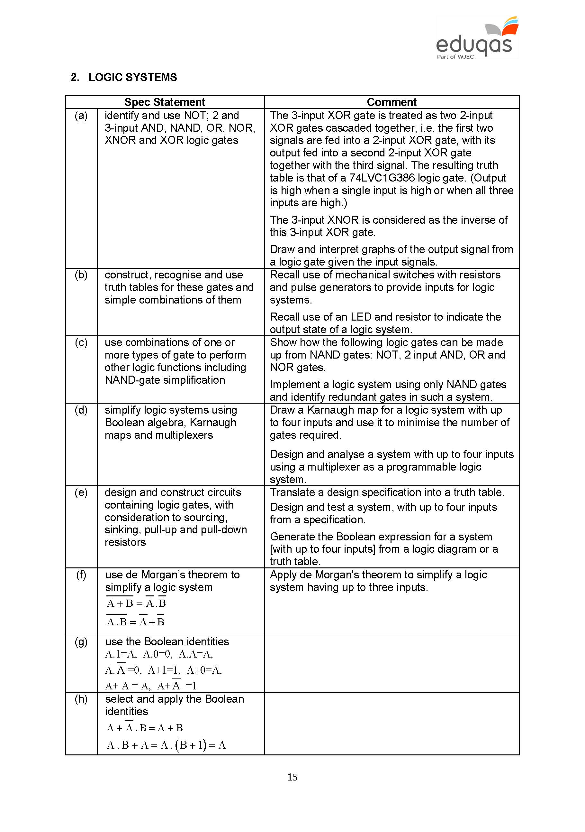
GCSE Electronics
Guidance for Teaching

Slide 8
Teaching Plan
Teaching of GCSE
The eBook chapters have been organised in a suggested teaching order.
 | Component 1
Electronic systems and subsystems | Chapter 1
Circuit Concepts | Chapter 2
Resistive components in circuits | Chapter 3
Switching circuits | Chapter 4
Application of diodes | Chapter 5
Combinational logic systems | Chapter 6

Slide 9
Teaching Plan
Teaching of GCSE
 | Component 2
Timing circuits | Chapter 1
Sequential systems | Chapter 2
Interfacing digital and analogue systems | Chapter 3
Control circuits | Chapter 4
Operational amplifiers | Chapter 5

Slide 10
Event Feedback survey
Please help us evaluate our events by completing this short survey.
We will use your feedback to determine how we can improve our future events.
Scanning this QR code with your smartphone or tablet opens the survey on your mobile device. Some devices already have QR code readers built in, or you can download a QR code reader app onto your device.
Alternatively you can access the bilingual survey via the web link below.
This link has also been sent to the email address entered during course registration.
https://www.surveymonkey.co.uk/r/eduqasCPD

Slide 11
Any Questions?
Contact Details
Phil Glover
Subject Officer
electronics@eduqas.co.uk
029 2026 5477
Matthew Roberts
Support Officer
electronics@eduqas.co.uk
029 2240 4254

