Slide 1
CPD Autumn 2018-19
Non-examination Assessment
Language and Identity

Slide 2
Overview
At a basic level, the investigation should include:
a brief introduction to the area of study under scrutiny
a brief introduction to the hypothesis to be tested
a brief explanation of the methodology
the main body of the investigation as an analysis into the sense of identity, including:
o selection and use of knowledge to argue a case
o interrogation of data to support the argument
a conclusion about the ways in which language is used to create and communicate a sense of identity.
Notes:
The suggestions here are just that – different ideas to stimulate discussions between teachers and learners in producing their NEA investigation. WJEC does not prescribe a specific structure for the essay.

Slide 3
Developing a Title:
Use of 'investigate and analyse' and 'using relevant data‘?
Link between language and identity, and the chosen language area?
Include a strong hypothesis to help candidates develop a line of argument?
The focus of the investigation may alter slightly as the learner explores the issues/concepts and data in greater depth.
Notes:
The suggestions here are just that – different ideas to stimulate discussions between teachers and learners in producing their NEA investigation. WJEC does not prescribe a specific structure for the essay.

Slide 4
1. Language and self-representation
How could these two examples of NEA titles be more focused?
Does the medium and context of a conversation affect the register and formality I use?
Does my context, audience and purpose have an impact on the way I speak in terms of grammar, lexis and formality?
How do I use language in different situations and contexts to represent myself and construct the linguistic identities that constitute my personal linguistic repertoire?
An investigation into the ways I use language in order to construct different identities and idiolects for myself, depending on context.

Slide 5
2. Language and gender
How could these two examples of NEA titles be more focused?
What is the relationship between language and gender in transgender autobiographies?
Do girls give linguistic direction more effectively than boys in a co-coaching environment?
More focused examples:
Using relevant data, investigate and analyse the ways by which female artists use their music to reclaim their female identity.
How has the representation of women’s identity changed over time in children’s stories? What does this tell us about attitudes to women in each society?

Slide 6
3. Language and culture
How could these two examples of NEA titles be more focused?
Using relevant data, investigate and analyse how these 21st century Christian songs convey the cultural ideologies of Christianity?
Do certain situations in football alter the ways in which language is used by football-fans?
More focused examples:
Using relevant data, investigate and analyse the presentation of the identity of Liverpool fans in the language used by The Sun at the time of the Hillsborough disaster and later, when the paper apologises for false statements made in the original report.
How do the sermons of three Christian church services reflect the identity of the specific denominations?

Slide 7
4. Language diversity
How could these two examples of NEA titles be more focused?
To what extent does the language of the law in the media reflect real life?
Using relevant data, analyse and investigate the ways in which the characters in ‘Only Fools and Horses’ comply with cultural working-class stereotypes.
More focused examples:
Using relevant data, investigate and analyse the ways in which Grime artists use language to create diverse identities in the Grime music scene.
Using relevant data, explore and analyse how speakers conveyed a Mancunian identity in the aftermath of the Manchester bombing of 2017.

Slide 8
Characteristics of successful responses:
a clear focus on language and identity
a range of sustained apt terminology
a well organised study with topic sentences used throughout
well-embedded linguistic theory used to inform the investigation
an understanding of how contextual factors are associated with the construction of meaning
a familiarity with the assessment objectives and their descriptors.
How can you prepare students to demonstrate these skills/knowledge in their NEA investigations?

Slide 9
Areas for improvement:
a knowledge of genre
a clearly defined hypothesis closely linked to language and identity
the selection of concepts and issues relevant to the investigation
analysis of data rather than description
the use of data that provides enough breadth and depth for an A level investigation.
How can you support students in addressing some/all of these areas of weakness?

Slide 10
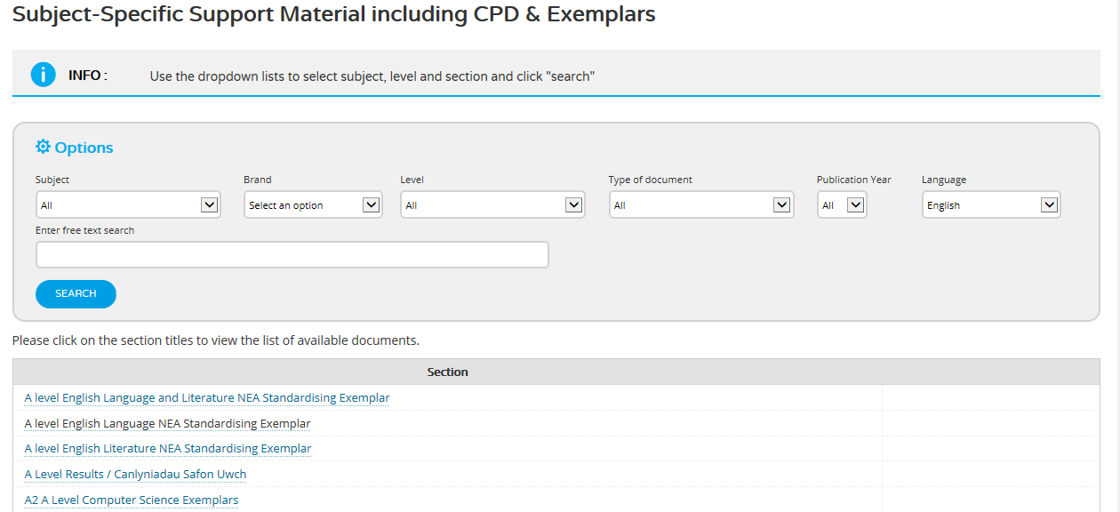
Standardising material
A series of short training videos are available on the WJEC secure website for teachers, which cover a range of different levels of response to the NEA investigation for A level English Language.

