Slide 1
WJEC Eduqas
A Level English Language and literature
CPD Autumn 2017
Component 2

Slide 2
Component 2
Overview
Written examination: 2 hours (120 marks)
30% of qualification
Section A: Shakespeare (closed-book) One compulsory extract-based task and one essay question from a choice of two based on the reading of a Shakespeare play from a prescribed list
Section B: Post-1900 drama (closed-book) One question from a choice of two based on the reading of one play from a prescribed list.

Slide 3
Mark Allocation
Questions in Section A carry 72 marks (part (a) 24 marks and part (b) or (c) 48 marks).
Questions in Section B carry 48 marks.
Time management in the exam
Section A – it is advisable to spend 30 minutes on the extract-based question and 45 minutes on the essay
Section B - spend 45 minutes

Slide 4
In both Section A and Section B, candidates will need to demonstrate that they can:
use integrated linguistic and literary approaches
analyse how meanings are shaped in their set text
show knowledge and understanding of relevant language levels
use accurately a range of linguistic and literary terminology
demonstrate an understanding of the significance and influence of the contexts in which texts are produced and received
organise responses in a clear and effective academic style and register with coherent written expression.

Slide 5
Section A: Shakespeare (closed-book)
Section A is based on the study of one Shakespeare play selected from the list below:
Antony and Cleopatra
King Lear
Much Ado About Nothing
Othello
The Tempest
Section A requires candidates to respond to:
one compulsory extract-based task (24 marks)
one extended essay from a choice of two (48 marks).

Slide 6
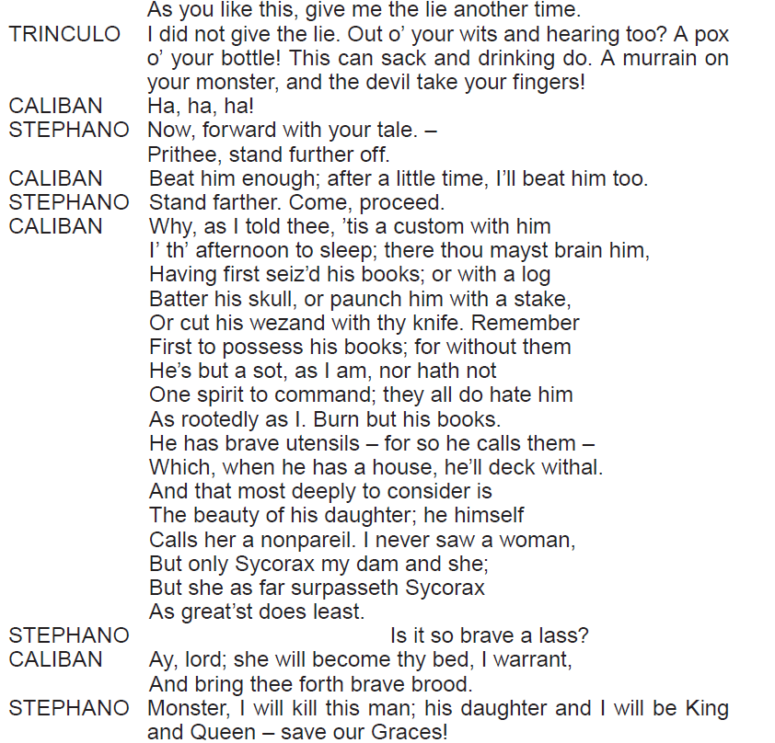
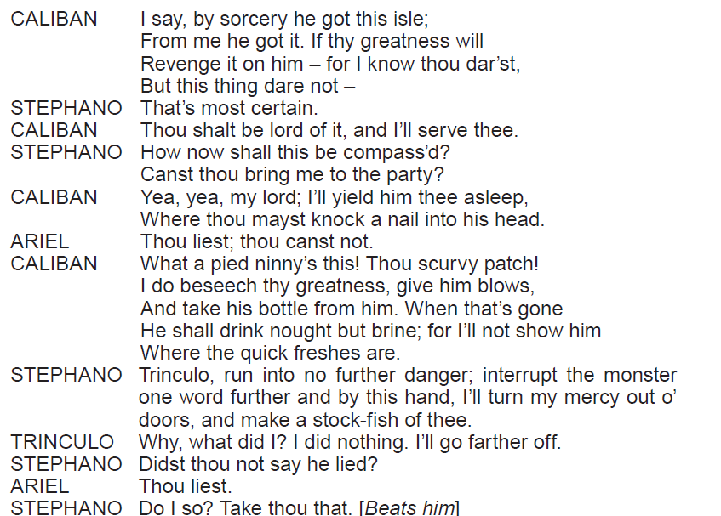
The Extract-Based Question
For the extract-based task, candidates will need to demonstrate their ability to read closely a key passage from the set text.
The Tempest
By focusing closely on the literary and linguistic techniques used, explore how Shakespeare creates a sense of comedy in this extract from Act 3, Scene 2.
[24]

Slide 7
Assessment Objectives
AO1 (12 marks)
Apply concepts and methods from integrated linguistic and literary study as appropriate, using associated terminology and coherent written expression
AO2 (12 marks)
Analyse ways in which meanings are shaped in texts

Slide 8
The Essay Question
The essay will require candidates to demonstrate knowledge of the wider play and to select appropriate supporting evidence in their response.
There will be a choice of question on the studied text. Candidates are required to answer one of the questions.
Either,
‘Parental power and control.’ Consider how far Shakespeare’s presentation of Prospero’s relationship with his daughter conforms to 17th century Jacobean society’s expectations. [48]
Or,
(b) Examine Shakespeare’s presentation of the themes of deception and trickery in The Tempest. [48]

Slide 9
Assessment Objectives – Essay Question
AO1 (12 marks)
Apply concepts and methods from integrated linguistic and literary study as appropriate, using associated terminology and coherent written expression
AO2 (12 marks)
Analyse ways in which meanings are shaped in texts
AO3 (24 marks)
Demonstrate the significance and influence of the contexts in which texts are produced and received

Slide 10
Section B: Post-1900 drama (closed-book)
Section B is based on the study of one post-1900 drama text from the list below:
Edward Albee: Who’s Afraid of Virginia Woolf?
Alan Bennett: The History Boys
Brian Friel: Translations
Diane Samuels: Kindertransport
Tennessee Williams: Cat on a Hot Tin Roof
Section B requires candidates to answer one question from a choice of two.

Slide 11
Sample Questions
There will be a choice of question on the studied text e.g.
Tennessee Williams: Cat on a Hot Tin Roof
Either,
14. ‘Williams presents an American society that does not value love.’ How far do you agree with this interpretation of Cat on a Hot Tin Roof? [48]
Or,
15. ‘And so tonight we’re going to make the lie true.’ Explore Williams’ presentation of truth and illusion in American society in Cat on A Hot Tin Roof. [48]

Slide 12
Assessment Objectives
AO1(16 marks)
Apply concepts and methods from integrated linguistic and literary study as appropriate, using associated terminology and coherent written expression
AO2 (16 marks)
Analyse ways in which meanings are shaped in texts
AO3 (16 marks)
Demonstrate the significance and influence of the contexts in which texts are produced and received

Slide 13
Component 2 Examiner’s Report – Key Messages
What went well…
As a closed text examination, this paper is challenging for candidates and it was encouraging to note that many centres had thoroughly prepared candidates for this examination.
Many candidates engaged with the set texts and examiners read many insightful and perceptive responses to the set questions.
The best responses evaluated literary and linguistic features (AO1), confidently linking language and meaning (AO2).
For the essay on both Section A and Section B candidates also had to provide relevant contextual detail (AO3) and link it meaningfully to the set text they had studied - the best responses saw this context being applied to the Shakespeare and modern drama texts.

Slide 14
Component 2 Examiner’s Report – Key Messages
Section A
The extract question…
Spend 30 minutes responding to the extract question in Section A.
Candidates need to read, think and write at speed.
Candidates are free to select detail from within the extract to focus on but they are expected to provide coverage of the whole extract. (e.g. some candidates only referred to the first half of the extract and completely ignored the ending).
Sustained analysis of the extract, covering a range of points and exploring language/meaning in detail, is needed.
Brief responses are self-penalising (e.g. responses that were a side to a side and half rarely scored well).

Slide 15
Component 2 Examiner’s Report – Key Messages
The extract question…
Include a brief introductory sentence placing the extract in the context of the play – 1-2 sentences are sufficient here.
Candidates need to focus on discussing the specified extract rather than other parts of the play.
Candidates are expected to respond to the extract with knowledge and insight - the extract should not be treated as an unseen text.

Slide 16
Component 2 Examiner’s Report – Key Messages
The extract question…
Candidates need to be specific in identifying terminology - too many candidates quoted whole sentences or phrases, generally labelling them with the ‘verb’/’modal verb’/’noun’ etc., without identifying which word they were attempting to analyse.
Candidates should refer to at least one term per cited example – this term should be specifically supported by the example.
Terms need to be purposefully applied – this is not a feature spotting exercise.

Slide 17
Component 2 Examiner’s Report – Key Messages
The extract question…
Context (AO3) is not explicitly assessed in Section A – avoid irrelevant contextual detail.
It is possible to credit contextual information if a candidate has used relevant detail to inform their reading (AO2) of the extract.
However, a number of candidates included irrelevant contextual detail at the expense of close focused literary and linguistic analysis (AO1) when discussing meaning (AO2).
Candidates need to be reminded of the importance of reading the set question and shaping their response to address the requirements of the question asked.

Slide 18
Component 2 Examiner’s Report – Key Messages
Sections A and B
The essay question…
Spend 45 minutes responding to the essay in Section A and 45 minutes responding to the essay on Section B.
Candidates need to produce one essay from a choice of two on each text (one Shakespeare essay, one modern drama essay).
Candidates are expected to show wider knowledge of the text as a whole.
Candidates may refer to a selection of key episodes in detail as long as they place them within the context of the whole text and they are relevant to the actual response.
The selection of examples to support their argument also addresses AO1, as this Assessment Objective considers their line of argument and the organisation of their response.
It is not advisable for candidates to refer only to the first act of the play (e.g. Cordelia).

Slide 19
Component 2 Examiner’s Report – Key Messages
The essay question…
Encourage candidates to plan their response carefully.
Responses need to be shaped and coherent arguments clearly constructed.
Essays need to be sustained – work that is too brief is self-penalising.
Essays that are overly long (some were in excess of 12 sides) can also be self-penalising as the focus sometimes drifts.
Answer the set question – some students had pre-prepared responses they were determined to write down regardless of the question (e.g. an essay on Beatrice in Much Ado About Nothing rather than focusing specifically on attitudes to women).

Slide 20
Component 2 Examiner’s Report – Key Messages
The essay question…
Given the fact that this is a closed text examination, in order to fully access AO1 candidates need to have prepared thoroughly and learned a sufficient number of relevant quotations.
They need to apply a range of literary and linguistic terms to access the marks available.
As with Section A, candidates need to be far more specific in identifying language (e.g. The use of the conjunction ‘By land and sea’….’).
Candidates need to be reminded of the importance of quoting accurately from the play – there were several instances of made up quotations.
Avoid description/narration – candidates should be encouraged to adopt the SEA approach.

Slide 21
Component 2 Examiner’s Report – Key Messages
The essay question…
Context (AO3) is clearly important in essay question in both Section A and Section B - relevant context should be used to illuminate the candidate’s argument.
Avoid generalised context which has little relevance to the set task (e.g. context being addressed through irrelevant biographical information relating to the author).
Avoid the ‘history’ essay – some candidates provided limited discussion of the actual play itself.
Responses should always lead with the play itself and embed relevant contextual detail.
Candidates need to put the text at the centre of their response and apply relevant context (rather than vice-versa).

Slide 22
Component 2 Examiner’s Report – Key Messages
The essay question…
The best responses applied context to their reading of the text and provided thoughtful interpretations of the play.
Candidates who wrote mini-biographies, random historical detail or who included context as a ‘bolt-on’ at the end of a paragraph performed less successfully than those who meaningfully embedded contextual detail into their responses.

Slide 23
Component 2 Examiner’s Report – Key Messages
Prepare candidates with a wide and broad understanding of the social, political, historical and cultural context of their chosen text and how to apply that context to the Shakespeare and modern drama texts
Encourage candidates to consider how their chosen texts can be interpreted in contemporary and modern societies

Slide 24
Component 2 Examiner’s Report – Key Messages
In terms of organisation, students need to be reminded of the importance of paragraphing and coherent written expression
The correct spelling of Shakespeare and character names must also be stressed

Slide 25
Component 2 - Focus Areas
Exploding the question
Context

Slide 26
Exploding The Question
For both Section A and Section B of the paper, candidates need to be reminded of the importance of reading the set question and shaping their response to address the requirements of the question asked

Slide 27
Exploding The Extract Question
Example 1
The Tempest
5. By focusing closely on the literary and linguistic techniques used, explore how Shakespeare creates a sense of comedy in this extract from Act 3, Scene 2.
Several candidates ignored this question and focused on the presentation of a the Caliban and Stephano, making no attempt to link back to the question

Slide 28
Exploding The Extract Question
Example 2
King Lear
2. By focusing closely on the literary and linguistic techniques used, explore how Shakespeare creates dramatic tension in this extract from Act 1, Scene 4.
Several candidates ignored this question and focused on Lear

Slide 29
How does the playwright create dramatic tension/comedy/mood and atmosphere?
Some approaches candidates could use…
What is actually happening on stage – the action itself
Staging/Props
Setting
Characterisation
Character interaction
Conflict – external or internal
Turn-taking
Use of dialogue
Dramatic irony
Language
In order to answer a dramatic tension/comedy/mood and atmosphere question, candidates need a clear overview of what is going on in the extract.
Candidates need to use clear topic sentences. E.g. Shakespeare creates comedy through the way Ariel manipulates the action…
Weaker responses in the examination tended to lead on language techniques.
E.g. Shakespeare creates dramatic tension through the use of the superlative.

Slide 30
Exploding The Essay Question
Example 1
Othello
4b . ‘Love never betrays. People do.’ Explore Shakespeare’s presentation of the theme of betrayal in Othello.
Some candidates wrote about love - they read the opening quotation and not the whole question

Slide 31
Exploding The Essay Question
Example 2
Much Ado About Nothing
3a. Examine Shakespeare’s presentation of attitudes towards women in Much Ado About Nothing.
Several candidates had prepared an essay on Beatrice, and ignored the set question – limiting their response to a single character
Those candidates who used time in the examination to plan the essay prior to writing it and thought sensibly about how they could Beatrice in a wider context about women within the play scored better

Slide 32
Exploding The Essay Question
Example 3
The History Boys
9. Explore Bennett’s presentation of masculinity in The History Boys.
Some candidates had a very limited grasp of what is actually meant by the concept of masculinity
Several candidates had prepared an essay on women and ignored the set question
Using women under the umbrella of this task is a valid approach if the question is addressed
Those candidates who used time in the examination to plan the essay prior to writing it and thought sensibly about how they could utilise women in an essay on masculinity response tended to provide more relevant responses

Slide 33
Context
Candidates need to put the text at the centre of their response and apply relevant context (rather than vice-versa).
Context must be meaningfully applied.
Some approaches that candidates could adopt include:
Social, political, historical and cultural context
Biographical – use with caution
Audience reaction - contemporary and modern
Genre
Critical viewpoints
Productions

Slide 34
Activity : applying context to the examination question
In groups, consider one of the questions from last year’s examination.
Select key events from the play that could be used to address the question.
Create a list of relevant contextual points that can be applied to each section of the play you have selected.

Slide 35
2b. ‘King Lear is a tragedy of family life.’ How far do you agree with this interpretation of King Lear?
[48]
Section of the play | Relevant contextual detail
1. Lear’s decision to divide his Kingdom in Act 1 Scene 1 – division of family | Abuse of patriarchal power Subversion of the Great Chain of Being Divine Right of Kings Reaction of Jacobean audience James 1
2.
3.
4.
5. Deaths of Lear and Cordelia | Concept of the tragic hero Wheel of Fortune Divine Justice

Slide 36
Activity: assessing context within the essay response
Look at the following paragraph taken from an essay produced by a student in the Summer 2017 session in response to the question:
‘King Lear is a tragedy of family life.’ How far do you agree with this interpretation of King Lear?
Consider how relevant the context supplied actually is.
Assess the paragraph for AO1, AO2 and AO3.

Slide 37
Firstly, King Lear can be seen as a ‘tragedy of family life’ due to the pride and selfishness of Lear in the opening of the play. Instantly, he decides to divide his kingdom in three as shown through the imperatives ‘Give me the map’ and ‘know tis our fast intent to divide into three our kingdom.’ A contemporary audience would have grown suspicious with regards to Lear’s actions as they were familiar with the dangers of dividing Britain, Through this, Shakespeare not only overtly praises the monarch of the time – James 1 – on unifying Britain but also covertly warns him of the dangers to come if Britain were ever to split. In splitting the kingdom, Lear selfishly commands his daughters to express their ‘excessive love’ for him through a love contest which later leads to chaos and disloyalty in family life. Lear’s continued use of imperatives – ‘Our eldest born, speak first’ – force his daughters to exaggerate his worth within the family unit and to compete for their inheritance in the public arena of the court. Through greed and false flattery, Goneril and Regan go to extreme measures to express their undying love for their father as shown through the comparative adjective ‘dearer’ in the triadic structure ‘Dear than eyesight, space and liberty’. Goneril’s extraordinary remarks are clearly untruthful as she compares her father to ungraspable and grand elements. Instantly, such dishonesty and greed – while satisfying Lear’s ego – pushes him to see his youngest daughter’s honest declarative utterance – ‘I love your majesty, according to my bond, no more no less’ - as all the more outlandish and disobedient. The presence of the juxtaposition of ‘more’ and ‘less’ with the mitigating negation ‘no’ to Lear is cruel in that it limits her love, fails to satisfy his selfish needs and is perceived as a direct challenge to his patriarchal authority. Lear sees this as an act of defiance and becomes so enraged he ‘disclaims’ all ‘paternal care’, ‘propinquity’ and ‘blood’. The repetition of plosive sounds convey Lear’s fury and through the stative verb ‘disclaims’, Lear breaks not only the filial bond with his daughter but also the Great Chain of Being. This disruption of the natural order has catastrophic consequences within both the domestic and political realms.

Slide 38
Response leads with the text and focuses on the question
Relevant use of supporting quotations and terminology
Mature reading of text
Context is used to illuminate the argument

Slide 39
Any Questions?
gceenglish@eduqas.co.uk
Rhodri Jones: Subject Officer
029 20 265188
Mike Williams:
Subject Support Officer
029 20 265129
@eduqas_english
eduqas.co.uk

